Slide 1
Manage Teacher and Student Records
Manage Teacher Records

Slide 2
C3-SR01:Update Teacher Records
Description:
This function allows school administrator to add or update teachers’ personal information
Granted Role:
School Administrator – Teacher Records, Student Registrar

Slide 3
C3-SR01:Update Teacher Records
Menu Path:
Campus Community > Personal Information > Add/Update a Person
Campus Community > Personal Information > Biographical > Personal Attributes > Teacher Family Details

Slide 4
How to use the system
Navigate to the screen via menu path
Search for a particular teacher
Update teacher’s existing data
Save
Refer to Online Help for more details

Slide 5
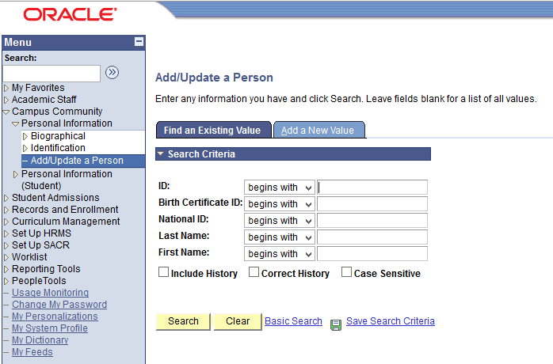
Update Teacher Records
Navigate: Campus Community > Personal Information > Add/Update a Person
Enter search parameter.
Here, we search by National ID (or IC Number) or ID
Click the Search button.

Slide 6
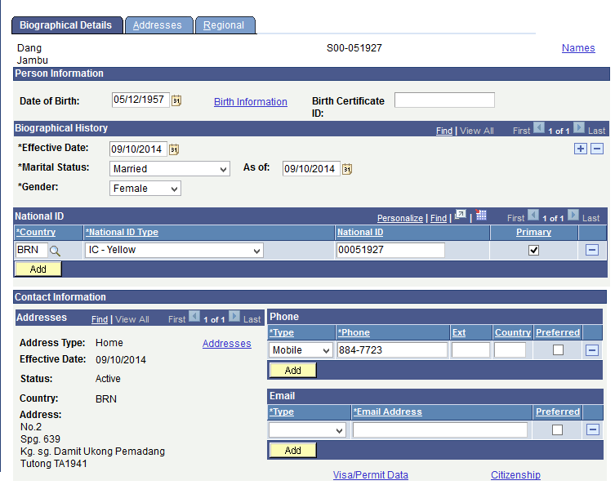
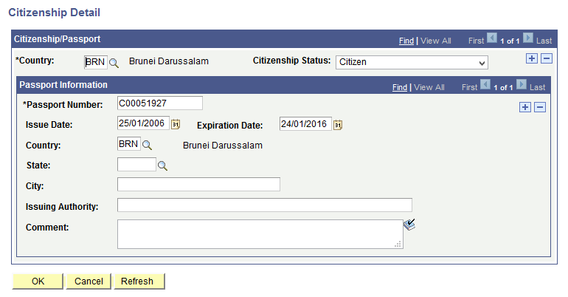
Update Teacher Records
Teacher record is displayed
There are many information displayed such as:
Person Information
Biographical History
National ID(IC)
Address
Contact (Phone & Email)
Citizenship
Today we will cover:
Address
Phone Contact
Teacher Family Details

Slide 7
Contents
Update Existing Address
Add New Address
Update Existing Phone Contact
Add New Phone Contact
Update Teacher Family Details

Slide 8
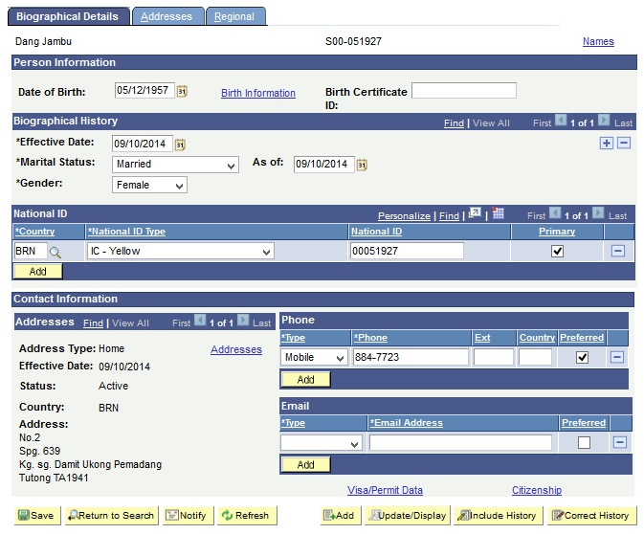
Update Existing Address
Click the Addresses link to update the address

Slide 9
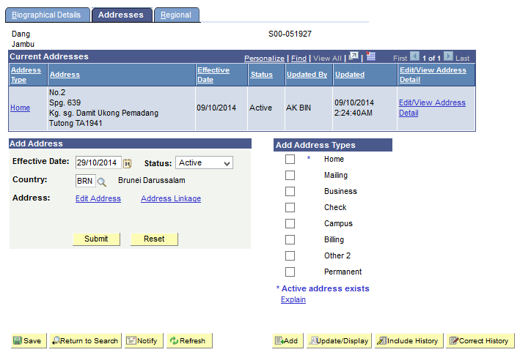
Click Home
Select the Address Type to be updated.
Click Home link to update the home address

Slide 10
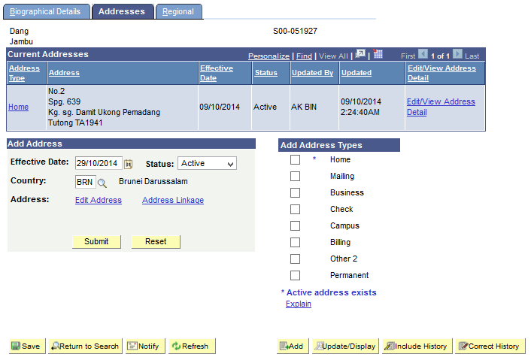
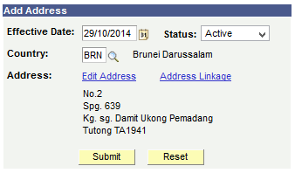
Update Existing Address
Address will be populated

Slide 11
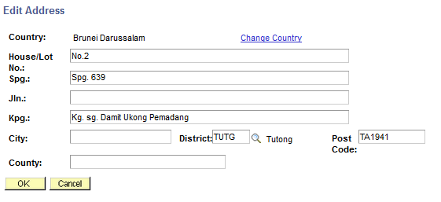
Update Existing Address
Enter the details of the address into the respective fields.
For e.g.
Jln.: Jln Penapar Ukong
Click Ok button

Slide 12
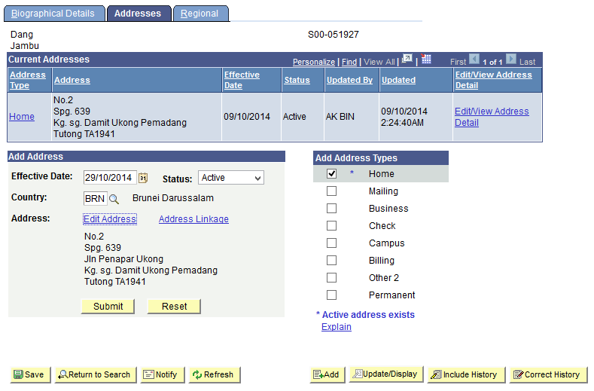
Select Address Type
Choose the Address Types, e.g.
Home = House Address
Mailing = Postal Address
Tick Home
Address Types with * indicates that active address exists

Slide 13
Submit Address
Click Submit button to record address.

Slide 14
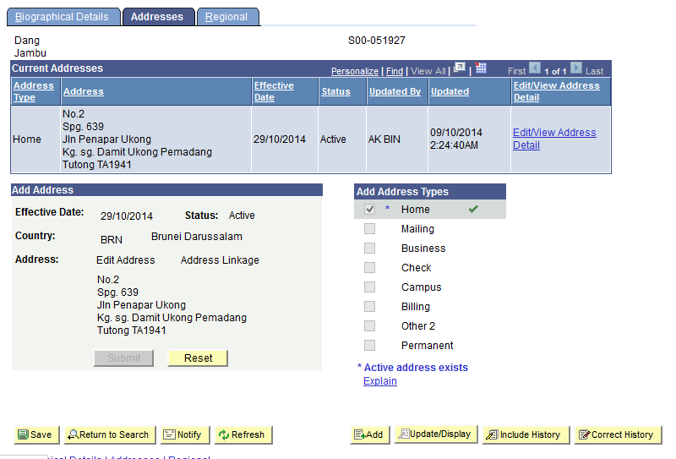
Save Existing Address
Address is updated

Slide 15
Contents
Update Existing Address
Add New Address
Update Existing Phone Contact
Add New Phone Contact
Update Teacher Family Details

Slide 16
Add New Address
Click Reset button to start fresh

Slide 17
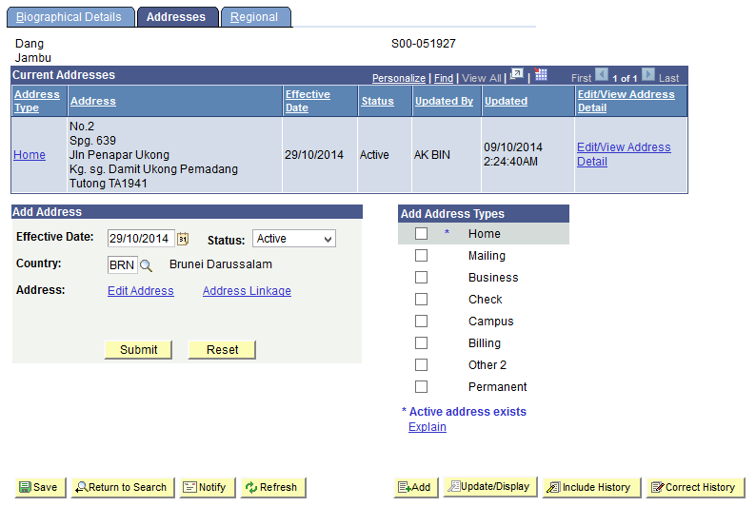
Click Edit Address
Click Edit Address link to add address

Slide 18
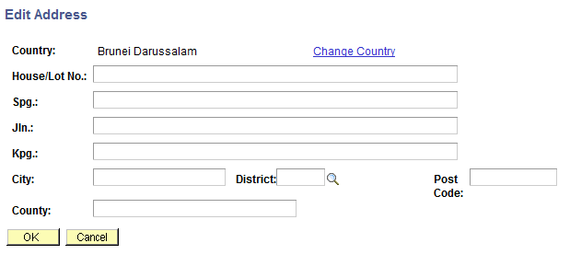
Enter details and Click Ok
Enter the details of the address into the respective fields.
For e.g.
Kpg.: P.O.BOX 1234
Click Ok button

Slide 19
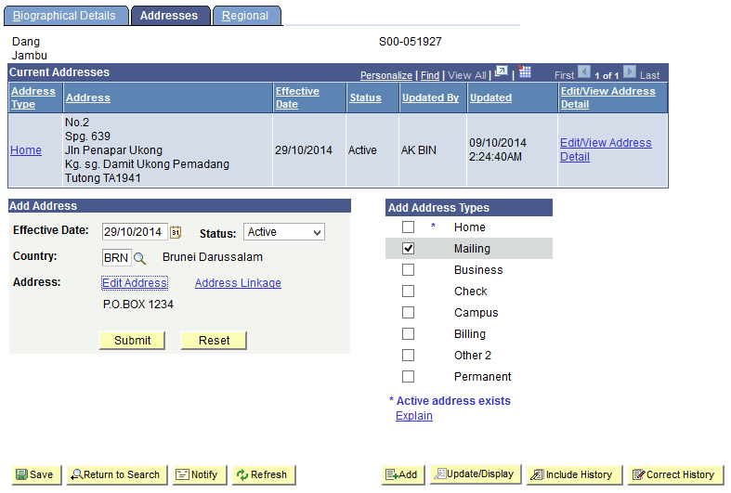
Select Address Type and Submit Address
Tick Mailing to save as mailing address
Click Submit button to record address.

Slide 20
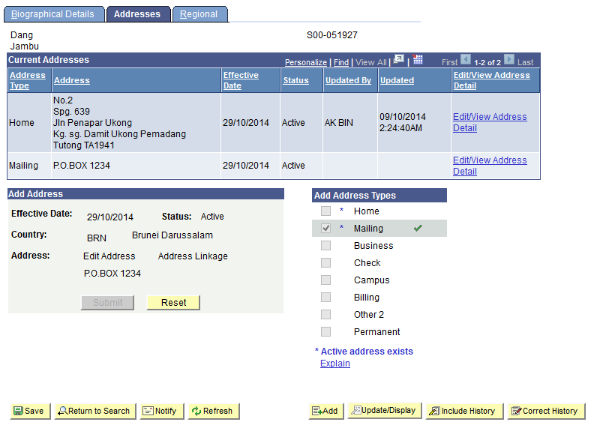
Save New Address
Address is submitted
Click Save button

Slide 21
Contents
Update Existing Address
Add New Address
Update Existing Phone Contact
Add New Phone Contact
Update Teacher Family Details

Slide 22
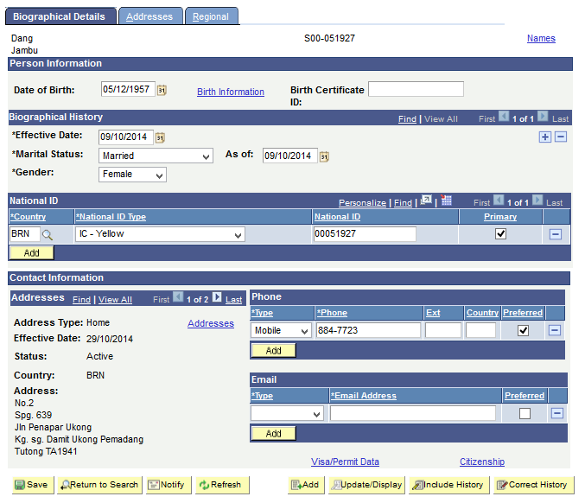
Update Existing Phone Contact
Update Phone field to update existing phone details
Tick Preferred to indicate preferred phone for contact

Slide 23
Save Existing Phone Contact
Click Save button

Slide 24
Contents
Update Existing Address
Add New Address
Update Existing Phone Contact
Add New Phone Contact
Update Teacher Family Details

Slide 25
Add New Phone Contact
Click Add button to add more phone details

Slide 26
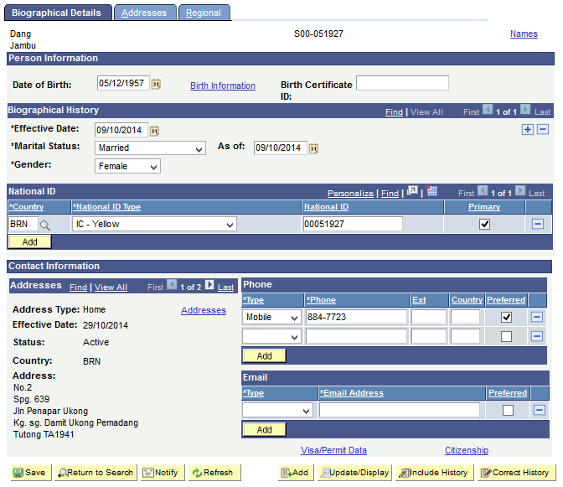
Select Phone Type
Click ‘-’ to delete phone details
Select Phone Type, e.g.
Home = Home number
FAX = Fax number
Work = Office number
Mobile = Mobile number

Slide 27
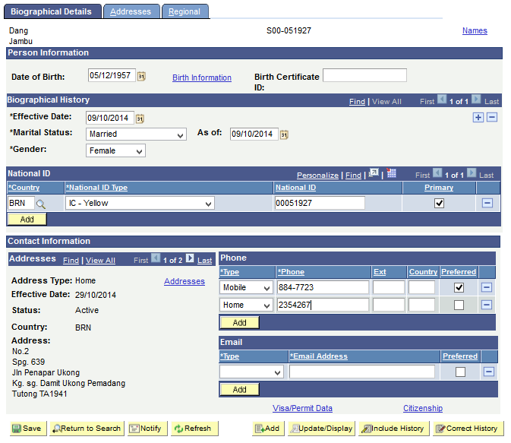
Save Phone Contact
Enter phone number
Click Save button

Slide 28
Contents
Update Existing Address
Add New Address
Update Existing Phone Contact
Add New Phone Contact
Update Teacher Family Details

Slide 29
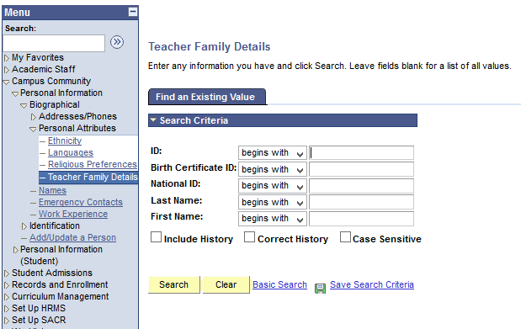
Update Teacher’s Family Details
Navigate: Campus Community > Personal Information > Biographical > Personal Attributes > Teacher Family Details
Enter search parameter.
Here, we search by National ID (or IC Number) or ID
Click Search button

Slide 30
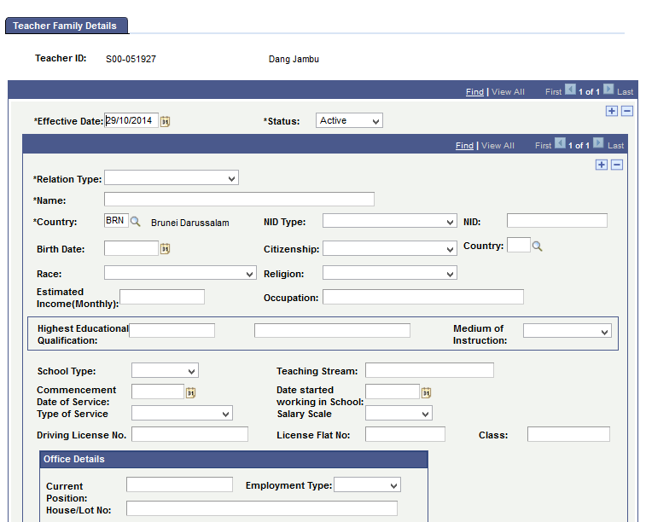
Enter Teacher’s Family Details
Enter teacher’s family member details
Click on ‘+’ to add more family details
If spouse is also a teacher, fill in this section

Slide 31
End of Presentation
Thank You

