Slide 1
C4P - Manage Assessment

Slide 2
Assessment Setup
1. Student Assessment
3. Criteria Cut-off Date Setup/Criteria Cut-off Date for Primary
4. Define Component Criteria
5. Define Sub Component Criteria
Setup the assessment types and sub component, e.g. SBA - classwork, homework, project, practical, etc.
Setup deadline for the assessment to be defined
Setup the marks and weightage of the assessment for each subject
E.g. BCAT, Monthly Test
Setup the marks and weightage for the sub component, e.g. Classwork, Homework, Project, Paper 1, Paper 2
Head of Department(HOD) to setup weightages
2. Define Component and Sub Component

Slide 3
C4P-AS01: Student Assessment
Description:
This Function allows the Roles below to enter the Assessment Weightages
Granted Role:
Head of Subject Department
School Exam Secretary (Secondary)
*Note: Primary by DS Primary
Menu Path:
Academic Staff > Assessment and Exams > Setup > Student Assessment

Slide 4
How to use
Navigate to the Screen via Menu Path
Click Search for Existing Value
Choose Course ID
Click the Course ID
Refer also to Online Help

Slide 5
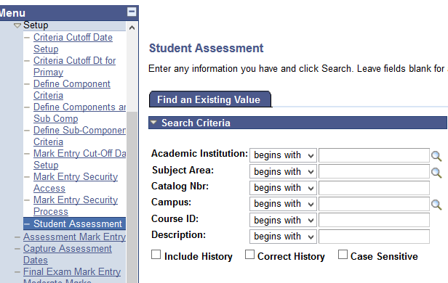
Navigate
Navigation: Academic Staff > Assessment and Exams > Setup > Student Assessment

Slide 6
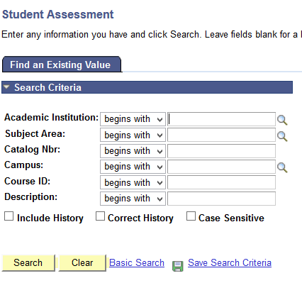
Click Search Button

Slide 7
Select the Course ID

Slide 8
Understanding Catalog Nbr
Catalog Nbr | 3 | 5 | 0 | 1
Running Number
Academic Career
1 – Preschool
2 – Primary
3 – Secondary
4 – Sixth Form
Academic Level | Pre-School | Primary | Secondary | Sixth Form
0 | Pre-School
1 |  | Year 1 | Year 7 | Lower Sixth
2 |  | Year 2 | Year 8 | Upper Sixth
3 |  | Year 3 | Year 9
4 |  | Year 4 | Year 10
5 |  | Year 5 | Year 11
6 |  | Year 6
Notes:
Running Number for same subjects. For example,
For Preschool, Primary, Year 7 and Year 8, all 01.
For Upper Secondary, Core Mathematics and Optional Additional Mathematics, Core Physics and Optional Physics

Slide 9
Understanding Catalog Nbr
Catalog Nbr | 2 | 2 | 0 | 1
Running Number
Academic Career
1 – Preschool
2 – Primary
3 – Secondary
4 – Sports
5 – Sixth Form
Academic Level | Pre-School | Primary | Secondary | Sports | Sixth Form
0 | Pre-School
1 |  | Year 1 | Year 7 | Year 7 | Lower Sixth
2 |  | Year 2 | Year 8 | Year 8 | Upper Sixth
3 |  | Year 3 | Year 9 | Year 9
4 |  | Year 4 | Year 10 | Year 10
5 |  | Year 5 | Year 11 | Year 11
6 |  | Year 6
Notes:
Running Number for same subjects. For example,
For Preschool, Primary, Year 7 and Year 8, all 01.
For Upper Secondary, Core Mathematics and Optional Additional Mathematics, Core Physics and Optional Physics

Slide 10
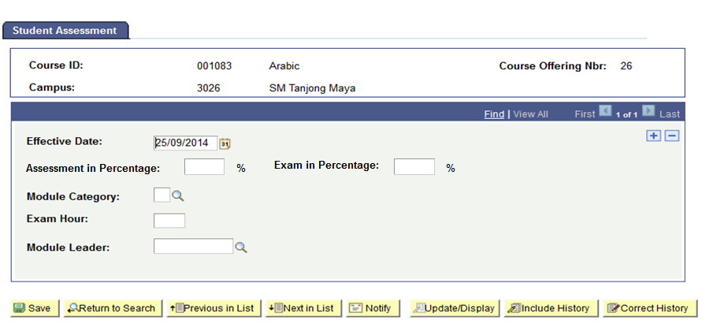
Fill in the Field
Assessment and Exam in percentage must be equal to 100%
SPA percentage textbox only appears if the module attributes is ‘SPA’, if NOT, the textbox will be hidden

Slide 11
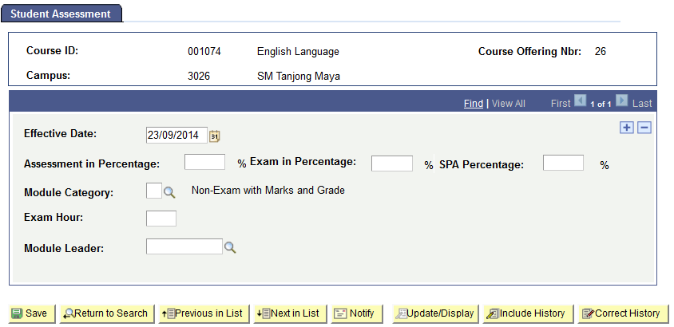
SPA Percentage

Slide 12
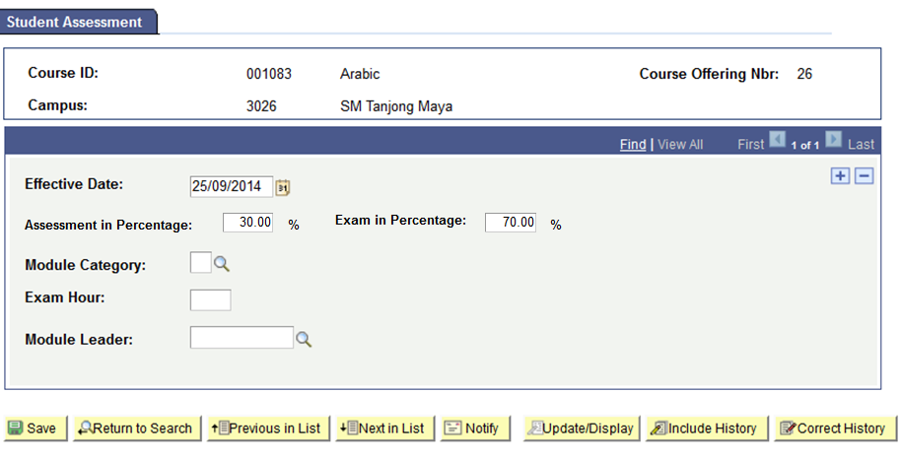
Select Module Category
Click prompt button to setup Module Category

Slide 13
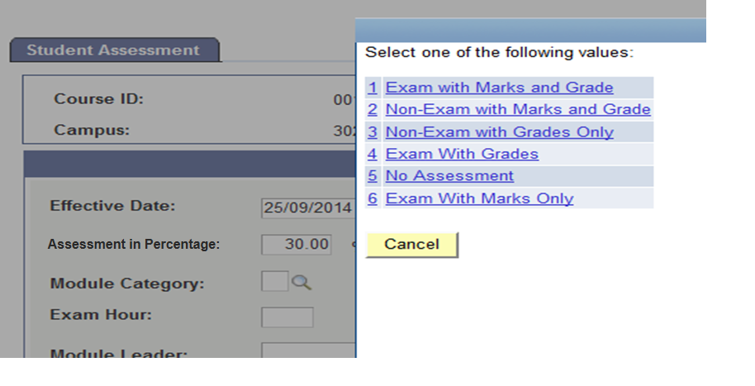
Select Module Category

Slide 14
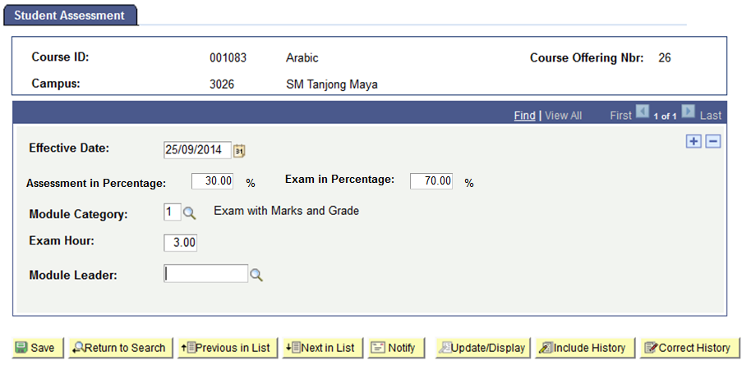
Select Module Leader
Head of Department in charge of the module

Slide 15
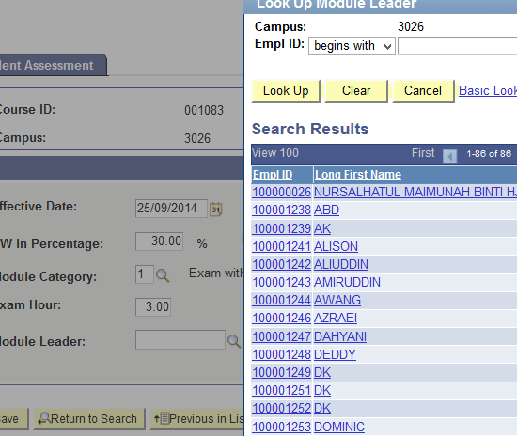
Select Module Leader

Slide 16
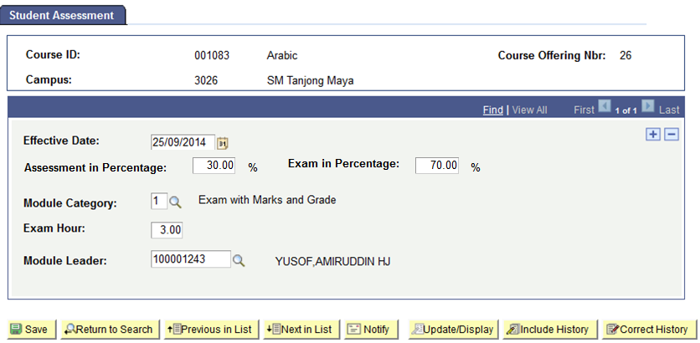
Click Save Button

Slide 17
Assessment Setup
1. Student Assessment
3. Criteria Cut-off Date Setup/Criteria Cut-off Date for Primary
4. Define Component Criteria
5. Define Sub Component Criteria
Setup the assessment types and sub component, e.g. SBA - classwork, homework, project, practical, etc.
Setup deadline for the assessment to be defined
Setup the marks and weightage for the assessment
E.g. BCAT, Monthly Test
Setup the marks and weightage for the sub component, e.g. Classwork, Homework, Project, Paper 1, Paper 2
Head of Department(HOD) to setup weightages
2. Define Component and Sub Component

Slide 18
C4P-AS02: Define Components and Sub Comp
Description:
This Function allows the Roles below to Define the Assessments/Examination to be conducted
Granted Role:
School Exam Secretary (Secondary)
*Note: Primary by DS Primary
Menu Path:
Academic Staff > Assessment and Exams > Setup > Define Components and Sub Comp

Slide 19
Concept - Secondary
Component Code
MYEY9 (Mid Year Exam)
Sub-Comp Code
P1 (Paper 1)
P2 (Paper 2)
P3 (Paper 3)
ORAL (Oral)
PRJCT (Project)
FLDWRK (Fieldwork)
CW (Coursework)
English Language
Paper 1
Paper 2
Oral
Biology
Paper 1
Paper 2
Paper 3
Computer Studies
Paper 1
Paper 2
Project

Slide 20
Concept - Primary
Component Code
SBA1Y4 (School Based Assessment 1)
Sub-Comp Code
Kerja Rumah (KR)
Kerja Sekolah (KS)
Projek/Kajian Luar Kelas (PROJEK)
Classwork (CW)
Homework (HW)
Student Participation (STUPCT)
Topical Test (TOPICL)
Practical (PRACTL)
Bahasa Melayu
Kerja Rumah
Kerja Sekolah
Projek/Kajian Luar Kelas
Mathematics
Classwork
Homework
Student Participation
Topical Test
Science
Classwork
Homework
Practical
Topical Test

Slide 21
How to use
Navigate to the Screen via Menu Path
Click Add new Value Tab
Enter Academic Institution
Enter Academic Organization
Enter Component Code
Click Add Button
Refer also to Online Help

Slide 22
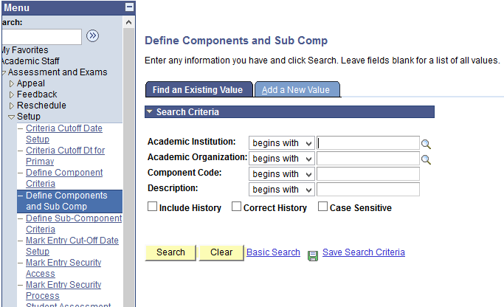
Navigate
Navigation: Academic Staff > Assessment and Exams > Setup > Define Components and Sub Comp

Slide 23
Click Add a New Value
Click Add a New Value Tab to enter new Assessment Code

Slide 24
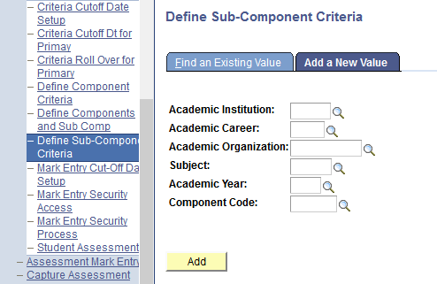
Select the Academic Institution
Click the lookup prompt

Slide 25
Select the Academic Institution

Slide 26
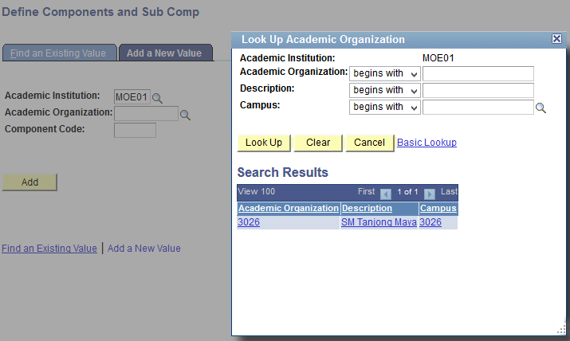
Select the Academic Organization

Slide 27
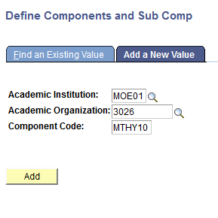
Enter the Component Code
Note:
Component Code is limited to 6 characters only

Slide 28
Click Add Button

Slide 29
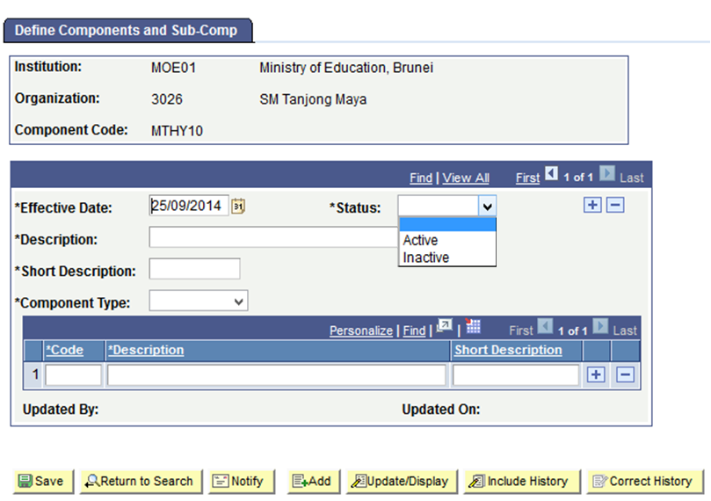
Select Active Status
Click dropdown list and Select Active Status

Slide 30
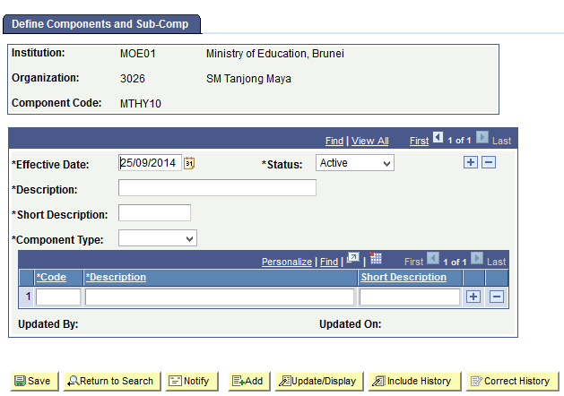
Fill up the rest of the fields

Slide 31
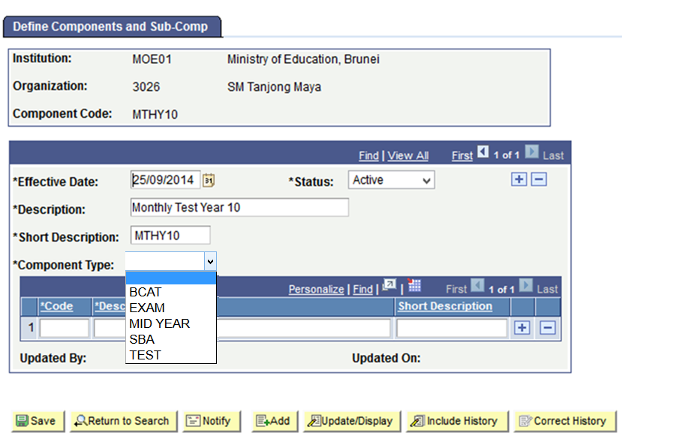
Select Component Type
Click dropdown list to select the Assessment Type:
BCAT – Year 7 and Year 8
EXAM – Qualifying / End of Year Examination
MID YEAR – Mid Year Examination
SBA – School Based Assessment (Primary)
TEST – Other Assessments, e.g Mock / Assessment Test

Slide 32
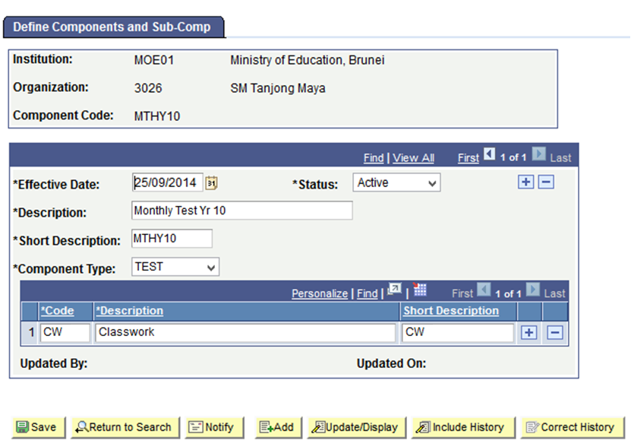
Define Sub Component (Sub Assessment)
CW – Classwork
HW – Homework
P1 – Paper 1
P2 – Paper 2

Slide 33
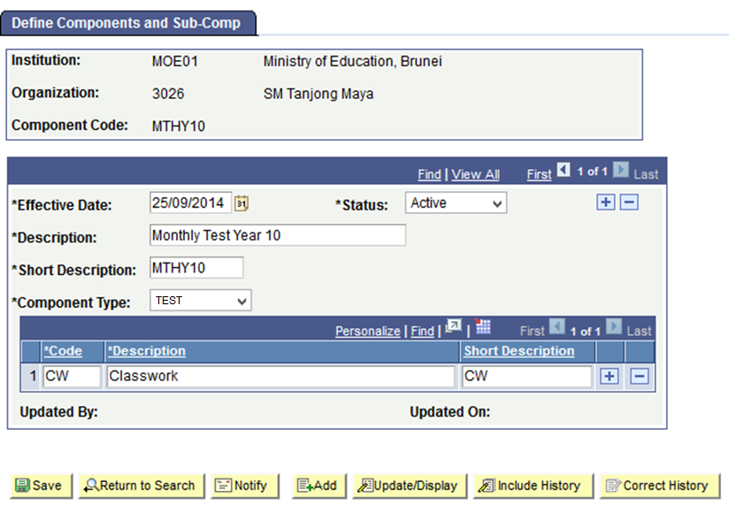
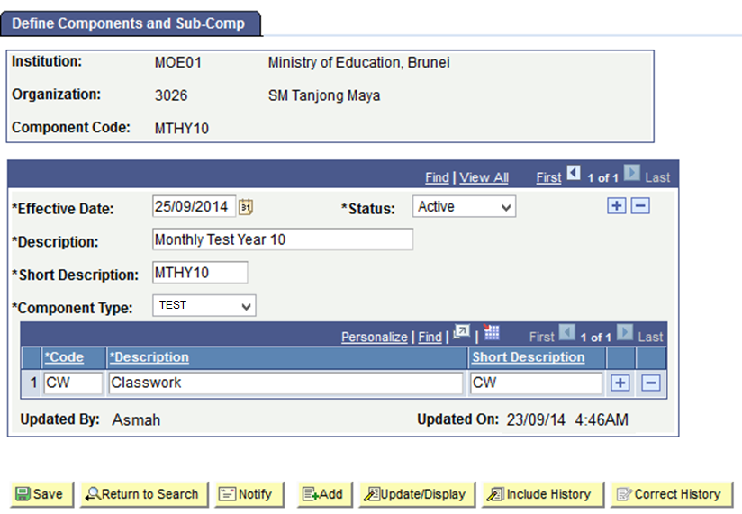
Click Save Button

Slide 34
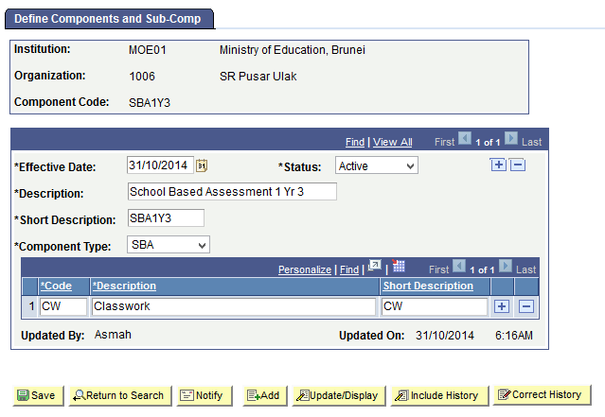
Primary

Slide 35
Assessment Setup
1. Student Assessment
3. Criteria Cut-off Date Setup/Criteria Cut-off Date for Primary
4. Define Component Criteria
5. Define Sub Component Criteria
Setup the assessment types and sub component, e.g. SBA - classwork, homework, project, practical, etc.
Setup deadline for the assessment to be defined
Setup the marks and weightage for the assessment
E.g. BCAT, Monthly Test
Setup the marks and weightage for the sub component, e.g. Classwork, Homework, Project, Paper 1, Paper 2
Head of Department(HOD) to setup weightages
2. Define Component and Sub Component

Slide 36
C4P-AS03: Setup Criteria Cut-off Date
Description:
This Function allows the Roles below to Setup the Criteria Cut-off Date
Granted Role:
School Exam Secretary (Secondary)
Menu Path:
Academic Staff > Assessment and Exams > Setup > Criteria Cutoff Date Setup

Slide 37
How to use
Navigate to the Screen via Menu Path
Click Add new Value Tab
Enter Academic Institution
Enter Academic Organization
Enter Academic Year
Click Add Button
Refer also to Online Help

Slide 38
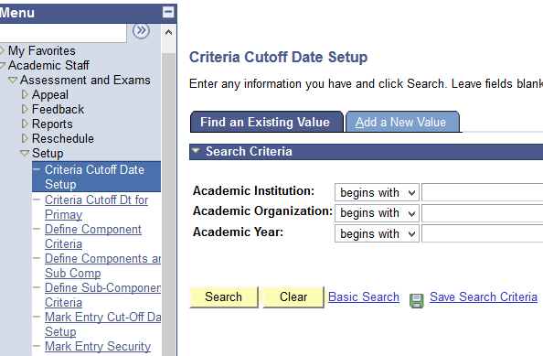
Navigate
Navigation: Academic Staff > Assessment and Exams > Setup > Criteria Cut-off Date Setup/ Criteria Cut-off Dt for Primary

Slide 39
Click Add a New Value

Slide 40
Select the Academic Institution

Slide 41
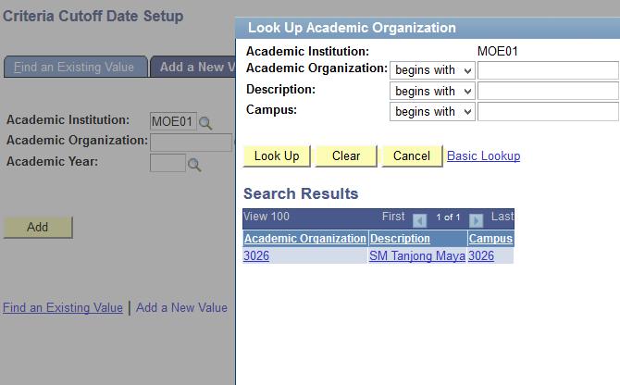
Select the Academic Organization
Select the Academic Organization.

Slide 42
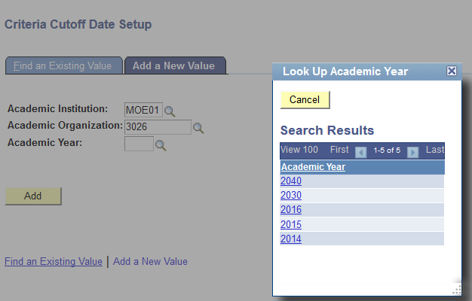
Select the Academic Year

Slide 43
Click Add Button

Slide 44
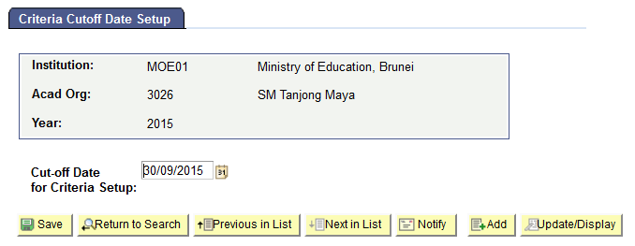
Enter the Cut-off Date
Set Deadline to define Component and Subcomponent criteria

Slide 45
Save the Criteria Cut-off Date
Before Cut-off Date,
Users CAN add/modify/delete:
Define Component Criteria
Define Sub-Component Criteria
On/After Cut-off Date,
Users CANNOT add/modify/delete:
Define Component Criteria
Define Sub-Component Criteria

Slide 46
Assessment Setup
1. Student Assessment
3. Criteria Cut-off Date Setup/Criteria Cut-off Date for Primary
4. Define Component Criteria
5. Define Sub Component Criteria
Setup the assessment types and sub component, e.g. SBA - classwork, homework, project, practical, etc.
Setup deadline for the assessment to be defined
Setup the marks and weightage of the assessment for each subject
E.g. BCAT, Monthly Test
Setup the marks and weightage for the sub component, e.g. Classwork, Homework, Project, Paper 1, Paper 2
Head of Department(HOD) to setup weightages
2. Define Component and Sub Component

Slide 47
C4P-AS04: Define Component Criteria
Description:
This Function allows the Roles below to setup the marks and weightages of the assessment for each subject
Granted Role:
School Exam Secretary (Secondary)
Menu Path:
Academic Staff > Assessment and Exams > Setup > Define Component Criteria

Slide 48
How to use
Navigate to the Screen via Menu Path
Click Add new Value Tab
Enter Academic Institution
Enter Academic Career
Enter Subject
Enter Academic Year
Click Add Button
Refer also to Online Help

Slide 49
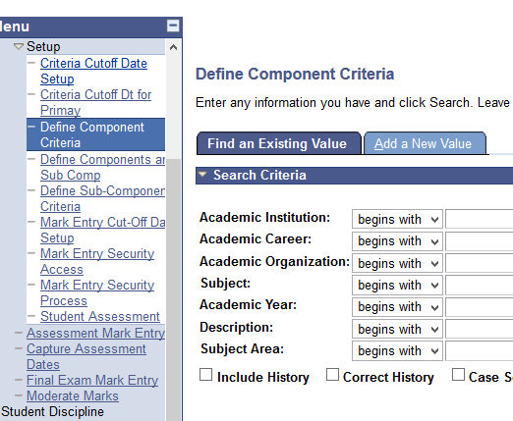
Navigate
Navigation: Academic Staff > Assessment and Exams > Setup > Define Component Criteria

Slide 50
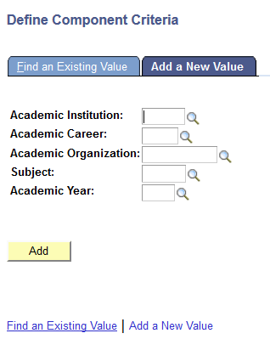
Click Add a New Value

Slide 51
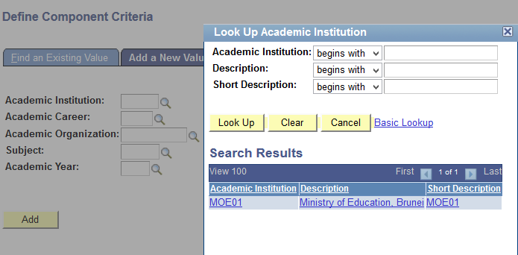
Select the Academic Institution

Slide 52
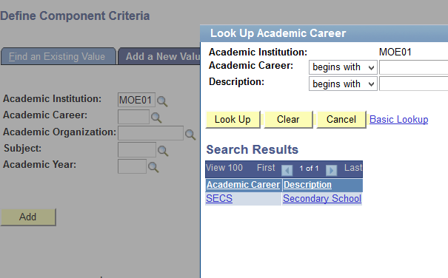
Select the Academic Career

Slide 53
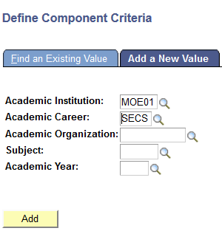
Fill up the rest of the field

Slide 54
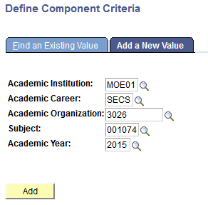
Click Add Button

Slide 55
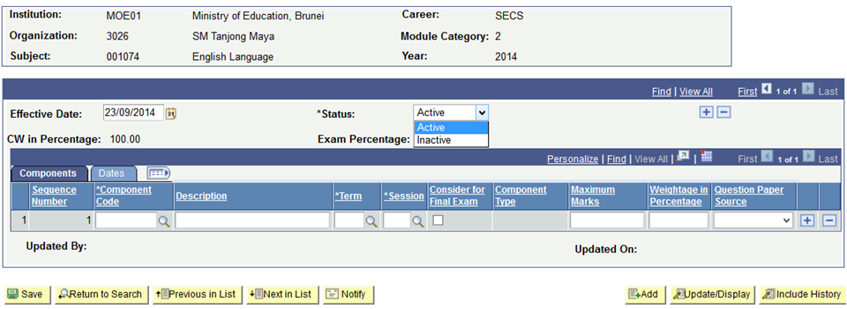
Select Active Status
Click dropdown list to select the status
Notes:
Add status screen

Slide 56
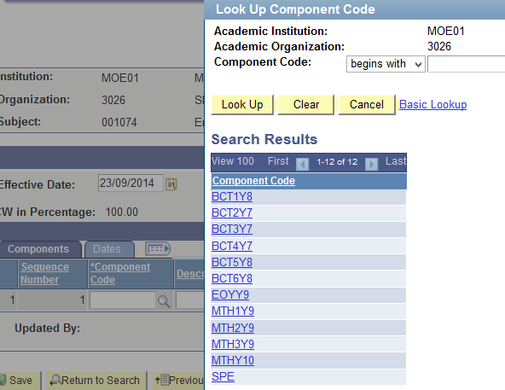
Select Component Code
Click prompt button to select the Component Code

Slide 57
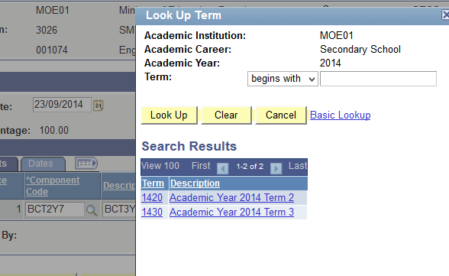
Select Term

Slide 58
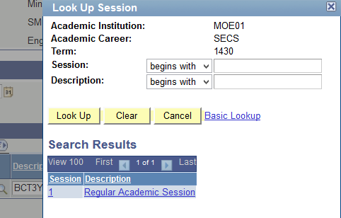
Select Session

Slide 59
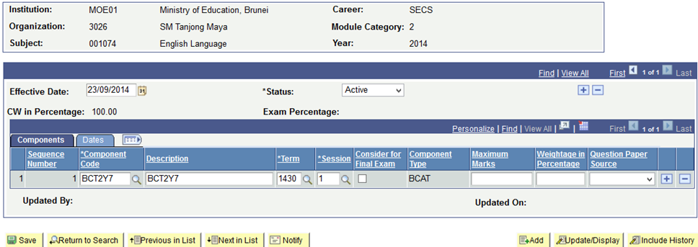
Fill in the rest of the Field

Slide 60
Understanding Component Weightages
Assessment % - 40%
Exam % - 60%
Term 1
Term 2
Term 3
Term 4
(End-of-Year Exam)
Term 1
MT1Y9 (Monthly Test 1) – 5%
Term 2
MT2Y9 (Monthly Test 2) – 5%
MYEY9 (Mid Year Exam) – 20%
Term 3
MT3Y9 (Monthly Test 3) – 5%
MT4Y9 (Monthly Test 3) – 5%
Term 4
EOYY9 (End of Year Examination) – 60%

Slide 61
Primary
Assessment % - 30%
Exam % - 70%
Term 1
Term 2
(End-of-Year Exam)
Term 1 (Session 1 and 2)
SBA1Y3 (School Based Assessment 1 Yr 3) – 10%
SBA2Y3 (School Based Assessment 2 Yr 3) – 10%
Term 2 (Session 1)
SBA3Y3 (School Based Assessment 3 Yr 3) – 10%
Term 2 (Session 2)
SBEY3 (School Based Examination) - 70%

Slide 62
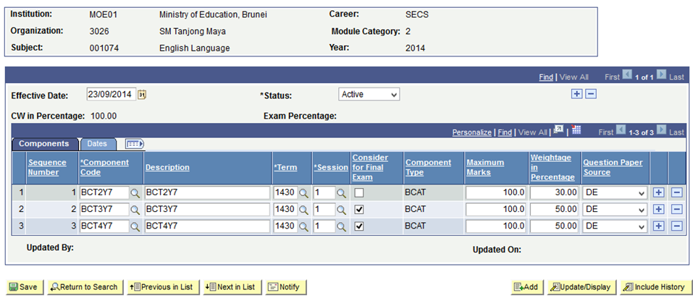
Weightage in Percentage
Message box if weightages are not equal to Assessment in Percentage
Click checkbox to consider for exam
Note:
Sum of weightages must be equal to Assessment in Percentage

Slide 63
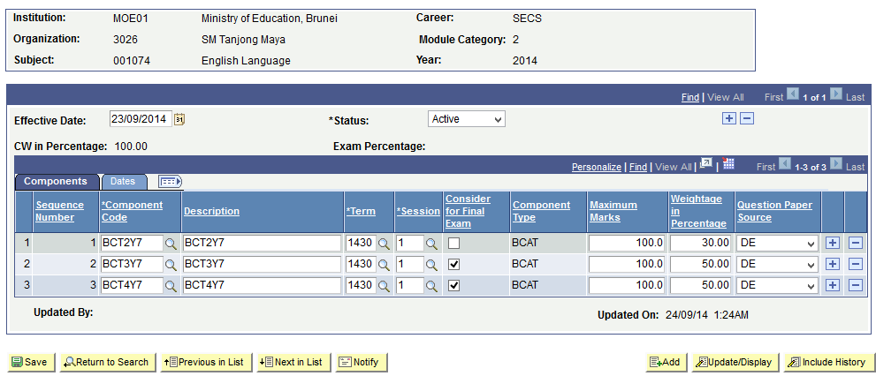
Save the Component Criteria
(+) Add Component code
(–) Delete Component code

Slide 64
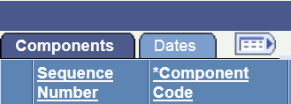
Click on Dates

Slide 65
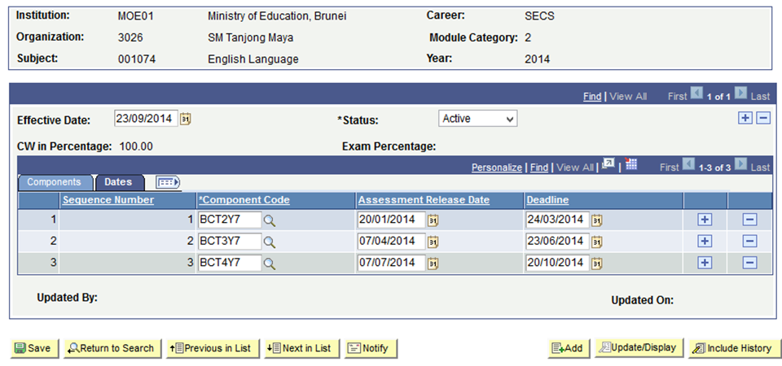
Fill in the Dates
Assessment Release Date
Date Teacher informs the student of project/classwork
Deadline
Date the student needs to submit the Assessment

Slide 66
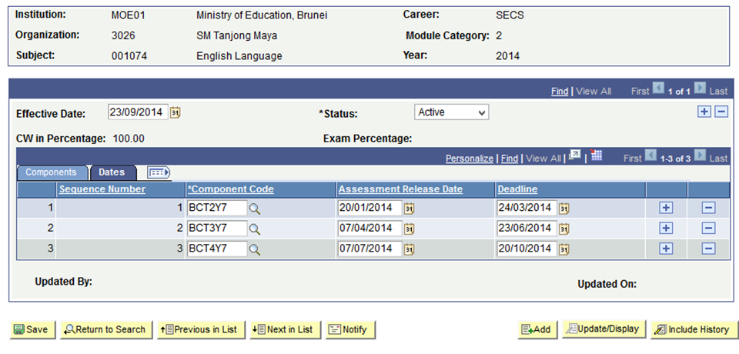
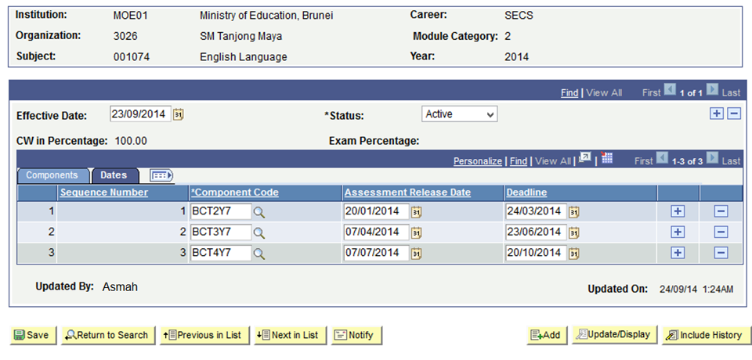
Click Save Button

Slide 67
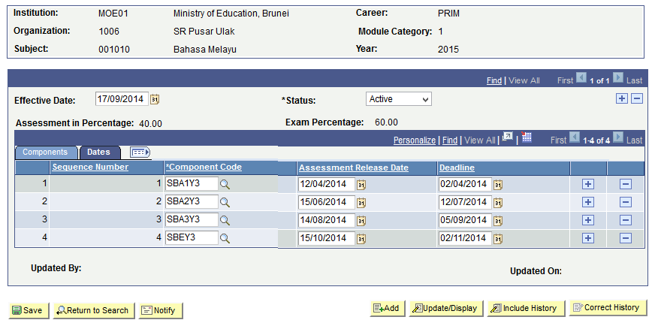
Click Save Button (Primary)

Slide 68
Assessment Setup
1. Student Assessment
3. Criteria Cut-off Date Setup/Criteria Cut-off Date for Primary
4. Define Component Criteria
5. Define Sub Component Criteria
Setup the assessment types and sub component, e.g. SBA - classwork, homework, project, practical, etc.
Setup deadline for the assessment to be defined
Setup the marks and weightage for the assessment
E.g. BCAT, Monthly Test
Setup the marks and weightage for the sub component, e.g. Classwork, Homework, Project, Paper 1, Paper 2
Head of Department(HOD) to setup weightages
2. Define Component and Sub Component

Slide 69
C4P-AS05: Define Sub-Component Criteria
Description:
This function allows the Roles below to Define Sub-Component Criteria
Granted Role:
School Exam Secretary (Secondary)
Menu Path:
Academic Staff > Assessment and Exams > Setup > Define Sub-Component Criteria

Slide 70
Understanding Sub Component Weightages
Assessment % - 40%
Exam % - 60%
Term 1
Term 2
Term 3
Term 4
(End-of-Year Exam)
Term 1
MT1Y9 (Monthly Test 1) – 5%
Term 2
MT2Y9 (Monthly Test 2) – 5%
MYEY9 (Mid Year Exam) – 20%
Term 3
MT3Y9 (Monthly Test 3) – 5%
MT4Y9 (Monthly Test 3) – 5%
Term 4
EOYY9 (End of Year Examination) – 60%
Biology
P1 (Paper 1) – 20%
P2 (Paper 2) – 30%
P3 (Paper 3) – 10%

Slide 71
Primary
Assessment % -30%
Exam % - 70%
Term 1
Term 2
(End-of-Year Exam)
Term 1
SBA1Y3 (School Based Assessment 1 Yr 3) - 10%
SBA2Y3 (School Based Assessment 2 Yr 3) - 10%
Term 2
SBA3Y3 (School Based Assessment 3 Yr 3) - 10%
Term 2
SBEY3 (School Based Examination) – 70%
English Language
P1 (Paper 1) – 30%
P2 (Paper 2) – 30%
ORAL (Oral & Spelling) – 10%

Slide 72
How to use
Navigate to the Screen via Menu Path
Click Add new Value Tab
Enter Academic Institution
Enter Academic Career
Enter Academic Organization
Enter Subject
Enter Academic Year
Enter Component Code
Click Add
Refer also to Online Help

Slide 73
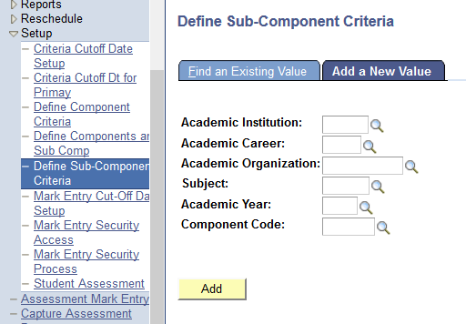
Navigate
Navigation: Academic Staff > Assessment and Exams > Setup > Define Sub Component Criteria

Slide 74
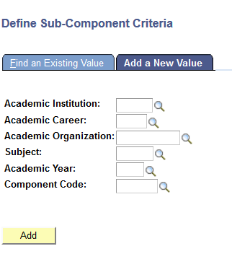
Click Add a New Value

Slide 75
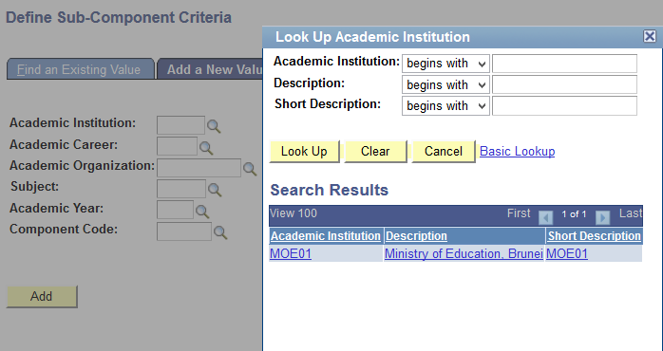
Select the Academic Institution

Slide 76
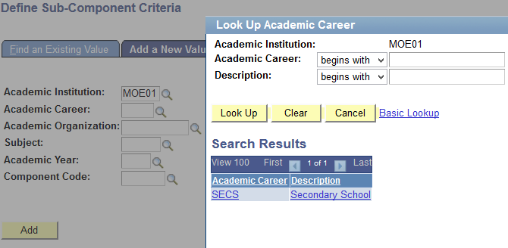
Select the Academic Career

Slide 77
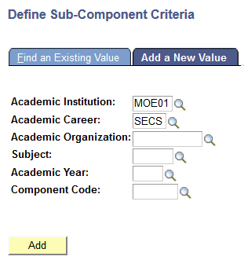
Fill in the rest of the Field

Slide 78
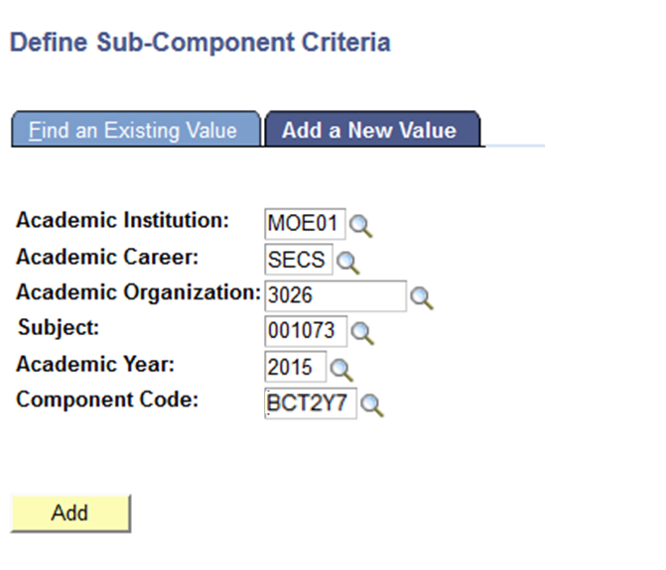
Click Add Button

Slide 79
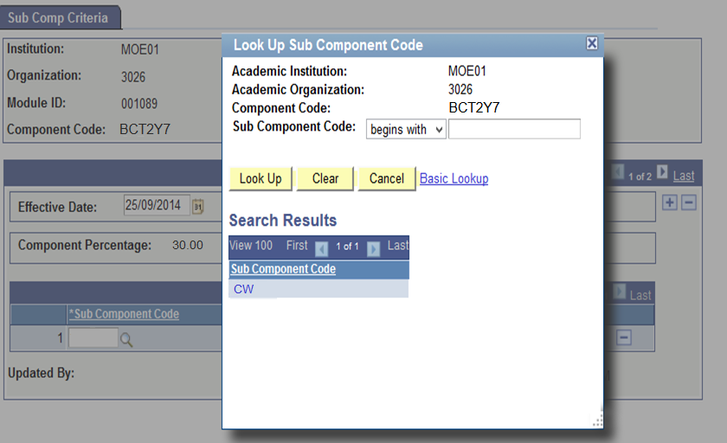
Select the Sub Component Code

Slide 80
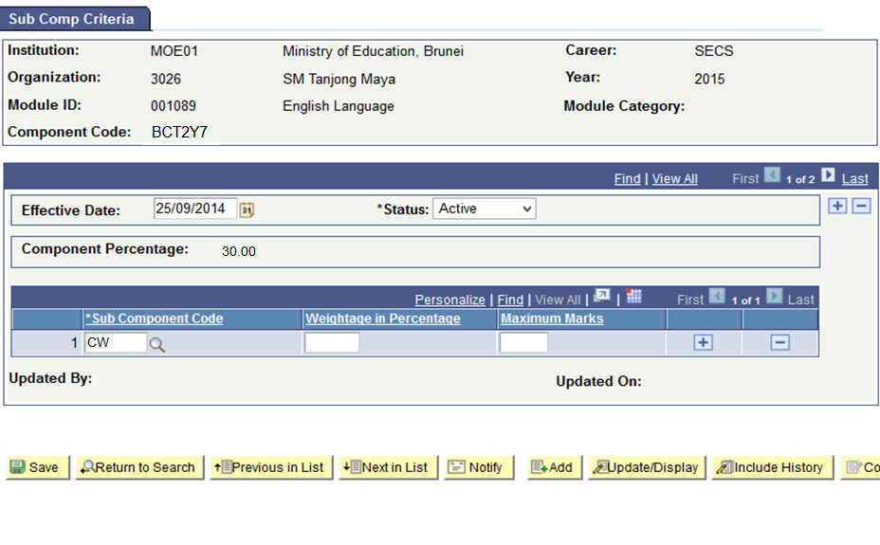
Fill in the rest of the Field

Slide 81
Click Save Button
Weightage in Percentage must be equal to Component Percentage

Slide 82
Primary
Weightage in Percentage must be equal to Component Percentage

Slide 83
Grading Assessment Flow Chart
6. Mark Entry Cut-off Date
Set deadline for Teachers to enter marks
7. Mark Entry Security Process
Automatically retrieves list of teachers allowed to enter marks into system
8. Mark Entry Security Access
Modify security for Teacher to enter marks (Add, Delete and Modify)
Moderate Marks
(Sixth Form)
After marks are entered, perform moderation of marks and grades

Slide 84
C4P-AS06: Mark Entry Cut-off Date
Description:
This Function allows the Roles below to setup Mark Entry Cut-off Date
Granted Role:
School Exam Secretary
Menu Path:
Academic Staff > Assessment and Exams > Setup >
Mark Entry Cut-off Date

Slide 85
How to use
Navigate to the Screen via Menu Path
Click Add a New Value Tab
Enter Academic Institution
Enter Academic Career
Enter Term
Enter Academic Organization
Choose Session
Click Add Button
Refer also to Online Help

Slide 86
Navigate
Navigation: Academic Staff > Assessment and Exams > Setup > Mark Entry Cut-off Date Setup

Slide 87
Add a New Value

Slide 88
Click Academic Institution

Slide 89
Fill in the rest of the Field

Slide 90
Select dropdown Session
Select the Session from the list:
Regular Academic Session
(Secondary / 6th Form)
2. Term 1,2,3 and 4 (Primary)

Slide 91
Enter Cut off Date for Mark Entry
Enter deadline for Mark Entry

Slide 92
After Mark Entry Cutoff Date

Slide 93
Grading Assessment Flow Chart
6. Mark Entry Cut-off Date
Set deadline for Teachers to enter marks
7. Mark Entry Security Process
Automatically retrieves list of teachers allowed to enter marks into system
8. Mark Entry Security Access
Modify security for Teacher to enter marks (Add, Delete and Modify)
Moderate Marks
(Sixth Form)
After marks are entered, perform moderation of marks and grades

Slide 94
C4P-AS07: Mark Entry Security Process
Description:
This Function allows the Roles below to assign Mark Entry Security to Teachers
Granted Role:
School Exam Secretary
Menu Path:
Academic Staff > Assessment and Exams > Setup > Mark Entry Security Process

Slide 95
How to use
Navigate to the Screen via Menu Path
Click Add a New Value Tab
Enter Run Control ID
Click Add Button
Refer also to Online Help

Slide 96
Navigate
Navigation:
Academic Staff > Assessment and Exams > Setup > Mark Entry Security Process

Slide 97
Enter Run Control ID
Enter a meaningful name for easy reference

Slide 98
Click Add Button

Slide 99
Select the Institution

Slide 100
Select the Academic Institution

Slide 101
Fill in all of the fields

Slide 102
Click Run Button

Slide 103
Click the checkbox Button

Slide 104
Click OK Button

Slide 105
Click Process Monitor
Take note of Process Instance number

Slide 106
Click Refresh Button
Click Refresh until:
Run Status changes to Success and
Distribution Status changes to Posted

Slide 107
Click Save Button

Slide 108
Grading Assessment Flow Chart
6. Mark Entry Cut-off Date
Set deadline for Teachers to enter marks
7. Mark Entry Security Process
Automatically retrieves list of teachers allowed to enter marks into system
8. Mark Entry Security Access
Modify security for Teacher to enter marks (Add, Delete and Modify)
Moderate Marks
(Sixth Form)
After marks are entered, perform moderation of marks and grades

Slide 109
C4P-AS08: Mark Entry Security Access
Description:
This Function allows the Roles below to add/delete/ modify the Mark Entry Security Access manually
Granted Role:
School Exam Secretary
Menu Path:
Academic Staff > Assessment and Exams > Setup > Mark Entry Security Access

Slide 110
How to use
Navigate to the Screen via Menu Path
Search for existing value
Click onto the Subject to give access
Navigate to desired Class Section
Add Employee ID
Click Save button
Refer also to Online Help

Slide 111
Navigate
Navigation: Academic Staff > Assessment and Exams > Setup > Mark Entry Security Access

Slide 112
Click Search button

Slide 113
Select the Course ID

Slide 114
Navigate to desired Class Section
Click Next to view another Class
Class Teacher

Slide 115
Select Employee ID
Click prompt button and select the Employee ID
(+) add Employee ID
(-) Delete Employee ID

Slide 116
Select Staff ID from list

Slide 117
Click Save Button
Staff ID present can view and modify the mark entry for the specific class

Slide 118
Grading Assessment Flow Chart
6. Mark Entry Cut-off Date
Set deadline for Teachers to enter marks
7. Mark Entry Security Process
Automatically retrieves list of teachers allowed to enter marks into system
8. Mark Entry Security Access
Modify Security for Teacher to enter marks (Add, Delete and Modify)
Moderate Marks
(Sixth Form)
After marks are entered, perform moderation of marks and grades

Slide 119
C4P–AS09: Moderate Marks
Description:
This Function allows the Role below to Moderate Mark
Granted Role:
School Database Officer (Sixth Form)
Menu Path:
Academic Staff > Assessment and Exams >
Moderate Marks

Slide 120
How to use
Navigate to the Screen via Menu Path
Click Search for Existing Value
Click the Specific Course ID
Refer also to Online Help

Slide 121
Navigate
Navigation:
Academic Staff > Assessment and Exams > Moderate Marks

Slide 122
Click Search Button

Slide 123
Select the specific Course ID

Slide 124
Enter the Grading Ranges

Slide 125
Click Fetch Students Button

Slide 126
Click Moderate Button

Slide 127
Student Results

Slide 128
Reschedule Request
1. Setup Reschedule Request period
2. Submit Reschedule Request
3. Cancel Reschedule Request
Setup timeline for accepting reschedule request
Apply to reschedule Test / Exam for Student
Cancel student’s reschedule application
4. List of Reschedule Request Report
5. Approved Reschedule Request Report
List of submitted reschedule request (Pending, Cancelled, Approved, Rejected)
List of only the approved reschedule request

Slide 129
Submit Reschedule Request
Reschedule Request Period
Submit Reschedule Request
Before Approval
Principal Approval
Cancel Reschedule Request
Approve Reschedule Request
Reject Reschedule Request

Slide 130
C4P-AS10: Reschedule Request Period
Description:
This Function allows the Roles to define Reschedule Request Period
Granted Role:
School Exam Secretary
Menu Path:
Academic Staff > Assessment and Exams > Reschedule > Reschedule Request Period

Slide 131
How to use
Navigate to the Screen via Menu Path
Click Add a New Value Tab
Enter Academic Institution
Enter Academic Career
Enter Academic Organization
Enter Term
Choose Session
Enter Component Code
Click Add Button
Refer also to Online Help

Slide 132
Navigate
Navigation: Academic Staff > Assessment and Exams > Reschedule > Reschedule Request Period

Slide 133
Add a New Value Tab
Click Add a New Value Tab to setup new Reschedule period for Assessment

Slide 134
Select the Academic Institution
Click the Lookup Prompt

Slide 135
Select the Academic Institution

Slide 136
Fill in the rest of the field

Slide 137
Click Add Button

Slide 138
Setup Reschedule Request Period
Define Reschedule Request Period

Slide 139
Click Save Button

Slide 140
Reschedule Request
1. Setup Reschedule Request period
2. Submit Reschedule Request
3. Cancel Reschedule Request
Setup timeline for accepting reschedule request
Apply to reschedule Test / Exam for Student
Cancel student’s reschedule application
4. List of Reschedule Request Report
5. Approved Reschedule Request Report
List of submitted reschedule request (Pending, Cancelled, Approved, Rejected)
List of only the approved reschedule request

Slide 141
C4P-AS11: Submit Reschedule Request
Description:
This Function allows the Role below to Submit Reschedule Request
Granted Role:
School Exam Secretary
Menu Path:
Academic Staff > Assessment and Exams > Reschedule > Submit Re-Schedule Request

Slide 142
How to use
Navigate to the Screen via Menu Path
Click Add a New Value Tab
Enter Academic Institution
Enter Academic Career
Enter Academic Organization
Enter Term
Choose Session
Enter Component Code
Click Add Button
Refer also to Online Help

Slide 143
Navigate
Navigation: Academic Staff > Assessment and Exams > Reschedule > Submit Reschedule Request

Slide 144
Click Add a New Value

Slide 145
Select the Academic Institution
Click the Lookup prompt

Slide 146
Select the Academic Institution

Slide 147
Select the Academic Program

Slide 148
Select Session
Select the Session from dropdown list:
1. Regular Academic Session (Secondary / 6th Form)
2. Term 1,2,3 and 4 (Primary)

Slide 149
Click the Add Button

Slide 150
Select Subject
Click the Lookup prompt

Slide 151
Select Subject

Slide 152
Fill in the Remarks/Comments

Slide 153
Add attachment

Slide 154
Click upload

Slide 155
Define the Supporting Documents
(+) Add Attachment
(-) Delete Attachment
Select the Dropdown
to define the type of Supporting Documents

Slide 156
View/ Delete Attachment

Slide 157
Click Submit Button

Slide 158
Click Ok Button

Slide 159
Reschedule Status
After submission, the Submit button is greyed out

Slide 160
After Submit
Before approval, ‘Cancel’ button is available.
After approval, ‘Cancel’ button will not be available.
User will have to contact Principal directly if they wish to cancel request.

Slide 161
After Submit (Primary)

Slide 162
Email sent to Principal

Slide 163
Email sent to School Exam Secretary

Slide 164
Reschedule Request
1. Setup Reschedule Request period
2. Submit Reschedule Request
3. Cancel Reschedule Request
Setup timeline for accepting reschedule request
Apply to reschedule Test / Exam for Student
Cancel student’s reschedule application
4. List of Reschedule Request Report
5. Approved Reschedule Request Report
List of submitted reschedule request (Pending, Cancelled, Approved, Rejected)
List of approved reschedule request

Slide 165
C4P-AS12: List of Reschedule Request Report
Description:
This Function allows the Role below to view List of Reschedule Request Report
Granted Role:
School Exam Secretary
Menu Path:
Reporting Tools > Query > Query Viewer

Slide 166
How to use
Navigate to the Screen via Menu Path
Enter Description Name
Click Search Button
Refer also to Online Help

Slide 167
Navigate
Navigation: Reporting Tools > Query > Query Viewer

Slide 168
Enter Description Name

Slide 169
Click Search Button

Slide 170
Click Run to HTML

Slide 171
Select Institution

Slide 172
Click Academic Institution

Slide 173
Fill in the rest of the field

Slide 174
Click View Results button

Slide 175
Click Excel Spreadsheet
Click Excel Spreadsheet to download to local machine

Slide 176
Click Ok Button

Slide 177
Excel Spreadsheet

Slide 178
Reschedule Request
1. Setup Reschedule Request period
2. Submit Reschedule Request
3. Cancel Reschedule Request
Setup timeline for accepting reschedule request
Apply to reschedule Test / Exam for student
Cancel student’s reschedule application
4. List of Reschedule Request Report
5. Approved Reschedule Request Report
List of submitted reschedule request (Pending, Cancelled, Approved, Rejected)
List of approved reschedule request

Slide 179
C4P-AS13: Approved Reschedule Request Report
Description:
This Function allows the Roles below to view List of Approved Reschedule Request
Granted Role:
School Examination Secretary
Menu Path:
Reporting Tools > Query > Query Viewer

Slide 180
How to use
Navigate to the Screen via Menu Path
Enter Description Name
Click Search Button
Refer also to Online Help

Slide 181
Navigate
Navigation: Reporting Tools > Query > Query Viewer

Slide 182
Enter Query Name

Slide 183
Click Search Button

Slide 184
Click Run to HTML

Slide 185
Select Institution

Slide 186
Select Institution

Slide 187
Fill in the rest of the field

Slide 188
View Results button

Slide 189
Click Excel Spreadsheet
Click Excel Spreadsheet to download

Slide 190
Click Ok Button

Slide 191
Excel Spreadsheet

Slide 192
End of Presentation
Thank You
☺

