Slide 1
Manage Assessment

Slide 2
Assessment Setup
1. Student Assessment
3. Criteria Cut-off Date Setup
4. Define Component Criteria
5. Define Sub Component Criteria
Setup the assessment types and sub component, e.g. SBA - classwork, homework, project, practical, etc.
Setup deadline for the assessment to be defined
Setup the marks and weightage of the assessment for each subject
E.g. BCAT, Monthly Test
Setup the marks and weightage for the sub component, e.g. Classwork, Homework, Project, Paper 1, Paper 2
Head of Department(HOD) to setup weightages
2. Define Component and Sub Component

Slide 3
Student Assessment
Description:
This Function allows the Roles below to enter the Assessment Weightages
Granted Role:
Head of Subject Department
School Exam Secretary (Secondary)
Menu Path:
Academic Staff > Assessment and Exams > Setup > Student Assessment

Slide 4
How to use
Navigate to the Screen via Menu Path
Click Search for Existing Value
Choose Course ID
Click the Course ID
Refer also to Online Help:
Navigate to Manage Assessment > Define Assessment Structure > Manage Assessment and Exam Percentage
http://help.ineis.moe.gov.bn/as/as_1.1.php

Slide 5
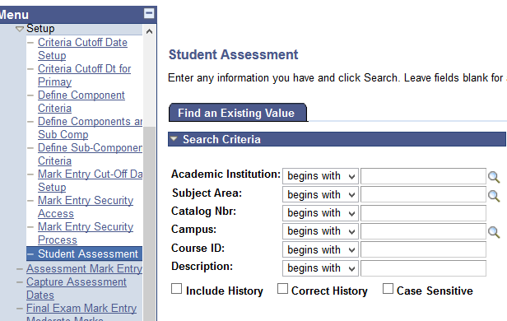
Navigate
Navigation: Academic Staff > Assessment and Exams > Setup > Student Assessment

Slide 6
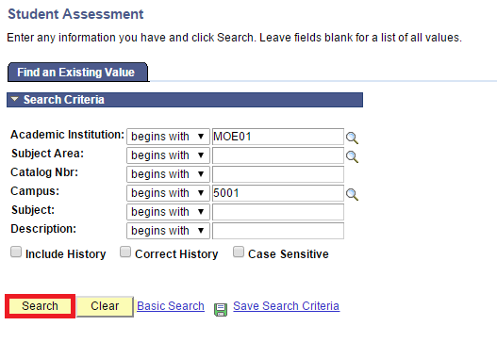
Click Search Button

Slide 7
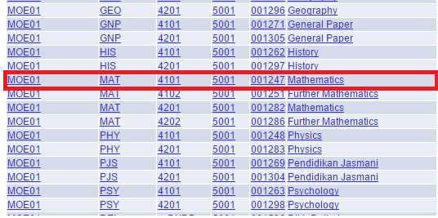
Select the Course ID

Slide 8
Understanding Catalog Nbr
Catalog Nbr | 4 | 1 | 0 | 1
Running Number
Academic Career
1 – Preschool
2 – Primary
3 – Secondary
4 – Sixth Form
Academic Level | Pre-School | Primary | Secondary | Sixth Form
0 | Pre-School
1 |  | Year 1 | Year 7 | Lower Sixth
2 |  | Year 2 | Year 8 | Upper Sixth
3 |  | Year 3 | Year 9
4 |  | Year 4 | Year 10
5 |  | Year 5 | Year 11
6 |  | Year 6
Notes:
Running Number for same subjects. For example,
For Preschool, Primary, Year 7 and Year 8, all 01.
For Upper Secondary, Core Mathematics and Optional Additional Mathematics, Core Physics and Optional Physics

Slide 9
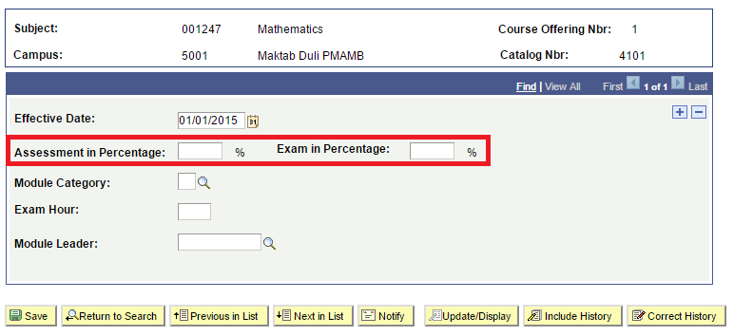
Fill in the Field
Assessment and Exam in percentage must be equal to 100%

Slide 10
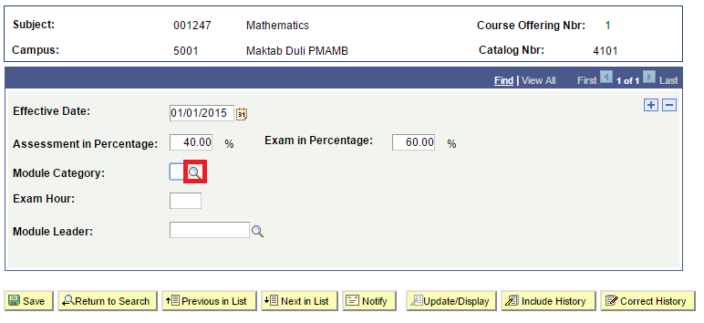
Select Module Category
Click prompt button to setup Module Category

Slide 11
Select Module Category

Slide 12
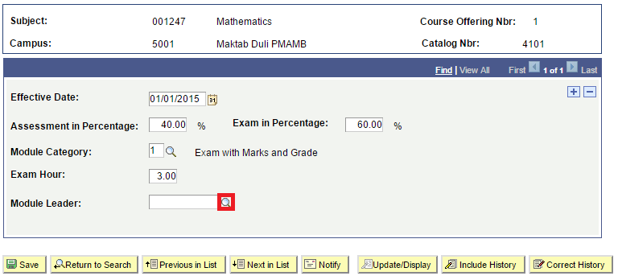
Select Module Leader
Head of Department in charge of the module

Slide 13
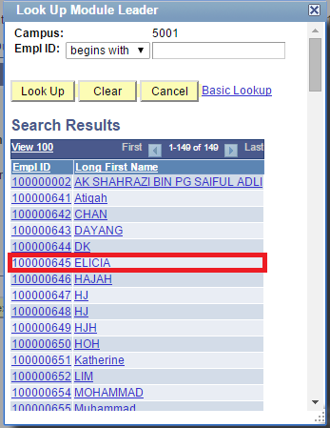
Select Module Leader

Slide 14
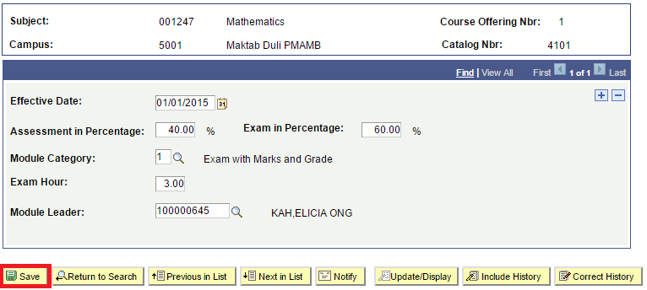
Click Save Button

Slide 15
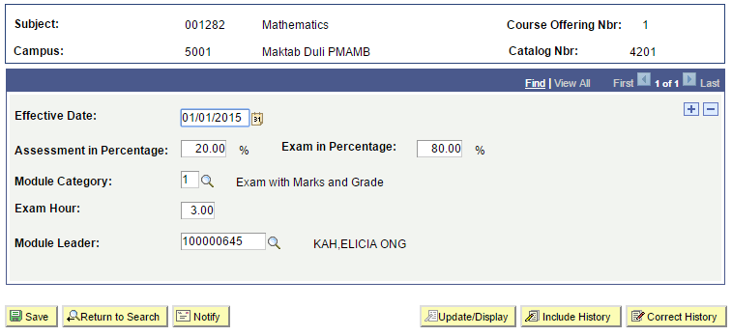
Upper 6 Mathematics

Slide 16
Assessment Setup
1. Student Assessment
3. Criteria Cut-off Date Setup
4. Define Component Criteria
5. Define Sub Component Criteria
Setup the assessment types and sub component, e.g. SBA - classwork, homework, project, practical, etc.
Setup deadline for the assessment to be defined
Setup the marks and weightage for the assessment
E.g. BCAT, Monthly Test
Setup the marks and weightage for the sub component, e.g. Classwork, Homework, Project, Paper 1, Paper 2
Head of Department(HOD) to setup weightages
2. Define Component and Sub Component

Slide 17
Define Components and Sub Comp
Description:
This Function allows the Roles below to Define the Assessments/Examination to be conducted
Granted Role:
School Exam Secretary (Secondary)
Menu Path:
Academic Staff > Assessment and Exams > Setup > Define Components and Sub Comp

Slide 18
Concept - Secondary
Component Code
APR1L6
Sub-Comp Code
TEST
TEST1
TEST2
PROJ (Project)
PRCTL (Practical)
Mathematics
TEST1
TEST2
Biology
TEST
PRCTL
Computer Studies
TEST
PROJ

Slide 19
How to use
Navigate to the Screen via Menu Path
Click Add a new Value Tab
Enter Academic Institution
Enter Academic Organization
Enter Component Code
Click Add Button
Refer also to Online Help:
Navigate to Manage Assessment > Define Assessment Structure > Manage Assessment and Sub-Assessment Types
http://help.ineis.moe.gov.bn/as/as_1.2.php#2

Slide 20
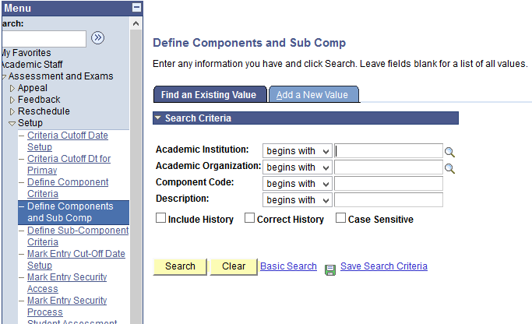
Navigate
Navigation: Academic Staff > Assessment and Exams > Setup > Define Components and Sub Comp

Slide 21
Click Add a New Value
Click Add a New Value Tab to enter new Assessment Code

Slide 22
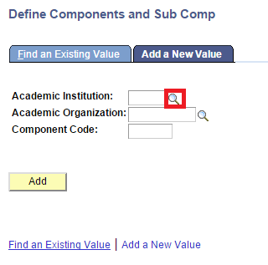
Select the Academic Institution
Click the lookup prompt

Slide 23
Select the Academic Institution

Slide 24
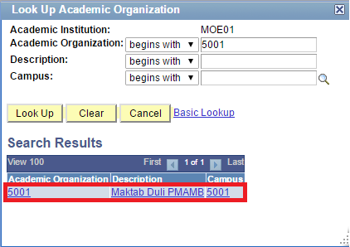
Select the Academic Organization

Slide 25
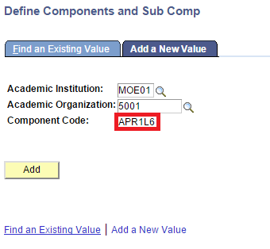
Enter the Component Code
Note:
Component Code is limited to 6 characters only

Slide 26
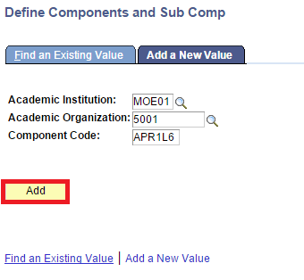
Click Add Button

Slide 27
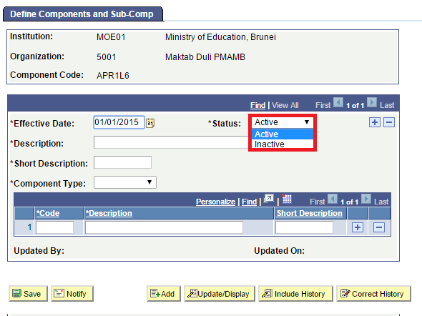
Select Active Status
Click dropdown list and Select Active Status

Slide 28
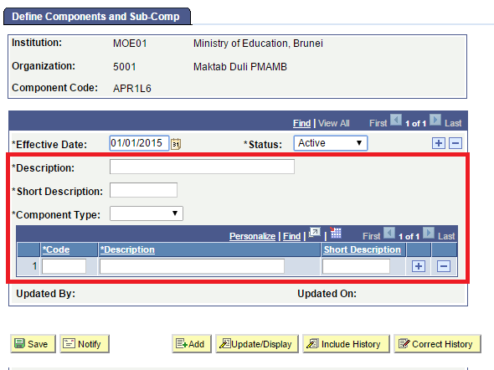
Fill up the rest of the fields

Slide 29
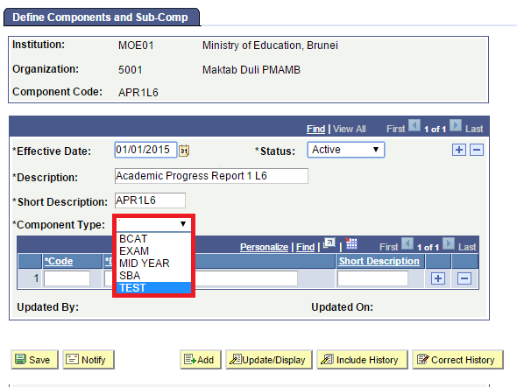
Select Component Type
Click dropdown list to select the Assessment Type:
BCAT – Year 7 and Year 8
EXAM – Qualifying / End of Year Examination
MID YEAR – Mid Year Examination
SBA – School Based Assessment
TEST – Other Assessments, e.g Mock / Assessment Test

Slide 30
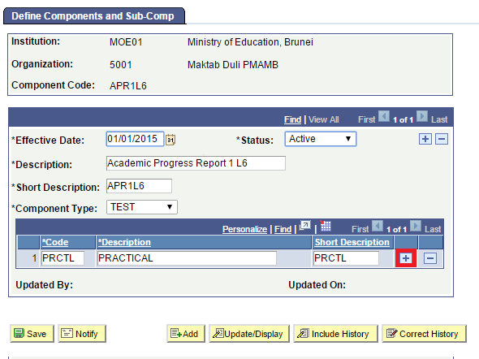
Define Sub Component (Sub Assessment)
Click ‘+’ button to add more sub-components

Slide 31
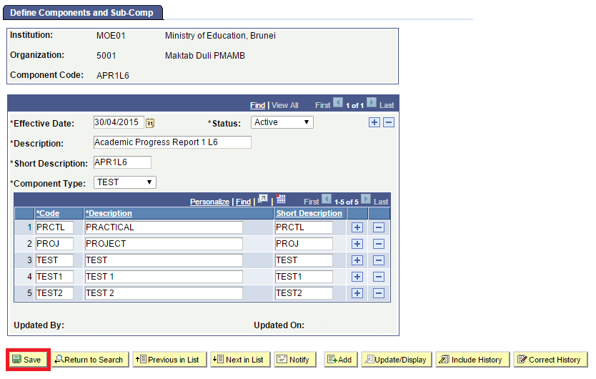

Slide 32
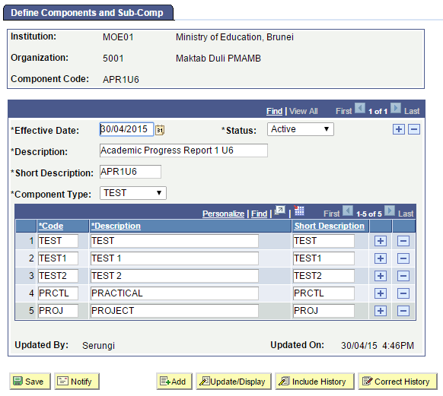

Slide 33
Assessment Setup
1. Student Assessment
3. Criteria Cut-off Date Setup
4. Define Component Criteria
5. Define Sub Component Criteria
Setup the assessment types and sub component, e.g. SBA - classwork, homework, project, practical, etc.
Setup deadline for the assessment to be defined
Setup the marks and weightage for the assessment
E.g. BCAT, Monthly Test
Setup the marks and weightage for the sub component, e.g. Classwork, Homework, Project, Paper 1, Paper 2
Head of Department(HOD) to setup weightages
2. Define Component and Sub Component

Slide 34
Setup Criteria Cut-off Date
Description:
This Function allows the Roles below to Setup the Criteria Cut-off Date
Granted Role:
School Exam Secretary (Secondary)
Menu Path:
Academic Staff > Assessment and Exams > Setup > Criteria Cutoff Date Setup

Slide 35
How to use
Navigate to the Screen via Menu Path
Click Add a new Value Tab
Enter Academic Institution
Enter Academic Organization
Enter Academic Year
Click Add Button
Refer also to Online Help:
Navigate to Manage Assessment > Define Assessment Structure > Manage Assessment and Sub-Assessment Types
http://help.ineis.moe.gov.bn/as/as_1.2.php#2

Slide 36
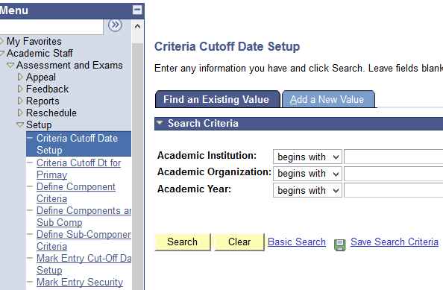
Navigate
Navigate
Navigation: Academic Staff > Assessment and Exams > Setup > Criteria Cut-off Date Setup

Slide 37
Click Add a New Value

Slide 38
Select the Academic Institution

Slide 39
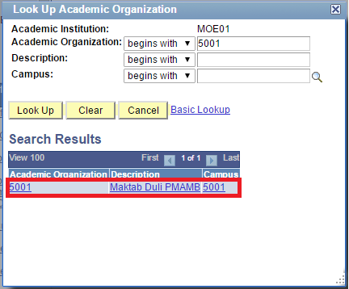
Select the Academic Organization
Select the Academic Organization.

Slide 40
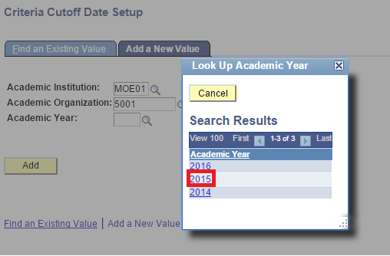
Select the Academic Year

Slide 41
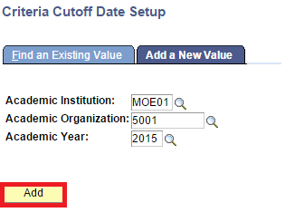
Click Add Button

Slide 42
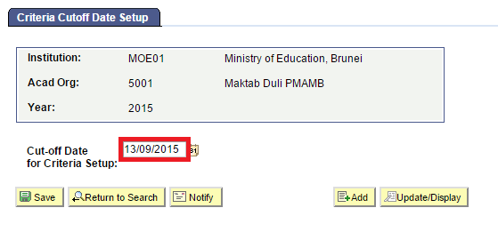
Enter the Cut-off Date
Set Deadline to define Component and Subcomponent criteria

Slide 43
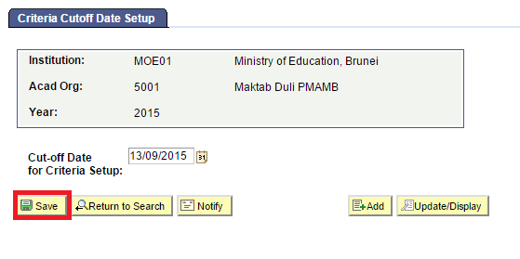
Save the Criteria Cut-off Date
Before Cut-off Date,
Users CAN add/modify/delete:
Define Component Criteria
Define Sub-Component Criteria
On/After Cut-off Date,
Users CANNOT add/modify/delete:
Define Component Criteria
Define Sub-Component Criteria

Slide 44
Assessment Setup
1. Student Assessment
3. Criteria Cut-off Date Setup
4. Define Component Criteria
5. Define Sub Component Criteria
Setup the assessment types and sub component, e.g. SBA - classwork, homework, project, practical, etc.
Setup deadline for the assessment to be defined
Setup the marks and weightage of the assessment for each subject
E.g. BCAT, Monthly Test
Setup the marks and weightage for the sub component, e.g. Classwork, Homework, Project, Paper 1, Paper 2
Head of Department(HOD) to setup weightages
2. Define Component and Sub Component

Slide 45
Define Component Criteria
Description:
This Function allows the Roles below to setup the marks and weightages of the assessment for each subject
Granted Role:
School Exam Secretary (Secondary)
Menu Path:
Academic Staff > Assessment and Exams > Setup > Define Component Criteria

Slide 46
How to use
Navigate to the Screen via Menu Path
Click Add a new Value Tab
Enter Academic Institution
Enter Academic Career
Enter Subject
Enter Academic Year
Click Add Button
Refer also to Online Help:
Navigate to Manage Assessment > Define Assessment Structure > Manage Assessment and Sub-Assessment Types
http://help.ineis.moe.gov.bn/as/as_1.2.php#2

Slide 47
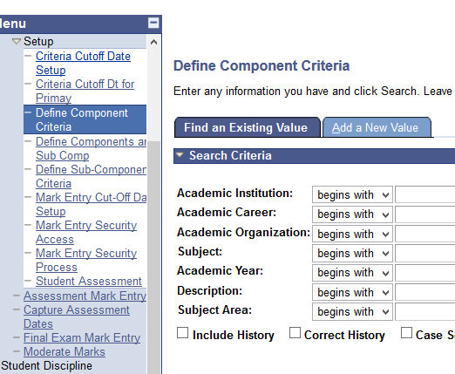
Navigate
Navigation: Academic Staff > Assessment and Exams > Setup > Define Component Criteria

Slide 48
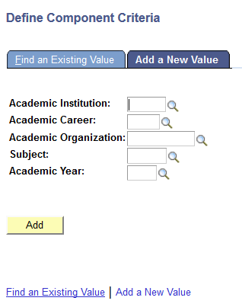
Click Add a New Value

Slide 49
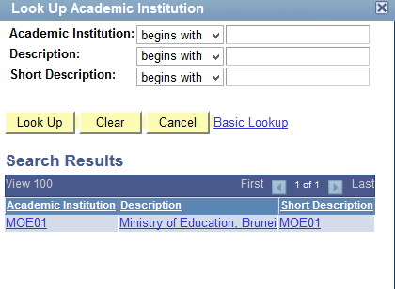
Select the Academic Institution

Slide 50
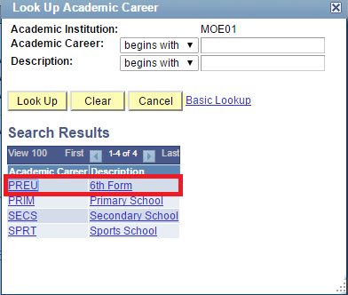
Select the Academic Career

Slide 51
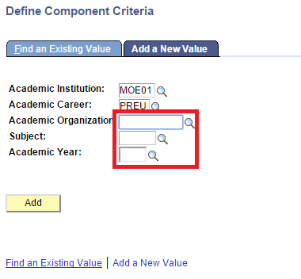
Fill up the rest of the field

Slide 52
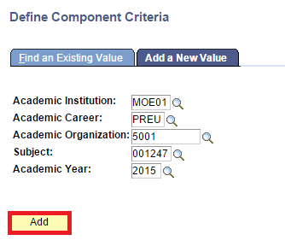
Click Add Button

Slide 53
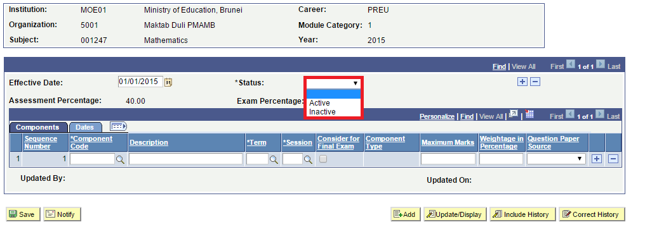
Select Active Status
Click dropdown list to select the status

Slide 54
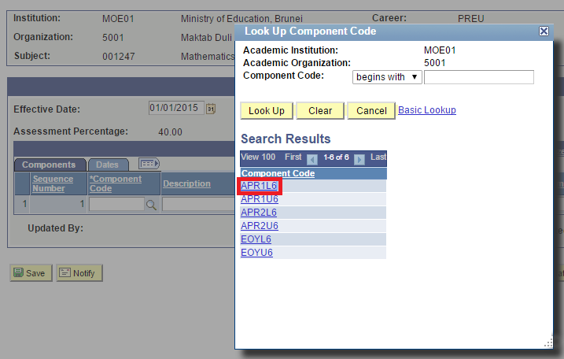
Select Component Code
Click prompt button to select the Component Code

Slide 55
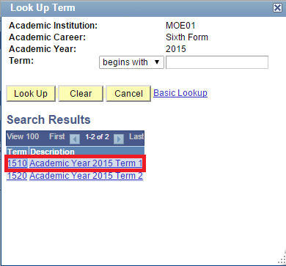
Select Term

Slide 56
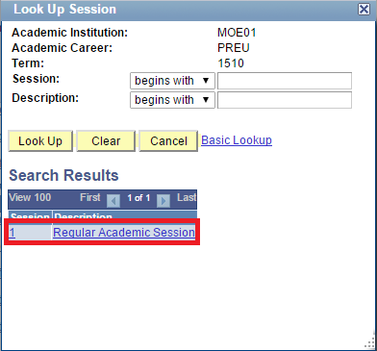
Select Session

Slide 57
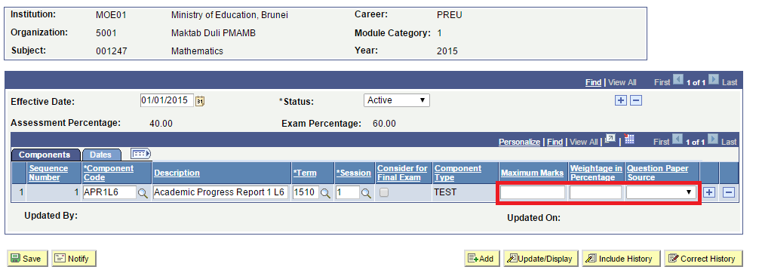
Fill the rest of the Field

Slide 58
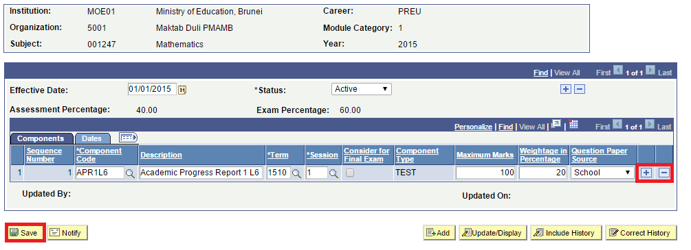
Click Save
(+) Add Component code
(–) Delete Component code

Slide 59
Understanding Component Weightages
Assessment % - 40%
Assessment % - 60%
Term 1
Term 2
Term 3
Term 1
APR1L6 (Academic Progress Report 1) – 10%
Term 2
APR2L6 (School Based Assessment 1)– 30%
Term 3
EOYL6 (School Based Assessment 1)– 60%

Slide 60
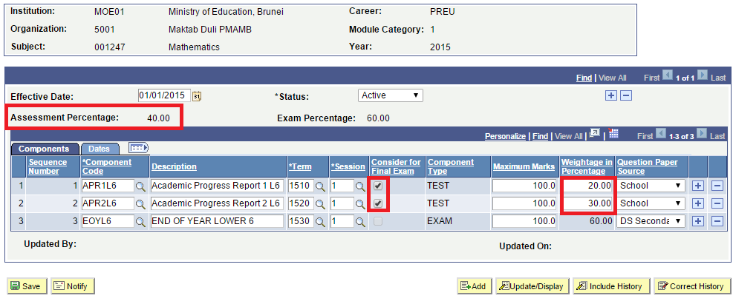
Weightage in Percentage
Note:
Sum of weightages must be equal to Assessment in Percentage
Message box if weightages are not equal to Assessment in Percentage
Click checkbox to consider for exam

Slide 61
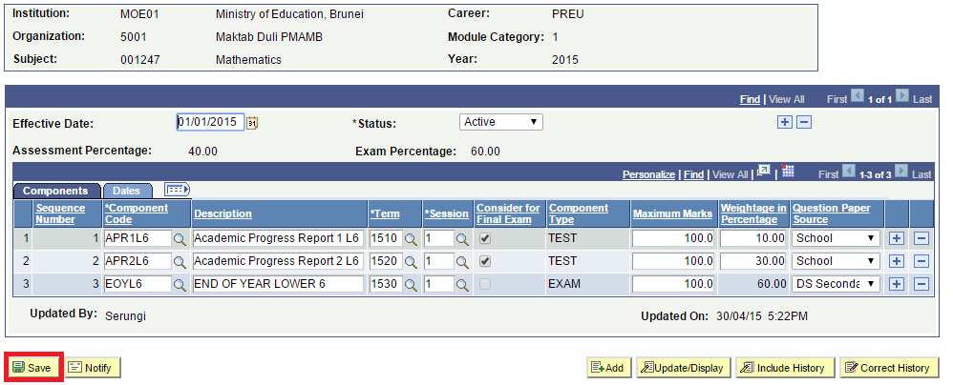
Click Save

Slide 62
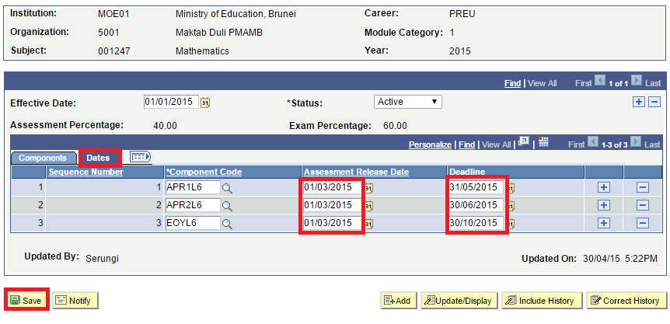
Fill in the Date
Assessment Release Date
Date Teacher informs the student of project/classwork
Deadline
Date the student needs to submit the Assessment

Slide 63
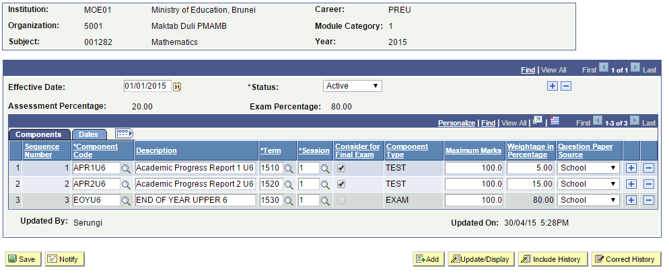
Upper 6 Mathematics

Slide 64
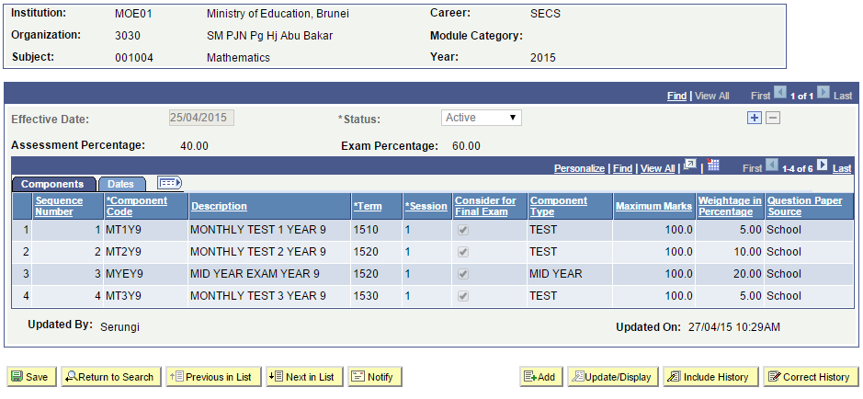
After Cut-off Date
User will not be able to add/modify/delete the Components Criteria if the current date is after the cut-off date.

Slide 65
Assessment Setup
1. Student Assessment
3. Criteria Cut-off Date Setup
4. Define Component Criteria
5. Define Sub Component Criteria
Setup the assessment types and sub component, e.g. SBA - classwork, homework, project, practical, etc.
Setup deadline for the assessment to be defined
Setup the marks and weightage for the assessment
E.g. BCAT, Monthly Test
Setup the marks and weightage for the sub component, e.g. Classwork, Homework, Project, Paper 1, Paper 2
Head of Department(HOD) to setup weightages
2. Define Component and Sub Component

Slide 66
Define Sub-Component Criteria
Description:
This function allows the Roles below to Define Sub-Component Criteria
Granted Role:
School Exam Secretary (Secondary)
Menu Path:
Academic Staff > Assessment and Exams > Setup > Define Sub-Component Criteria

Slide 67
Understanding Sub Component Weightages
Assessment % - 40%
Assessment % - 60%
Term 1
Term 2
Term 3
Mathematics (APR1L6)
TEST1 – 3%
TEST2 – 7%
Term 1
APR1L6 (Academic Progress Report 1) – 10%
Term 2
APR2L6 (School Based Assessment 1)– 30%
Term 3
EOYL6 (School Based Assessment 1)– 60%
Mathematics (APR2L6)
TEST – 30%

Slide 68
How to use
Navigate to the Screen via Menu Path
Click Add new Value Tab
Enter Academic Institution
Enter Academic Career
Enter Academic Organization
Enter Subject
Enter Academic Year
Enter Component Code
Click Add
Refer also to Online Help:
Navigate to Manage Assessment > Define Assessment Structure > Manage Assessment and Sub-Assessment Types
http://help.ineis.moe.gov.bn/as/as_1.2.php#2

Slide 69
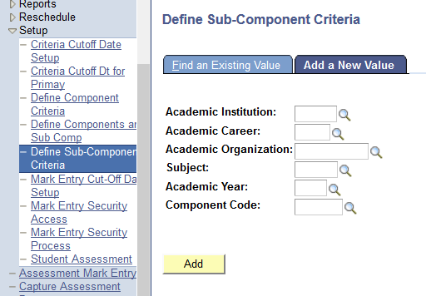
Navigate
Navigation: Academic Staff > Assessment and Exams > Setup > Define Sub Component Criteria

Slide 70
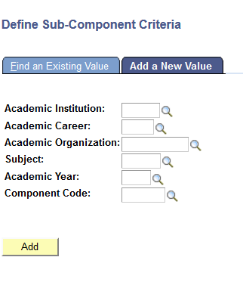
Click Add a New Value

Slide 71
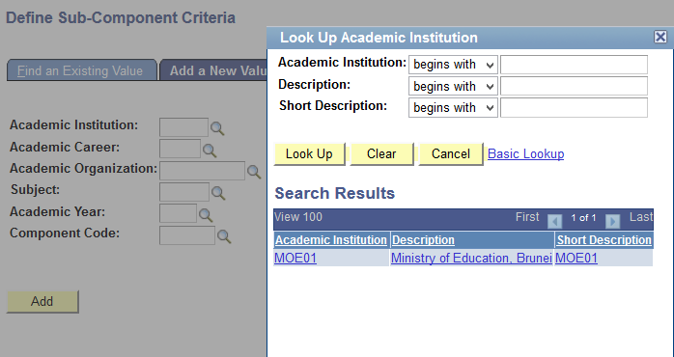
Select the Academic Institution

Slide 72
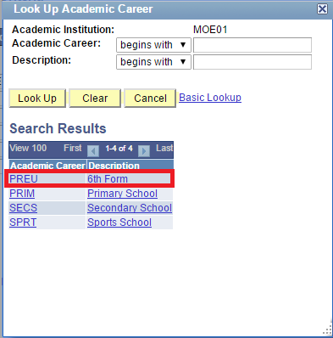
Select the Academic Career

Slide 73
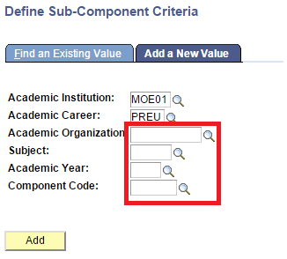
Fill in the rest of the Field

Slide 74
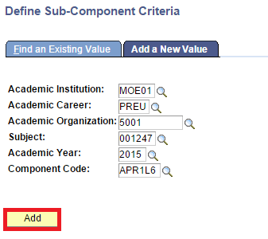
Click Add Buttom

Slide 75
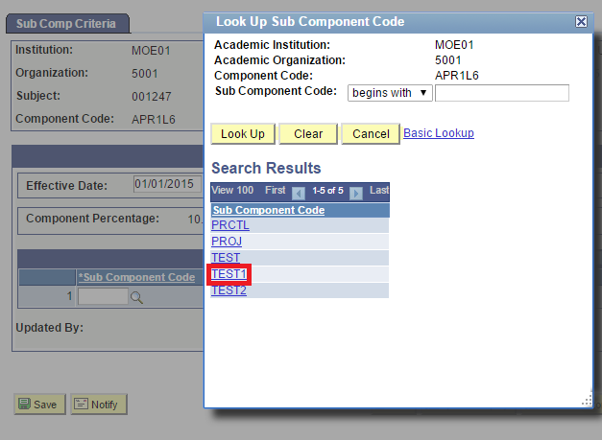
Select the Sub Components

Slide 76
Fill the rest of the Field

Slide 77
Click Save Button
Weightage in Percentage must be equal to Component Percentage
Message box if weightages are not equal to Assessment in Percentage

Slide 78
Sub-component for Mathematics APR1L6

Slide 79
Sub-component for Mathematics APR1U6

Slide 80
After Cut-off Date
User will not be able to add/modify/delete the Sub-Components Criteria if the current date is after the cut-off date.

Slide 81
Grading Assessment Flow Chart
6. Mark Entry Cut-off Date
Set deadline for Teachers to enter marks
7. Mark Entry Security Process
Automatically retrieves list of teachers allowed to enter marks into system
8. Mark Entry Security Access
Modify security for Teacher to enter marks (Add, Delete and Modify)
Moderate Marks
(Sixth Form)
After marks are entered, perform moderation of marks and grades

Slide 82
Mark Entry Cut-off Date
Description:
This Function allows the Roles below to setup Mark Entry Cut-off Date
Granted Role:
School Exam Secretary
Menu Path:
Academic Staff > Assessment and Exams > Setup >
Mark Entry Cut-off Date

Slide 83
How to use
Navigate to the Screen via Menu Path
Click Add a New Value Tab
Enter Academic Institution
Enter Academic Career
Enter Term
Enter Academic Organization
Choose Session
Click Add Button
Refer also to Online Help:
Navigate to Manage Assessment > Grade Assessment > Setup Mark Entry Cut-off Date and Security
http://help.ineis.moe.gov.bn/as/as_3.1.php

Slide 84
Navigate
Navigation: Academic Staff > Assessment and Exams > Setup > Mark Entry Cut-off Date Setup

Slide 85
Add a New Value

Slide 86
Click Academic Institution

Slide 87
Fill in the rest of the Field

Slide 88
Select dropdown Session
Select the Session from the list:
Regular Academic Session
(Secondary / 6th Form)
2. Term 1,2,3 and 4 (Primary)

Slide 89
Enter Cut off Date for Mark Entry
Enter deadline for Mark Entry

Slide 90
After Mark Entry Cutoff Date

Slide 91
Grading Assessment Flow Chart
6. Mark Entry Cut-off Date
Set deadline for Teachers to enter marks
7. Mark Entry Security Process
Automatically retrieves list of teachers allowed to enter marks into system
8. Mark Entry Security Access
Modify security for Teacher to enter marks (Add, Delete and Modify)
Moderate Marks
(Sixth Form)
After marks are entered, perform moderation of marks and grades

Slide 92
Mark Entry Security Process
Description:
This Function allows the Roles below to assign Mark Entry Security to Teachers
Granted Role:
School Exam Secretary
Menu Path:
Academic Staff > Assessment and Exams > Setup > Mark Entry Security Process

Slide 93
How to use
Navigate to the Screen via Menu Path
Click Add a New Value Tab
Enter Run Control ID
Click Add Button
Refer also to Online Help:
Navigate to Manage Assessment > Grade Assessment > Setup Mark Entry Cut-off Date and Security
http://help.ineis.moe.gov.bn/as/as_3.1.php

Slide 94
Navigate
Navigation:
Academic Staff > Assessment and Exams > Setup > Mark Entry Security Process

Slide 95
Enter Run Control ID
Enter a meaningful name for easy reference

Slide 96
Click Add Button

Slide 97
Select the Institution

Slide 98
Select the Academic Institution

Slide 99
Fill in all of the fields

Slide 100
Click Run Button

Slide 101
Click the checkbox Button

Slide 102
Click OK Button

Slide 103
Click Process Monitor
Take note of Process Instance number

Slide 104
Click Refresh Button
Click Refresh until:
Run Status changes to Success and
Distribution Status changes to Posted

Slide 105
Click Save Button

Slide 106
Grading Assessment Flow Chart
6. Mark Entry Cut-off Date
Set deadline for Teachers to enter marks
7. Mark Entry Security Process
Automatically retrieves list of teachers allowed to enter marks into system
8. Mark Entry Security Access
Modify security for Teacher to enter marks (Add, Delete and Modify)
Moderate Marks
(Sixth Form)
After marks are entered, perform moderation of marks and grades

Slide 107
Mark Entry Security Access
Description:
This Function allows the Roles below to add/delete/ modify the Mark Entry Security Access manually
Granted Role:
School Exam Secretary
Menu Path:
Academic Staff > Assessment and Exams > Setup > Mark Entry Security Access

Slide 108
How to use
Navigate to the Screen via Menu Path
Search for existing value
Click onto the Subject to give access
Navigate to desired Class Section
Add Employee ID
Click Save button
Refer also to Online Help:
Navigate to Manage Assessment > Grade Assessment > Setup Mark Entry Cut-off Date and Security
http://help.ineis.moe.gov.bn/as/as_3.1.php

Slide 109
Navigate
Navigation: Academic Staff > Assessment and Exams > Setup > Mark Entry Security Access

Slide 110
Click Search button

Slide 111
Select the Course ID

Slide 112
Navigate to desired Class Section
Click Next to view another Class
Class Teacher

Slide 113
Select Employee ID
Click prompt button and select the Employee ID
(+) add Employee ID
(-) Delete Employee ID

Slide 114
Select Staff ID from list

Slide 115
Click Save Button
Staff ID present can view and modify the mark entry for the specific class

Slide 116
Grading Assessment Flow Chart
6. Mark Entry Cut-off Date
Set deadline for Teachers to enter marks
7. Mark Entry Security Process
Automatically retrieves list of teachers allowed to enter marks into system
8. Mark Entry Security Access
Modify Security for Teacher to enter marks (Add, Delete and Modify)
Moderate Marks
(Sixth Form)
After marks are entered, perform moderation of marks and grades

Slide 117
Moderate Marks
Description:
This Function allows the Role below to Moderate Mark
Granted Role:
School Database Officer (Sixth Form)
Menu Path:
Academic Staff > Assessment and Exams >
Moderate Marks

Slide 118
How to use
Navigate to the Screen via Menu Path
Click Search for Existing Value
Click the Specific Course ID
Refer also to Online Help:
Navigate to Manage Assessment > Grade Assessment > Moderate Marks
http://help.ineis.moe.gov.bn/as/as_3.3.php

Slide 119
Navigate
Navigation:
Academic Staff > Assessment and Exams > Moderate Marks

Slide 120
Click Search Button

Slide 121
Select the specific Course ID

Slide 122
Enter the Grading Ranges

Slide 123
Click Fetch Students Button

Slide 124
Click Moderate Button

Slide 125
Student Results

Slide 126
Reschedule Request
1. Setup Reschedule Request period
2. Submit Reschedule Request
3. Cancel Reschedule Request
Setup timeline for accepting reschedule request
Apply to reschedule Test / Exam for Student
Cancel student’s reschedule application
4. List of Reschedule Request Report
5. Approved Reschedule Request Report
List of submitted reschedule request (Pending, Cancelled, Approved, Rejected)
List of only the approved reschedule request

Slide 127
Submit Reschedule Request
Reschedule Request Period
Submit Reschedule Request
Before Approval
Principal Approval
Cancel Reschedule Request
Approve Reschedule Request
Reject Reschedule Request

Slide 128
Reschedule Request Period
Description:
This Function allows the Roles to define Reschedule Request Period
Granted Role:
School Exam Secretary
Menu Path:
Academic Staff > Assessment and Exams > Reschedule > Reschedule Request Period

Slide 129
How to use
Navigate to the Screen via Menu Path
Click Add a New Value Tab
Enter Academic Institution
Enter Academic Career
Enter Academic Organization
Enter Term
Choose Session
Enter Component Code
Click Add Button
Refer also to Online Help:
Navigate to Manage Assessment > Re-schedule Assessments and Exams > Setup Reschedule Request Period
http://help.ineis.moe.gov.bn/as/as_5.1.php

Slide 130
Navigate
Navigation: Academic Staff > Assessment and Exams > Reschedule > Reschedule Request Period

Slide 131
Add a New Value Tab
Click Add a New Value Tab to setup new Reschedule period for Assessment

Slide 132
Select the Academic Institution
Click the Lookup Prompt

Slide 133
Select the Academic Institution

Slide 134
Fill in the rest of the field

Slide 135
Click Add Button

Slide 136
Setup Reschedule Request Period
Define Reschedule Request Period

Slide 137
Click Save Button

Slide 138
Reschedule Request
1. Setup Reschedule Request period
2. Submit Reschedule Request
3. Cancel Reschedule Request
Setup timeline for accepting reschedule request
Apply to reschedule Test / Exam for Student
Cancel student’s reschedule application
4. List of Reschedule Request Report
5. Approved Reschedule Request Report
List of submitted reschedule request (Pending, Cancelled, Approved, Rejected)
List of only the approved reschedule request

Slide 139
Submit Reschedule Request
Description:
This Function allows the Role below to Submit Reschedule Request
Granted Role:
School Exam Secretary
Menu Path:
Academic Staff > Assessment and Exams > Reschedule > Submit Re-Schedule Request

Slide 140
How to use
Navigate to the Screen via Menu Path
Click Add a New Value Tab
Enter Academic Institution
Enter Academic Career
Enter Academic Organization
Enter Term
Choose Session
Enter Component Code
Click Add Button
Refer also to Online Help
Navigate to Manage Assessment > Re-schedule Assessments and Exams > Submit and Cancel Reschedule Requests
http://help.ineis.moe.gov.bn/as/as_5.2.php

Slide 141
Navigate
Navigation: Academic Staff > Assessment and Exams > Reschedule > Submit Reschedule Request

Slide 142
Click Add a New Value

Slide 143
Select the Academic Institution
Click the Lookup prompt

Slide 144
Select the Academic Institution

Slide 145
Select the Academic Program

Slide 146
Select Session
Select the Session from dropdown list:
1. Regular Academic Session (Secondary / 6th Form)
2. Term 1,2,3 and 4 (Primary)

Slide 147
Click the Add Button

Slide 148
Select Subject
Click the Lookup prompt

Slide 149
Select Subject

Slide 150
Fill in the Remarks/Comments

Slide 151
Add attachment

Slide 152
Click upload

Slide 153
Define the Supporting Documents
(+) Add Attachment
(-) Delete Attachment
Select the Dropdown
to define the type of Supporting Documents

Slide 154
View/ Delete Attachment

Slide 155
Click Submit Button

Slide 156
Click Ok Button

Slide 157
Reschedule Status
After submission, the Submit button is greyed out

Slide 158
After Submit
Before approval, ‘Cancel’ button is available.
After approval, ‘Cancel’ button will not be available.
User will have to contact Principal directly if they wish to cancel request.

Slide 159
After Submit (Primary)

Slide 160
Email sent to Principal

Slide 161
Email sent to School Exam Secretary

Slide 162
Reschedule Request
1. Setup Reschedule Request period
2. Submit Reschedule Request
3. Cancel Reschedule Request
Setup timeline for accepting reschedule request
Apply to reschedule Test / Exam for Student
Cancel student’s reschedule application
4. List of Reschedule Request Report
5. Approved Reschedule Request Report
List of submitted reschedule request (Pending, Cancelled, Approved, Rejected)
List of approved reschedule request

Slide 163
C4P-AS12: List of Reschedule Request Report
Description:
This Function allows the Role below to view List of Reschedule Request Report
Granted Role:
School Exam Secretary
Menu Path:
Reporting Tools > Query > Query Viewer

Slide 164
How to use
Navigate to the Screen via Menu Path
Enter Description Name
Click Search Button
Refer also to Online Help
Navigate to Manage Assessment > Generate Report > Reschedule Report
http://help.ineis.moe.gov.bn/as/as_6.5.php

Slide 165
Navigate
Navigation: Reporting Tools > Query > Query Viewer

Slide 166
Enter Description Name

Slide 167
Click Search Button

Slide 168
Click Run to HTML

Slide 169
Select Institution

Slide 170
Click Academic Institution

Slide 171
Fill in the rest of the field

Slide 172
Click View Results button

Slide 173
Click Excel Spreadsheet
Click Excel Spreadsheet to download to local machine

Slide 174
Click Ok Button

Slide 175
Excel Spreadsheet

Slide 176
Reschedule Request
1. Setup Reschedule Request period
2. Submit Reschedule Request
3. Cancel Reschedule Request
Setup timeline for accepting reschedule request
Apply to reschedule Test / Exam for student
Cancel student’s reschedule application
4. List of Reschedule Request Report
5. Approved Reschedule Request Report
List of submitted reschedule request (Pending, Cancelled, Approved, Rejected)
List of approved reschedule request

Slide 177
Approved Reschedule Request Report
Description:
This Function allows the Roles below to view List of Approved Reschedule Request
Granted Role:
School Examination Secretary
Menu Path:
Reporting Tools > Query > Query Viewer

Slide 178
How to use
Navigate to the Screen via Menu Path
Enter Description Name
Click Search Button
Refer also to Online Help
Navigate to Manage Assessment > Generate Report > Reschedule Report
http://help.ineis.moe.gov.bn/as/as_6.5.php

Slide 179
Navigate
Navigation: Reporting Tools > Query > Query Viewer

Slide 180
Enter Query Name

Slide 181
Click Search Button

Slide 182
Click Run to HTML

Slide 183
Select Institution

Slide 184
Select Institution

Slide 185
Fill in the rest of the field

Slide 186
View Results button

Slide 187
Click Excel Spreadsheet
Click Excel Spreadsheet to download

Slide 188
Click Ok Button

Slide 189
Excel Spreadsheet

Slide 190
End of Presentation
Thank You
☺

