Slide 1
MANAGE GRADUATING STUDENTS

Slide 2
Introduction
Student Graduation is to update the Student Records for students who have completed their Academic programs (Graduating students). This process will automatically insert:
‘COMP’ – Completion record in the Student Program/Plan
Certificate in Student Certificate
User Role: Student Admin – Student Clearance
Note: Ensure to complete the Student Clearance process before running the Graduation process

Slide 3
Manage Graduation
There are 2 ways to graduate the students:
By Batch
To fetch the list of students to graduate using PS Query by specific Academic Program & Academic Plan, by filling in the Edit Prompts as follows:
Institution = ‘MOE01’
Academic Career = ‘SECS’
Academic Program = ‘SCGEA’
Academic Plan = ‘SCGEAY11’
Individually
To manually key in Student IDs.

Slide 4
MANAGE
GRADUATING STUDENTS
Run Graduation Process –
By Batch

Slide 5
Flow Chart
Run Graduation Process
By Batch
Individually
Verify Student Program/Plan
Verify Student Certificate

Slide 6
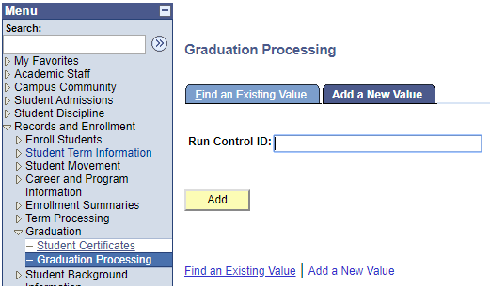
Run Graduation Process – By Batch
Navigate to Records and Enrollment > Graduation > Graduation Processing
In Add a New Value tab, enter the Run Control ID
Click Add button
2
1
3

Slide 7
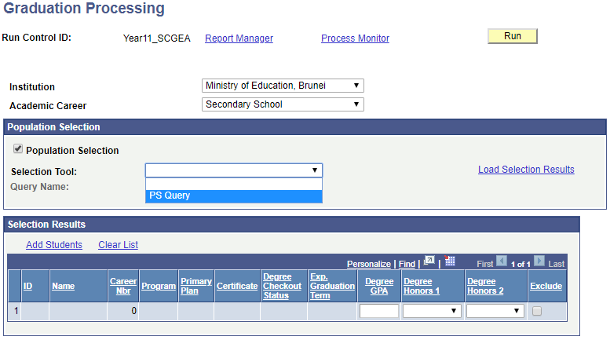
Run Graduation Process – By Batch
Select Academic Career
Ensure the Population Selection checkbox is checked
Select ‘PS Query’ from the Selection Tool field
4
5
6

Slide 8
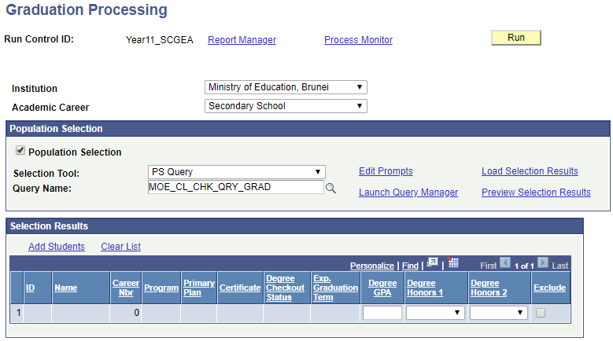
Run Graduation Process – By Batch
Select ‘MOE_CL_CHK_QRY_GRAD’ from Query Name lookup
Click Edit Prompt
Note: Ensure to run
Graduation Process for CCA career as well by using MOE_CCA_CHK_QRY_GRAD
8
7

Slide 9
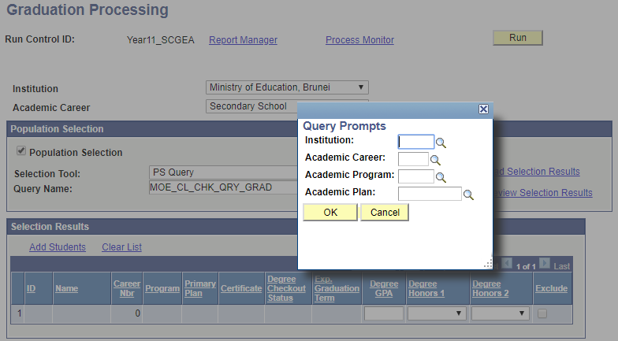
Run Graduation Process – By Batch
Enter Institution, Academic Career, Academic Program and Academic Plan
Click OK button
9
10

Slide 10
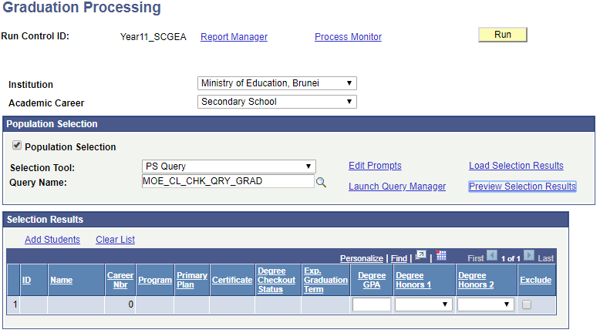
Run Graduation Process – By Batch
Click Preview Selection Results for verification
Click Load Selection Results to populate the students in Selection Results
11
12

Slide 11
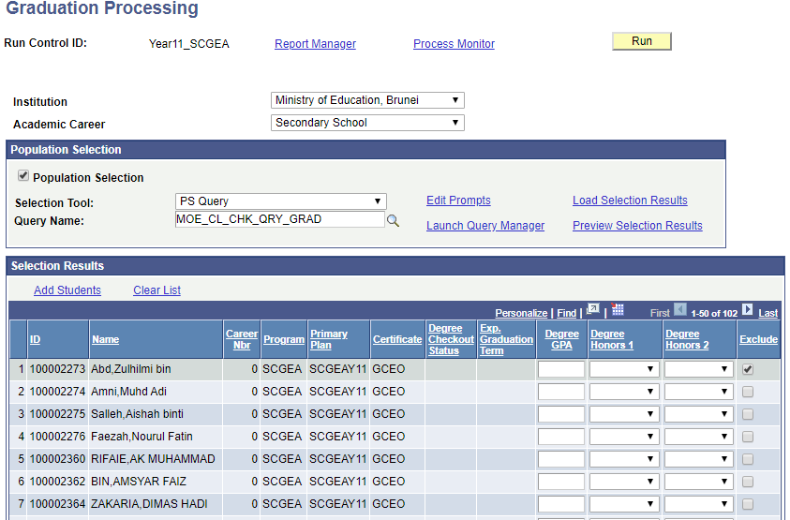
Run Graduation Process – By Batch
Click Add Students link to add more students OR select Exclude checkbox to exclude certain students from graduating

Slide 12
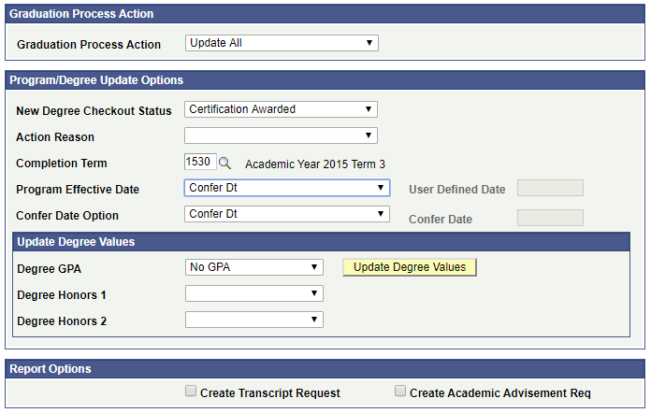
Run Graduation Process – By Batch
Select ‘Update All’ from Graduation Process Action dropdown box
Select ‘Certification Awarded’ from New Degree Checkout Status dropdown box
Select Term from Completion Term lookup
Select ‘Confer Dt’ from Program Effective Date dropdown box
14
15
16
17

Slide 13
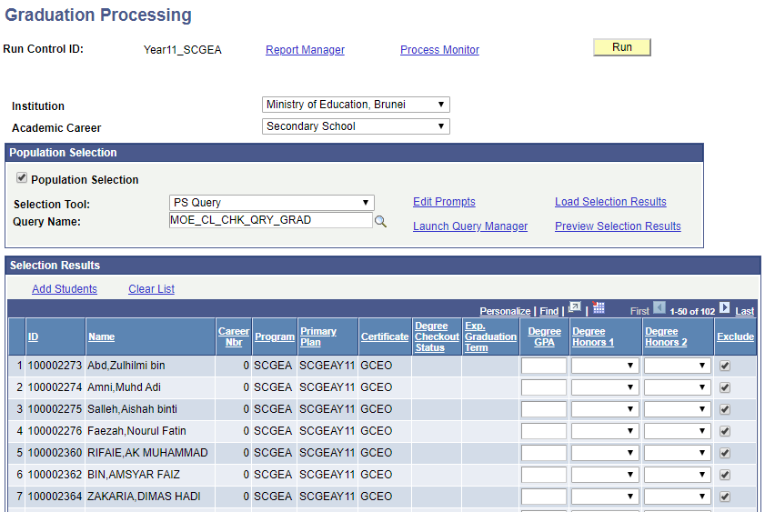
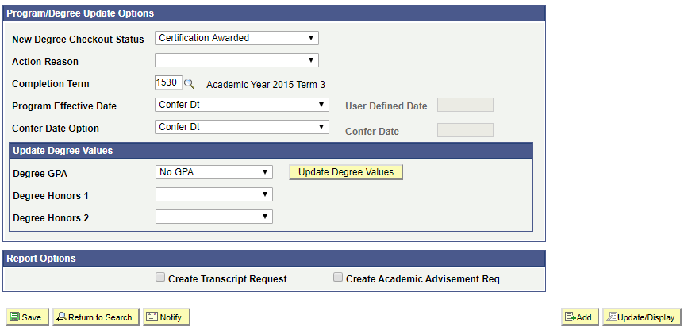
Run Graduation Process – By Batch
Click Save button
Click Run button to run the process
19
18

Slide 14
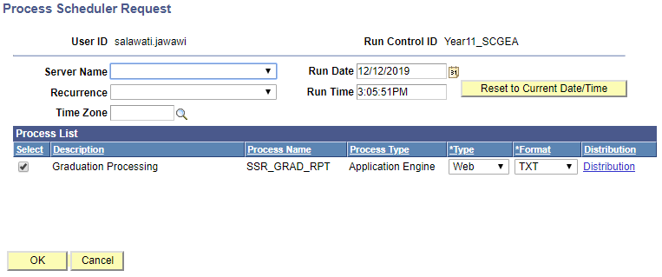
Run Graduation Process – By Batch
Ensure ‘Graduation Processing’ checkbox is ticked
Click OK button
20
21

Slide 15
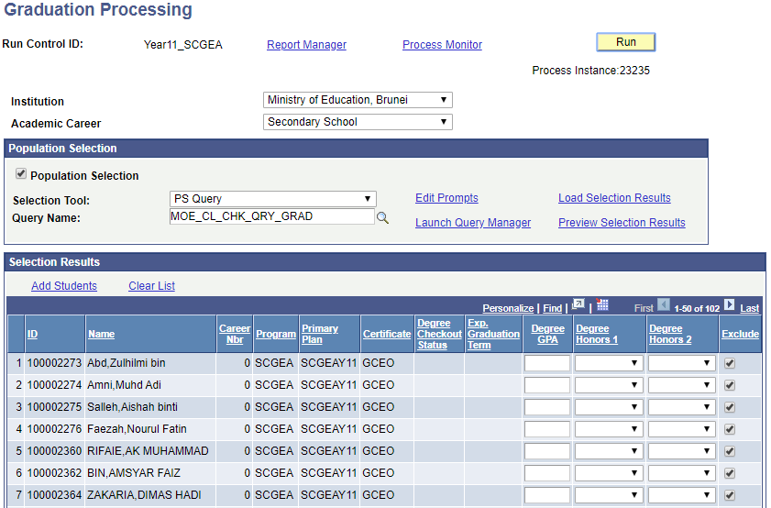
Run Graduation Process – By Batch
A Process Instance number will be assigned once the process has begun
Click Process Monitor link to check the status
23
22

Slide 16
Run Graduation Process – By Batch
By default values:
Run Status = ‘Processing’ or ‘Queued’
Distribution Status = ‘N/A’
Note: This is the same Process Instance number from earlier.

Slide 17
Run Graduation Process – By Batch
Click Refresh button at interval times until
Run Status = ‘Success’
Distribution Status = ‘Posted’

Slide 18
Run Graduation Process – By Batch
25. Click Details link

Slide 19
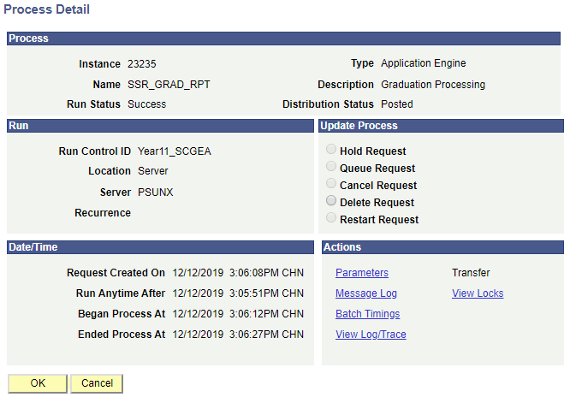
Run Graduation Process – By Batch
Click View Log/Trace link

Slide 20
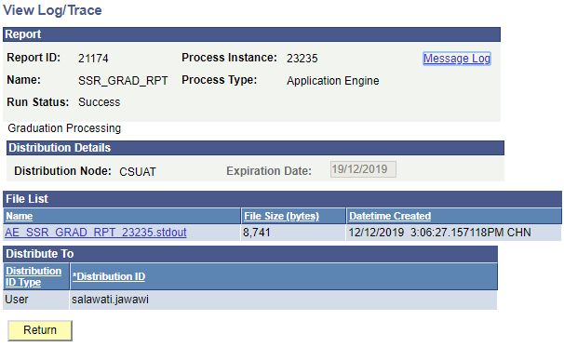
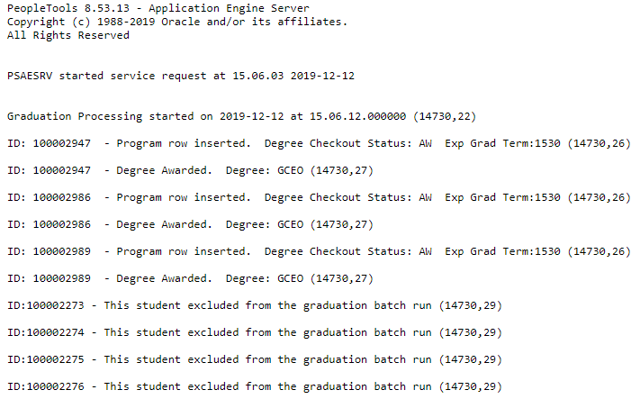
Run Graduation Process – By Batch
27. Click AE_SSR_GRAD_RPT(Instance No.).stdout link to view the summary of the list of graduation students

Slide 21
MANAGE
GRADUATING STUDENTS
Run Graduation Process –
Individually

Slide 22
Flow Chart
Run Graduation Process
By Batch
Individually
Verify Student Program/Plan
Verify Student Certificate

Slide 23
Run Graduation Process – Individually
Navigate to Records and Enrollment > Graduation > Graduation Processing
In Add a New Value tab, enter the Run Control ID
Click Add button
2
1
3

Slide 24
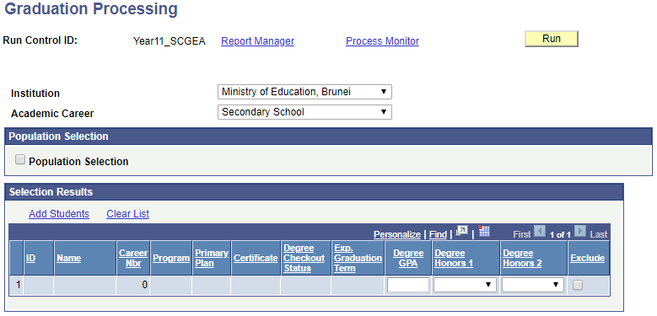
Run Graduation Process – Individually
Select Academic Career
Deselect the Population Selection checkbox
Click Add Students link to add a student
Note: Ensure to run
Graduation Process for CCA career as well.
4
5
6

Slide 25
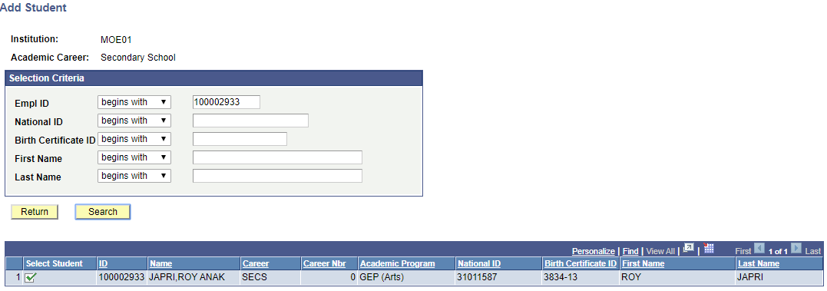
Run Graduation Process – Individually
Enter Student ID
Click Search button
Click the checkbox to select the student
7
8
9

Slide 26
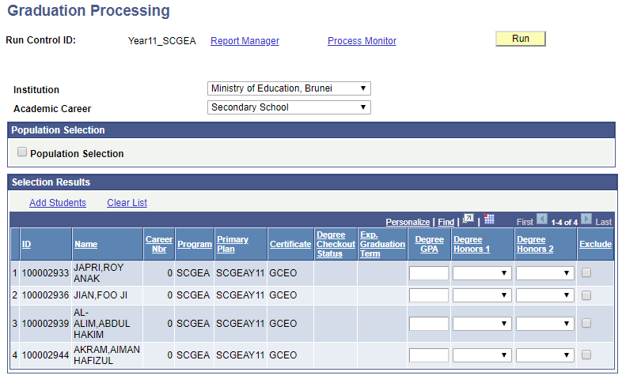
Run Graduation Process – Individually
10. Select Exclude checkbox to exclude certain students from graduating

Slide 27
Run Graduation Process – Individually
Select ‘Update All’ from Graduation Process Action dropdown box
Select ‘Certification Awarded’ from New Degree Checkout Status dropdown box
Select Term from Completion Term lookup
Select ‘Confer Dt’ from Program Effective Date dropdown box
11
12
13
14

Slide 28
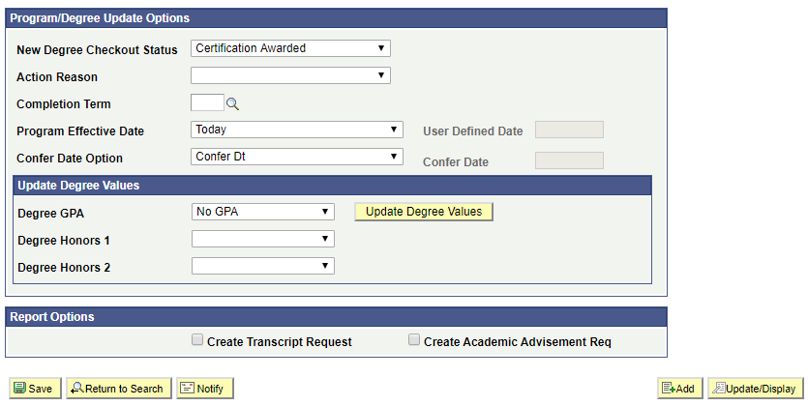
Run Graduation Process – Individually
Click Save button
Click Run button to run the process
16
15

Slide 29
Run Graduation Process – Individually
Ensure ‘Graduation Processing’ checkbox is ticked
Click OK button
17
18

Slide 30
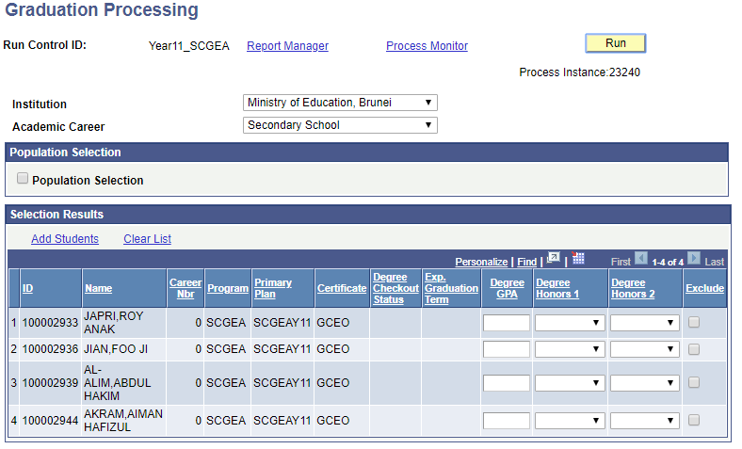
Run Graduation Process – Individually
A Process Instance number will be assigned once the process has begun
Click Process Monitor link to check the status
20
19

Slide 31
Run Graduation Process – Individually
By default values:
Run Status = ‘Processing’ or ‘Queued’
Distribution Status = ‘N/A’
Note: This is the same Process Instance number from earlier.

Slide 32
Run Graduation Process – Individually
Click Refresh button at interval times until
Run Status = ‘Success’
Distribution Status = ‘Posted’

Slide 33
Run Graduation Process – Individually
Click Details link

Slide 34
Run Graduation Process – Individually
Click View Log/Trace link

Slide 35
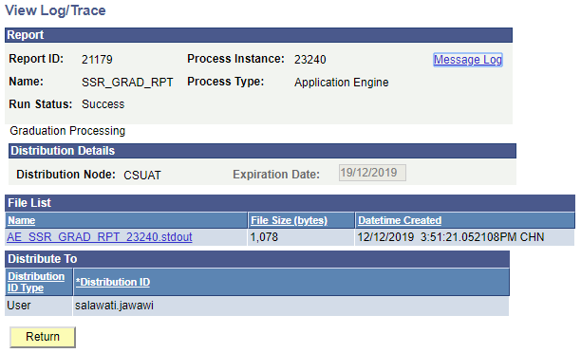
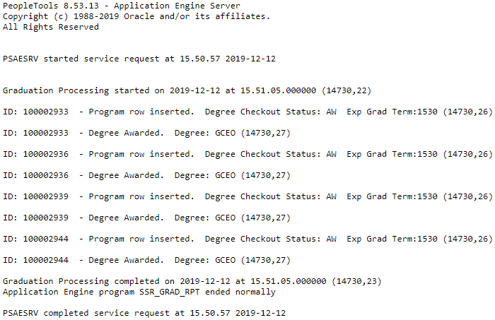
Run Graduation Process – Individually
Click AE_SSR_GRAD_RPT(Instance No.).stdout link to view the summary of the list of graduation students

Slide 36
MANAGE
GRADUATING STUDENTS
Verify Student Program/Plan

Slide 37
Flow Chart
Run Graduation Process
By Batch
Individually
Verify Student Program/Plan
Verify Student Certificate

Slide 38
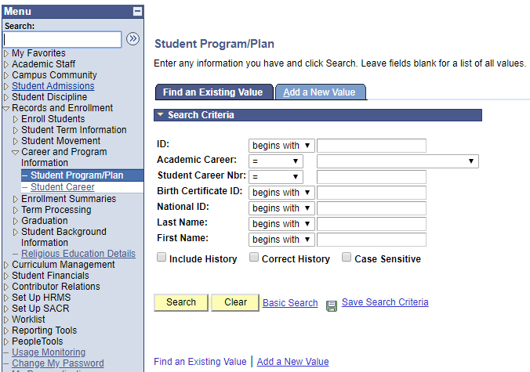
Verify Student Program/Plan
Navigate to Records and Enrollment > Career and Program Information > Student Program/Plan
In Find an Existing Value tab, enter the Student ID
Click Search button
1
2
3

Slide 39
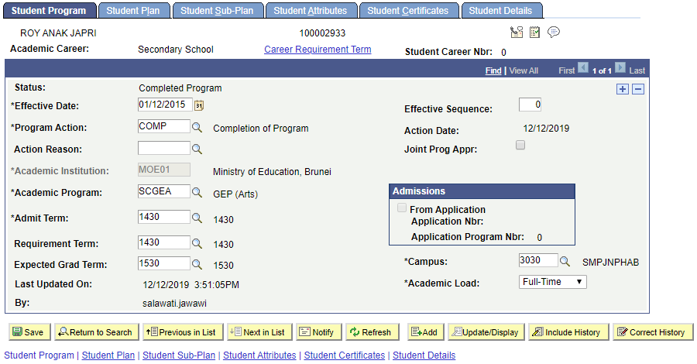
Verify Student Program/Plan
In Student Program tab, verify the Program Action of the latest record is ‘COMP’ – Completion of Program and Status is set to ‘Completed Program’

Slide 40
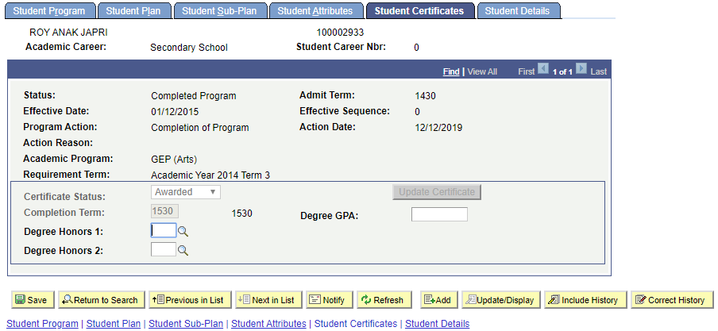
Verify Student Program/Plan
In Student Certificates tab, verify the Certificate Status is updated to ‘Awarded’ and the Completion Term is updated to the term the student graduated

Slide 41
MANAGE
GRADUATING STUDENTS
Verify Student Certificate

Slide 42
Flow Chart
Run Graduation Process
By Batch
Individually
Verify Student Program/Plan
Verify Student Certificate

Slide 43
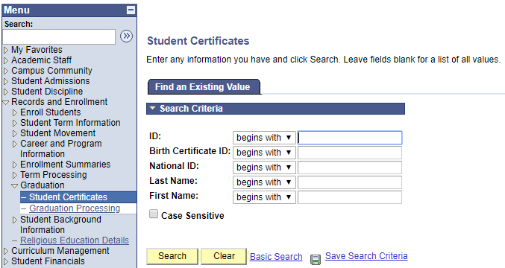
Verify Student Certificate
Navigate to Records and Enrollment > Graduation > Student Certificate
In Find an Existing Value tab, enter the Student ID
Click Search button
1
2
3

Slide 44
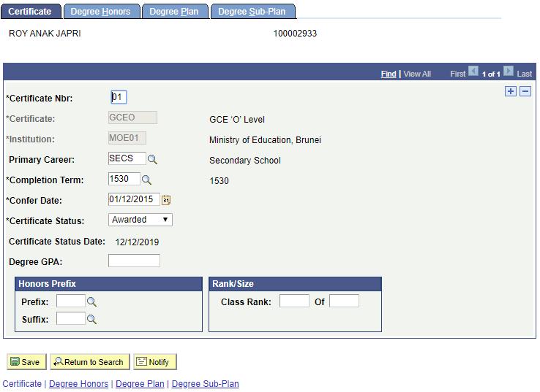
Verify Student Certificate
In Certificate tab, verify the Certificate awarded and Completion Term is updated correctly

Slide 45
End of Presentation
Thank You

