Slide 1
Student Admission Upload New Student

Slide 2
Introduction
Student Upload process allows user to upload students’ personal as well as academic information into the system by filling in the Student Data Template.
User Role:
School Student Registrar

Slide 3
Get student data from Query Viewer
Student Admission Upload New Student

Slide 4
Flow Chart
Where did the student come from?
Private or Arabic school
Government school
Was the student graduated from previous school?
No
Download Student Data Template
Update the Student Data Template and save as .csv format
Upload Student Data Template
Yes
Get student data from Query Viewer
Verify Uploaded Student

Slide 5
Get student data from Query Viewer
To get student detail from previous career
2. Enter : MOE_RPT_RE_006
3. Click on Search
1. Navigate: Reporting Tools > Query > Query Viewer

Slide 6
Get student data from Query Viewer
4. Click on HTML to view the list

Slide 7
Get student data from Query Viewer
5. Enter the Institution, Campus, Career and Term then click View Results
6. Click on View Results button
Note: Term entered should be the final term of the current academic year. i.e 1930 for student to upload to year 2020

Slide 8
Get student data from Query Viewer
7. Click Ctrl + F and enter the Student Name or ID to search for the student

Slide 9
Get student data from Query Viewer
8. Copy the Students’ information into Student Data Template

Slide 10
Download Student Data Template
Student Admission Upload New Student

Slide 11
Flow Chart
Where did the student come from?
Private or Arabic school
Government school
Was the student graduated from previous school?
No
Download Student Data Template
Update the Student Data Template and save as .csv format
Upload Student Data Template
Yes
Get student data from Query Viewer
Verify Uploaded Student

Slide 12
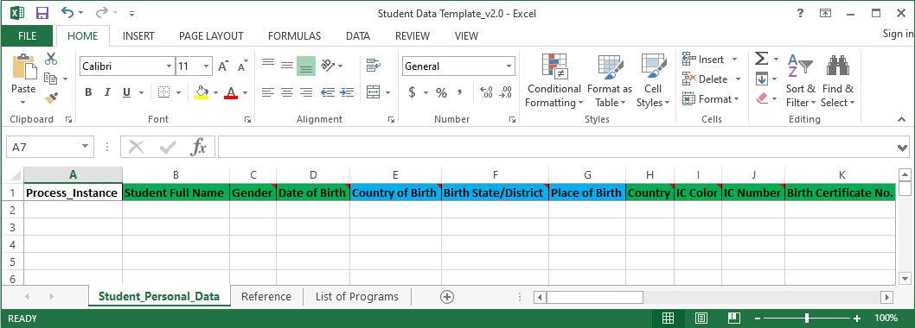
Download Student Data Template
User needs to fill in the Student Data template before proceeding to upload students into the system.
Download Student Data Template here.
Example of how Student Data Template looks like

Slide 13
Update the Student Data Template and save as .csv format
Student Admission Upload New Student

Slide 14
Flow Chart
Where did the student come from?
Private or Arabic school
Government school
Was the student graduated from previous school?
No
Download Student Data Template
Update the Student Data Template and save as .csv format
Upload Student Data Template
Yes
Get student data from Query Viewer
Verify Uploaded Student

Slide 15
Prepare Student Data Template
Prepare the template by filling in the student details. Please ensure the following:
ONE template file for ONE career. i.e. PRES and PRIM should be in separate templates
ONE template file for ONE campus.
Note: This is because the system only allows users to upload 1 career and 1 campus per upload
Country for IC and Citizenship should be filled as BRN even if student is not from Brunei.

Slide 16
Update the Student Data Template and save as .csv format
2. Select student’s Gender from the dropdown list:
M for Male student
F for Female student
1. Enter Student’s Full Name
Note: Download the instructions on how to fill in the Student Data Template here.

Slide 17
Update the Student Data Template and save as .csv format
3. Enter student’s Date of Birth with DD-MM-YYYY format
4. Select Country of Birth from dropdown list
Note: Download the instructions on how to fill in the Student Data Template here.

Slide 18
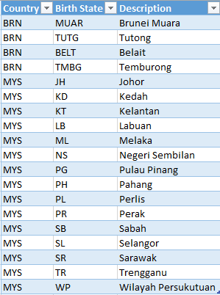
Update the Student Data Template and save as .csv format
5. Select Birth State from dropdown list.
NOTE: Birth State is only available for Brunei (BRN) and Malaysia (MYS) as shown in the table on the right. Leave Birth State for other countries empty
Note: Download the instructions on how to fill in the Student Data Template here.

Slide 19
Update the Student Data Template and save as .csv format
6. Enter student’s Place of Birth.
NOTE: Max number of character for Place of Birth is 30 characters
Note: Download the instructions on how to fill in the Student Data Template here.

Slide 20
Update the Student Data Template and save as .csv format
NOTE: IC Color and IC Number are only applicable for students who have IC
7. Country should always be BRN regardless if the students are foreigners
8. Select student’s IC Color from the dropdown list:
ICY for Yellow IC
ICR for Red IC
ICG for Green IC
Note: Download the instructions on how to fill in the Student Data Template here.

Slide 21
Update the Student Data Template and save as .csv format
NOTE: IC Color and IC Number are only applicable for students who have IC
10. Enter student’s Birth Certificate No.
9. Enter student’s Brunei IC Number
NOTE: Max number of character for Birth Certificate No. is 16 characters
Note: Download the instructions on how to fill in the Student Data Template here.

Slide 22
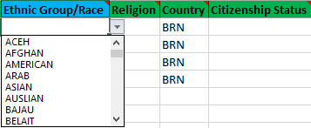
Update the Student Data Template and save as .csv format
11. Select student’s Ethnic Group/Race from dropdown list
Note: Download the instructions on how to fill in the Student Data Template here.

Slide 23
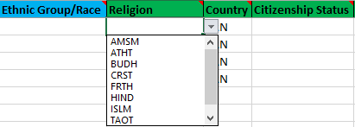
Update the Student Data Template and save as .csv format
12. Select student’s Religion from dropdown list
Note: Download the instructions on how to fill in the Student Data Template here.

Slide 24
Update the Student Data Template and save as .csv format
14. Select from dropdown list student’s Citizenship Status:
1 for Citizen
2 for Citizen by Registration
3 for Permanent Resident
4 for Stateless
5 for Non-citizen
13. Country should always be BRN regardless if the students are foreigners
Note: Download the instructions on how to fill in the Student Data Template here.

Slide 25
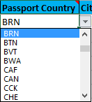
Update the Student Data Template and save as .csv format
NOTE: Passport details are recommended to be filled in for foreign students for Student Pass purposes
18. Select Passport Country from dropdown list
15. Enter student’s Passport No.
16. Enter student’s Passport Issue Date
17. Enter student’s Passport Expiry Date
NOTE: Issue Date and Expiry Date should be in DD-MM-YYYY format
Note: Download the instructions on how to fill in the Student Data Template here.

Slide 26
Update the Student Data Template and save as .csv format
NOTE: Only if passport details are available
NOTE: Max number of character for City is 30 characters
19. Enter the City where the passport was made
20. Enter student’s passport’s Issuing Authority
21. Enter the passport’s Comments/Other Information if any
NOTE: Max number of character for Issuing Authority is 50 characters
Note: Download the instructions on how to fill in the Student Data Template here.

Slide 27
Update the Student Data Template and save as .csv format
22. Enter student’s Home Phone Number
23. Enter student’s Mobile Phone Number
24. Enter student’s school Email Address
NOTE:
Only for Brunei phone numbers.
Enter only 1 home and 1 mobile phone number per student
Note: Download the instructions on how to fill in the Student Data Template here.

Slide 28
Update the Student Data Template and save as .csv format
25. Enter student’s address:
House/Lot No.
Simpang
Jalan
Kampong
26. Select District from the dropdown list
NOTE: Ensure there is no comma (,) in the addresses
Note: Download the instructions on how to fill in the Student Data Template here.

Slide 29
Update the Student Data Template and save as .csv format
27. Enter the student’s Post Code
28. Enter the student’s Rank Among Siblings
Note: Download the instructions on how to fill in the Student Data Template here.

Slide 30
Update the Student Data Template and save as .csv format
29. Select student’s Academic Career from dropdown list
NOTE: ONE template file should only contain students with the same career
Note: Download the instructions on how to fill in the Student Data Template here.

Slide 31
Update the Student Data Template and save as .csv format
30. Select student’s Academic Program from dropdown list
Note: Download the instructions on how to fill in the Student Data Template here.

Slide 32
Update the Student Data Template and save as .csv format
31. Select student’s Academic Plan from dropdown list
Note: Download the instructions on how to fill in the Student Data Template here.

Slide 33
Update the Student Data Template and save as .csv format
NOTE: ONE template file should only contain students in the same campus.
32. Enter the Campus code
Note: Download the instructions on how to fill in the Student Data Template here.

Slide 34
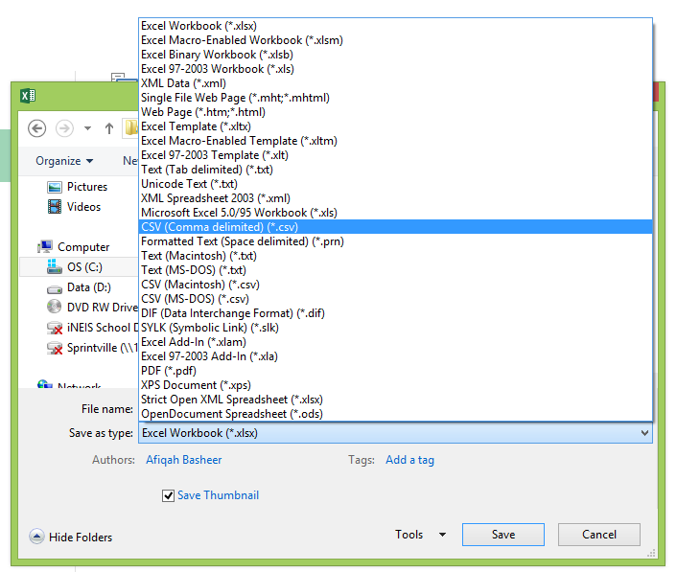
Update the Student Data Template and save as .csv format
34. File Naming Format:
School Code_Academic Career_Term
Example: 1028_PRIM_2010
33. Save file as CSV (Comma delimited) type.

Slide 35
Upload Student Data Template
Student Admission Upload New Student

Slide 36
Flow Chart
Where did the student come from?
Private or Arabic school
Government school
Was the student graduated from previous school?
No
Download Student Data Template
Update the Student Data Template and save as .csv format
Upload Student Data Template
Yes
Get student data from Query Viewer
Verify Uploaded Student

Slide 37
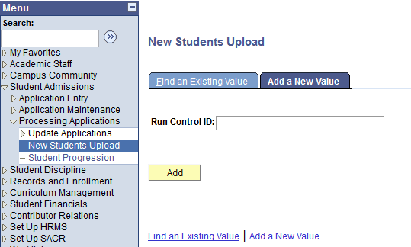
Upload Student Data Template
1. Navigate to Student Admissions > Processing Applications > New Students Upload
2. Click the Add a New Value tab.
3. Enter a new Run Control ID.
4. Click on Add button.

Slide 38
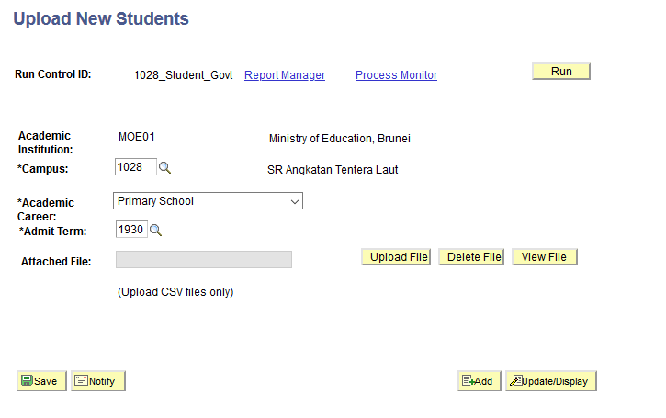
Upload Student Data Template
5. Select the Campus, Academic Career, Admit Term.
6. Upload the .csv file.
Note: Admit Term should be the term the student enter the school

Slide 39
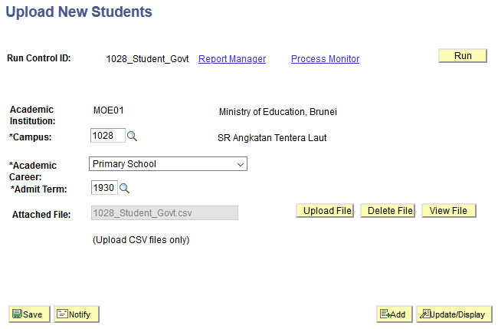
Upload Student Data Template
7. Click the Run button.

Slide 40
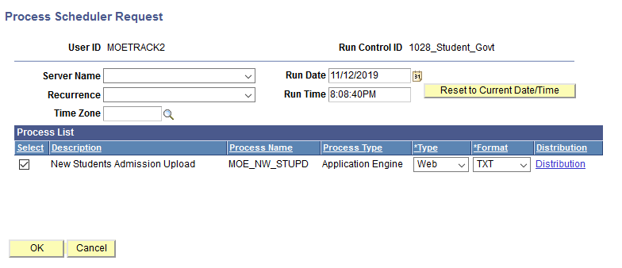
Upload Student Data Template
8. Ensure the MOE_NW_STUPD check box is ticked.
9. Click the OK button.

Slide 41
Upload Student Data Template
10. Click the Process Monitor link.
Process Instance: 14581
*Take note of the
Process Instance number

Slide 42
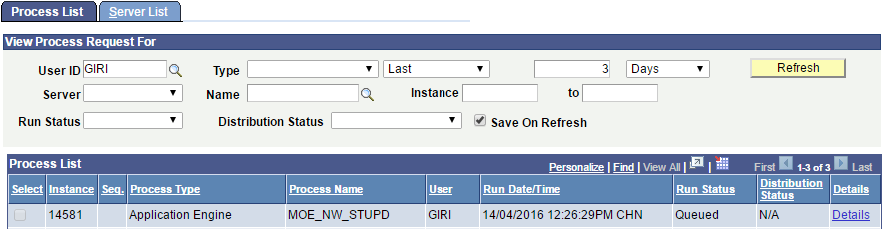
Upload Student Data Template
11. You should see that:
Run Status: Queued
Distribution Status: N/A
*The Process Instance number should be the same as earlier
12. Click the Refresh button at interval time.

Slide 43
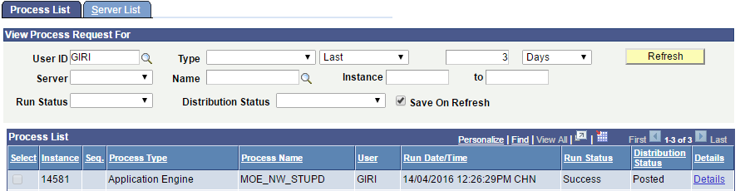
Upload Student Data Template
13. Click the Refresh button at interval time until:
Run Status: Success
Distribution Status: Posted
14. Click the Details link.

Slide 44
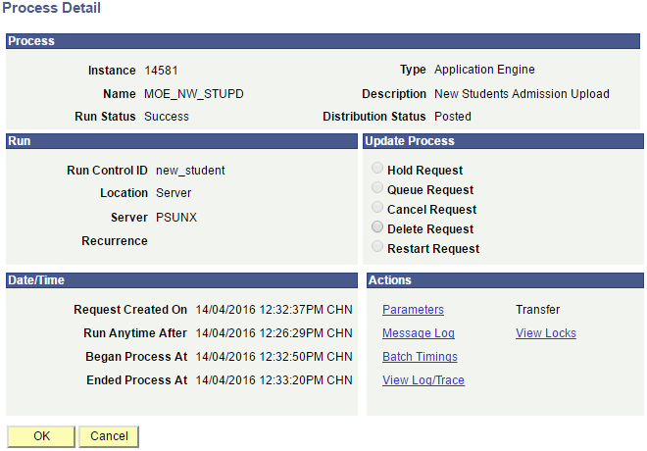
Upload Student Data Template
15. Click the View Log/Trace link.

Slide 45
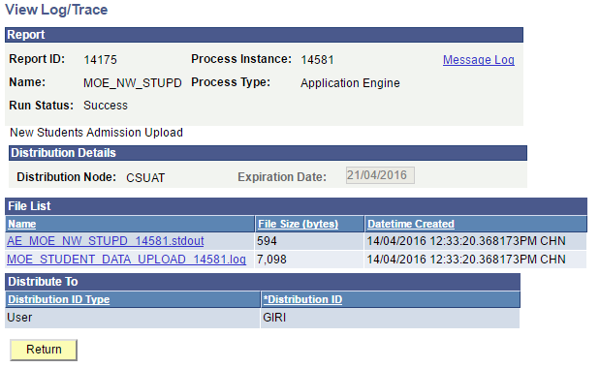
Upload Student Data Template
16. Click the .log link to view summary of uploaded students.

Slide 46
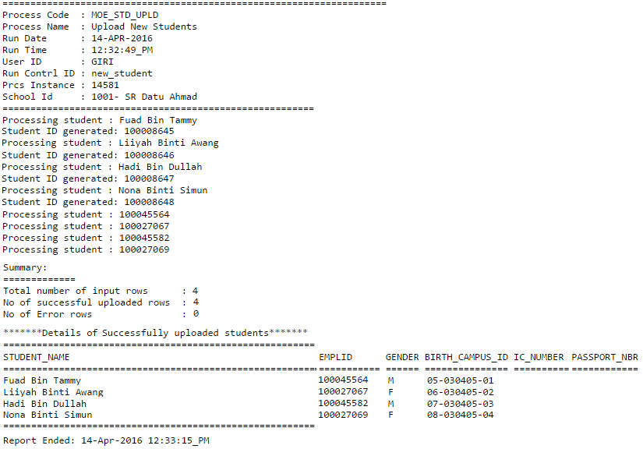
Upload Student Data Template
The summary shows details of:
Total number of students in the file,
Number of successfully uploaded student, and
Number of students unsuccessfully uploaded.
Details of successfully uploaded students.

Slide 47
Example of the Uploaded File With Error
The .log file showing the summary of the result and the student(s) with the error. Hence, recheck and correct the details for the specific student(s) in the excel file before reuploading

Slide 48
Verify Uploaded Student
Student Admission Upload New Student

Slide 49
Flow Chart
Where did the student come from?
Private or Arabic school
Government school
Was the student graduated from previous school?
No
Download Student Data Template
Update the Student Data Template and save as .csv format
Upload Student Data Template
Yes
Get student data from Query Viewer
Verify Uploaded Student

Slide 50
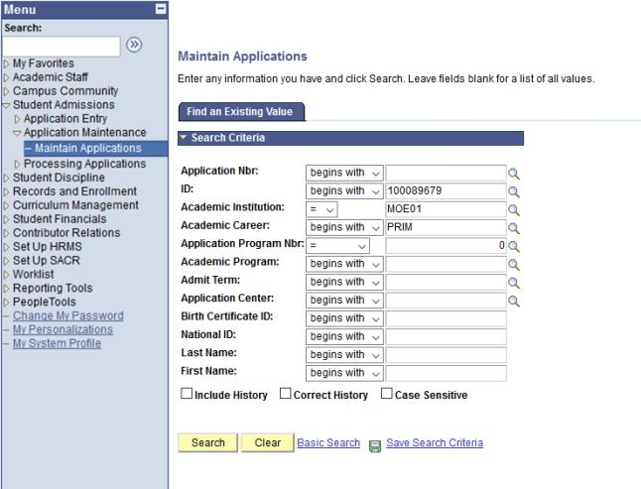
Verify Uploaded Student
1. Navigate to Student Admissions > Application Maintenance > Maintain Applications.
2. Enter the student’s ID, Academic Institution and Academic Career
3. Click on Search button.

Slide 51
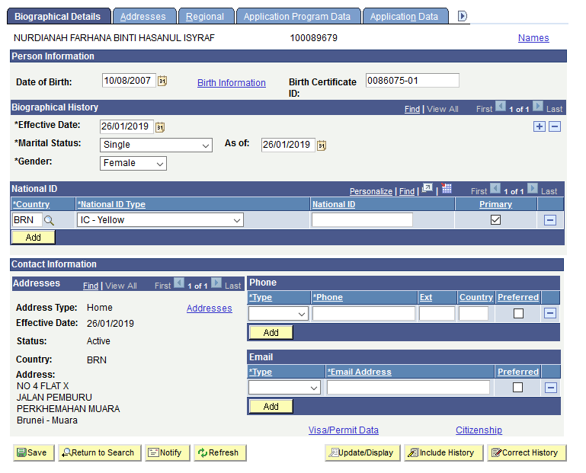
Verify Uploaded Student
4. Verify student Biographical Details data.
5. Click on Citizenship link.

Slide 52
Verify Uploaded Student
6. Verify Citizenship details.
7. Click on “Cancel” to return to previous page.

Slide 53
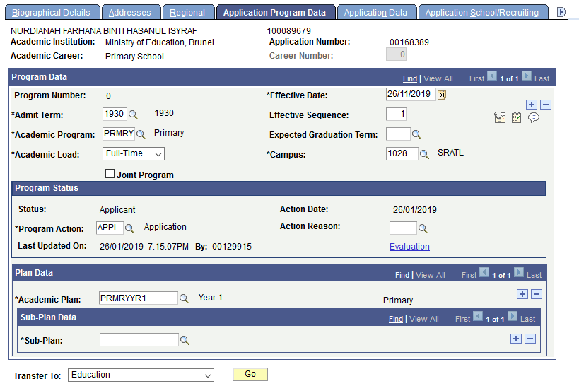
Verify Uploaded Student
8. Click the Application Program Data tab.
9. Verify student Program Data details.

Slide 54
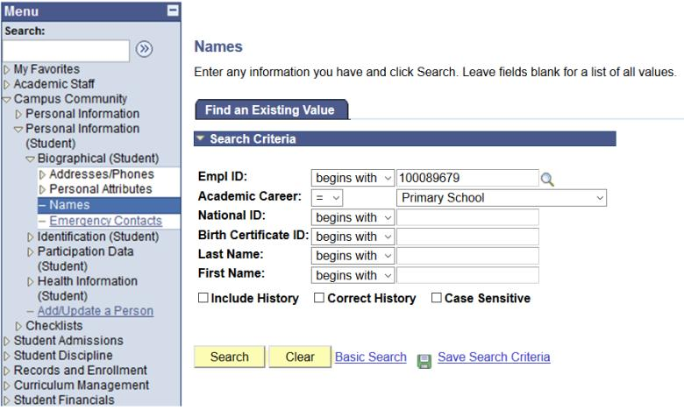
Verify Uploaded Student
10. Navigate to Campus Community > Personal Information (Student) > Biographical > Names.
11. Enter the student’s ID and Academic Career
12. Click on Search button.

Slide 55
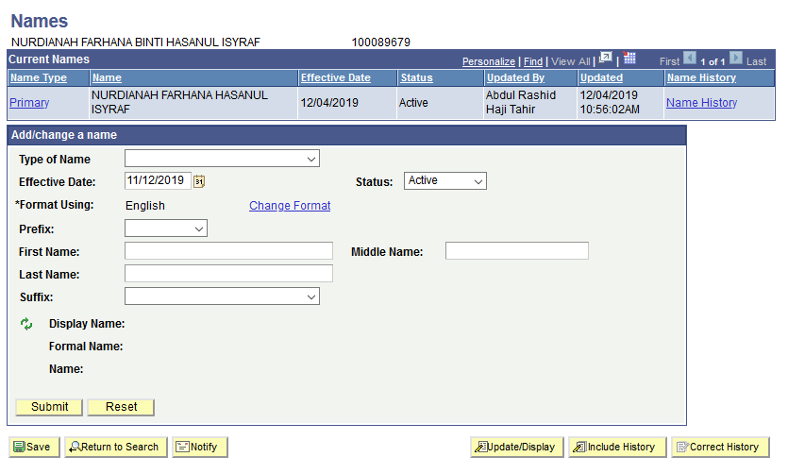
Verify Uploaded Student
13. Click on Primary link.

Slide 56
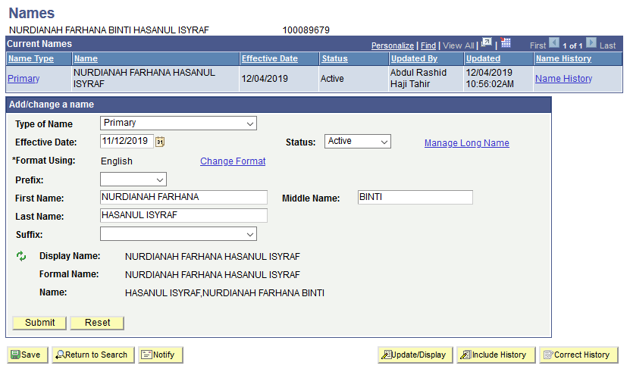
Verify Uploaded Student
14. Click on Manage Long Name link.

Slide 57
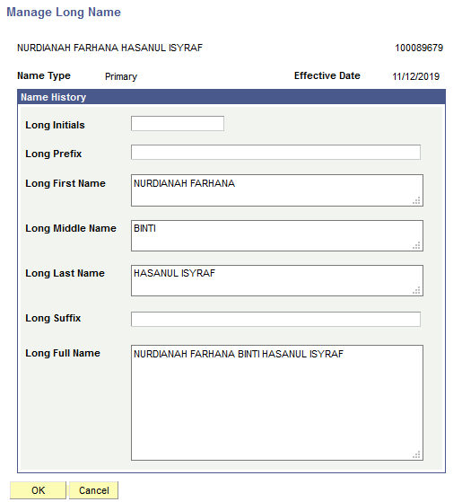
Verify Uploaded Student
15. Verify student Name details.

Slide 58
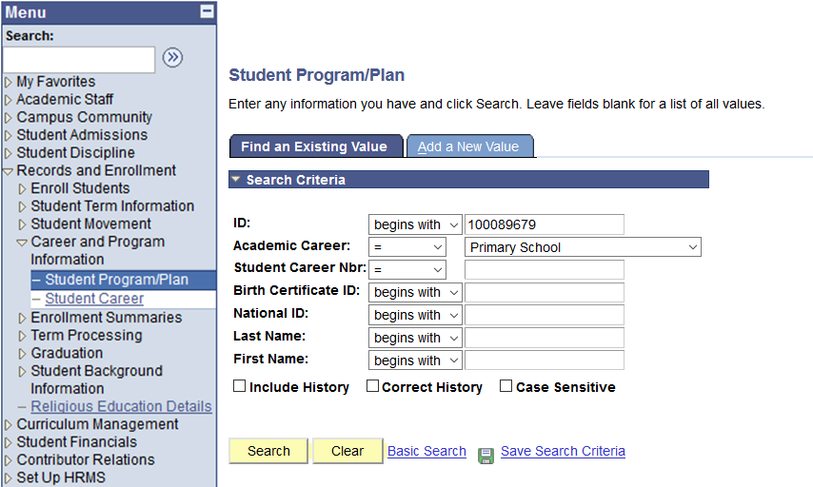
Verify Uploaded Student
16. Navigate to Records and Enrollment > Career and Program Information > Student Program/Plan.
17. Enter the student’s ID and Academic Career
18. Click on Search button.

Slide 59
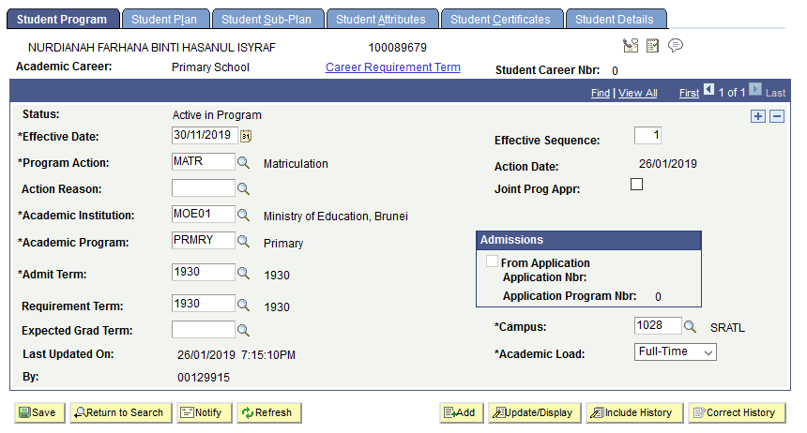
Verify Uploaded Student
19. Verify Student Program details.

Slide 60
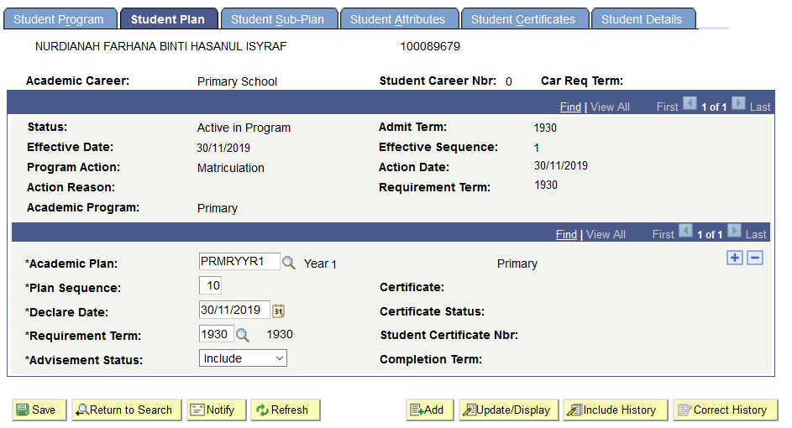
Verify Uploaded Student
20. Click the Student Plan tab.
21. Verify Student Plan details.

Slide 61
End of Presentation
Thank You

