Slide 1
Manage Student Progression

Slide 2
Introduction
This function allows user to progress students within the same Academic Program.
E.g. from year 1 to 2, from year 7 to 8, from year 9 to 10, etc.
However, as a prerequisite, user will need to run Attendance Statistics Calculation process before proceeding to progress students.
User Role:
School Student Registrar

Slide 3
Manage Student Progression
Run Attendance Statistics Calculation Process

Slide 4
Flow Chart
Run Attendance Statistics Calculation Process
Run Manage Student Progression Process
Verify Student Program/Plan
Progress Student Manually
Retain Student
Edit Wrong Progression

Slide 5
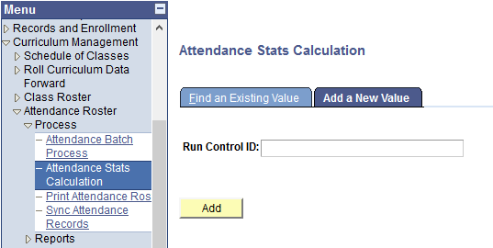
Run Attendance Statistics Calculation Process
1. Navigate: Curriculum Management > Attendance Roster > Process > Attendance Stats Calculation
2. Click on Add a New Value tab
3. Enter new Run Control ID
4. Click the Add button

Slide 6
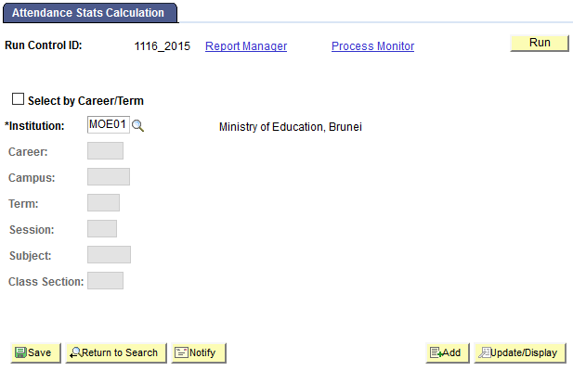
Run Attendance Statistics Calculation Process
6. Click on the Run button
5. Untick the Select by Career/Term checkbox to run the process for all classes in the school

Slide 7
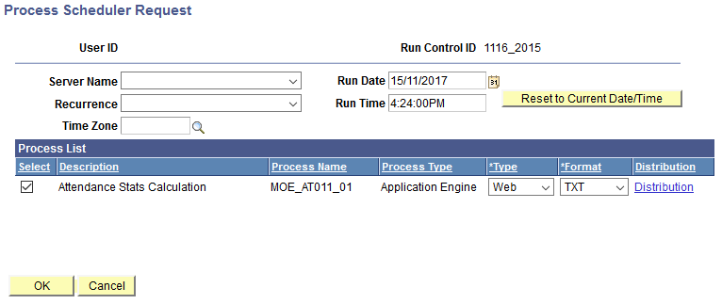
Run Attendance Statistics Calculation Process
7. Ensure the Attendance Stats Calculation checkbox is ticked
8. Click on OK button

Slide 8
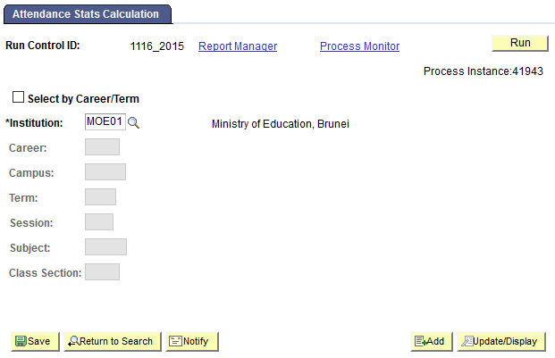
Run Attendance Statistics Calculation Process
*Take note of Process Instance number
9.Click the Process Monitor to check the status of the process

Slide 9
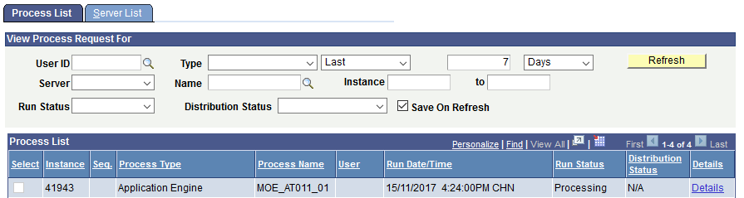
Run Attendance Statistics Calculation Process
11. Click Refresh button at interval times
Check for Process Name with MOE_AT011_01 and the Process Instance number should be the same as earlier
10. You should see that:
Run Status: Processing or Queued and
Distribution Status: N/A

Slide 10
Run Attendance Statistics Calculation Process
12. Click Refresh at interval times until
Run Status: Success and
Distribution Status: Posted

Slide 11
Manage Student Progression
Run Manage Student Progression Process

Slide 12
Flow Chart
Run Attendance Statistics Calculation Process
Run Manage Student Progression Process
Verify Student Program/Plan
Progress Student Manually
Retain Student
Edit Wrong Progression

Slide 13
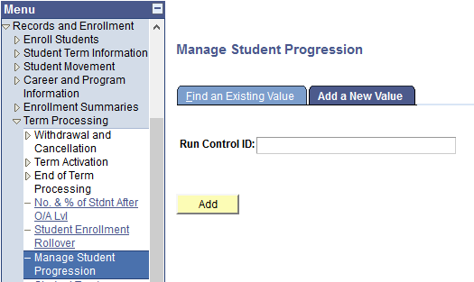
Run Manage Student Progression Process
2. Click on Add a New Value tab
1. Navigate: Records and Enrollment > Term Processing > Manage Student Progression
3. Enter new Run Control ID
4. Click the Add button

Slide 14
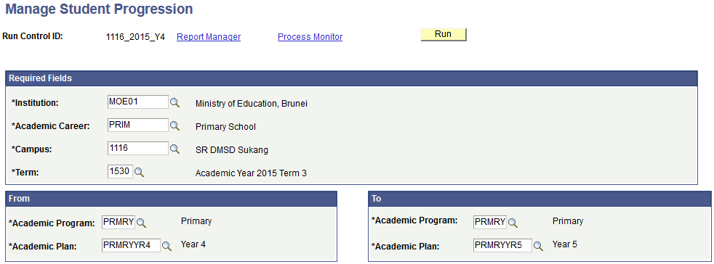
Run Manage Student Progression Process
8. Click the Run button
NOTE: Term should be the last term of the current Academic Year
5. Enter the Academic Career, Campus and Term fields
NOTE: Academic Program should be the same in “From” and “To” boxes
6. Enter the students’ Academic Program and current Academic Plan
7. Enter the students’ Academic Program and new Academic Plan

Slide 15
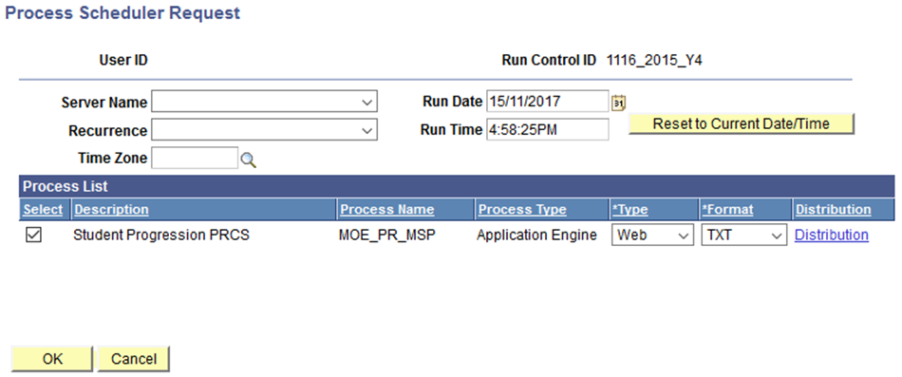
Run Manage Student Progression Process
10. Click on OK button
9. Ensure the Student Progression PRCS checkbox is ticked

Slide 16
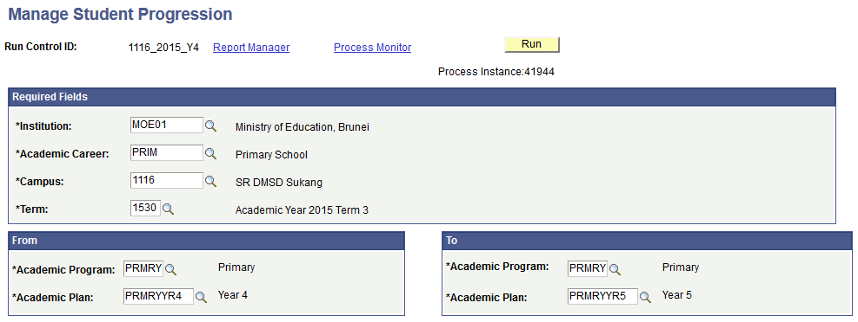
Run Manage Student Progression Process
11.Click the Process Monitor to check the status of the process
*Take note of Process Instance number

Slide 17
Run Manage Student Progression Process
13. Click Refresh button at interval times
*The Process Instance number should be the same as earlier
12. You should see that:
Run Status: Processing or Queued and
Distribution Status: N/A

Slide 18
Run Manage Student Progression Process
14. Click Refresh at interval times until
Run Status: Success and
Distribution Status: Posted
15. Click on Details link

Slide 19
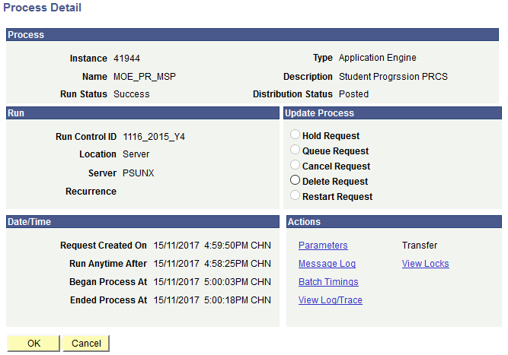
Run Manage Student Progression Process
16. Click on the View Log/Trace link

Slide 20
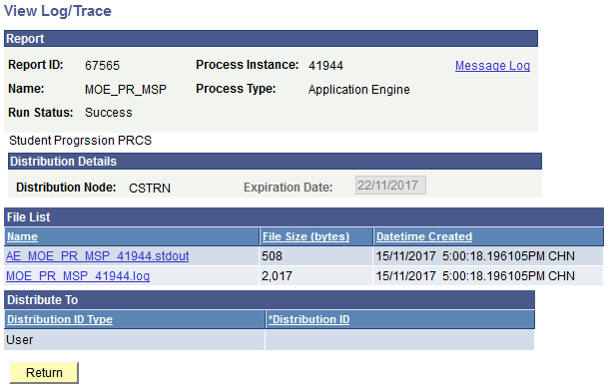
Run Manage Student Progression Process
17. Click on the .log link to view the progression result

Slide 21
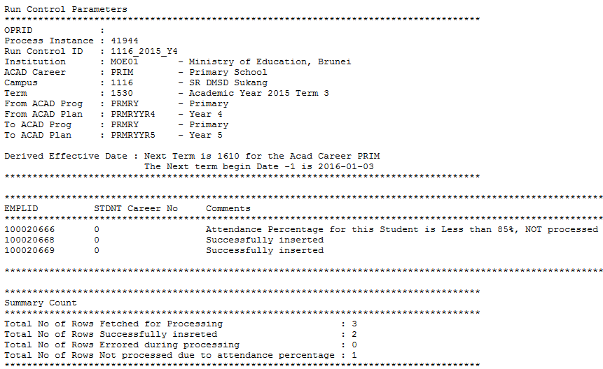
Run Manage Student Progression Process
The progression result page shows the students who have been successfully progressed as well as those who did not due to attendance percentage of less than 85%

Slide 22
Manage Student Progression
Verify Student Program/Plan

Slide 23
Flow Chart
Run Attendance Statistics Calculation Process
Run Manage Student Progression Process
Verify Student Program/Plan
Progress Student Manually
Retain Student
Edit Wrong Progression

Slide 24
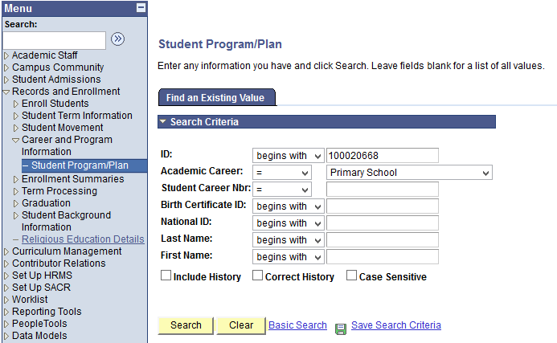
Verify Student Program/Plan
1. Navigate: Records and Enrollment > Career and Program Information > Student Program/Plan
2. Enter the student’s ID and Academic Career
3. Click on the Search button

Slide 25
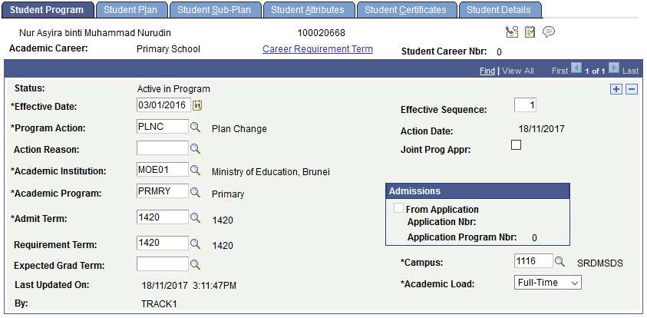
Verify Student Program/Plan
4. In the Student Program tab, ensure that:
- Effective Date should be a day before the start of the term
- Program Action should be PLNC (Plan Change)
- Academic Program should be the same program

Slide 26
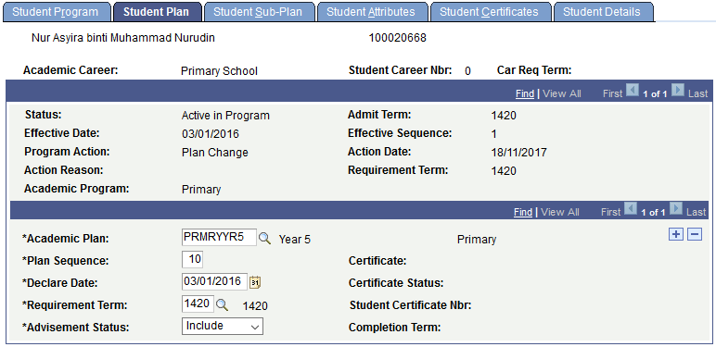
Verify Student Program/Plan
5. In the Student Plan tab, ensure that:
Academic Plan should be next year’s plan

Slide 27
Manage Student Progression
Progress Student Manually

Slide 28
Flow Chart
Run Attendance Statistics Calculation Process
Run Manage Student Progression Process
Verify Student Program/Plan
Progress Student Manually
Retain Student
Edit Wrong Progression

Slide 29
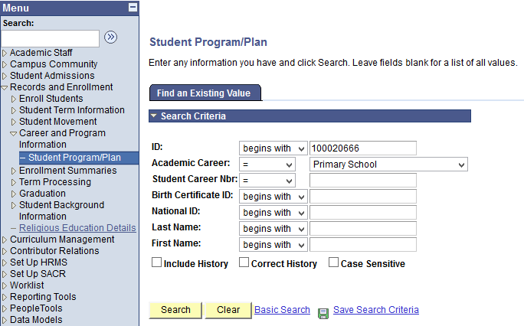
Progress Student Manually
1. Navigate: Records and Enrollment > Career and Program Information > Student Program/Plan
2. Enter the student’s ID and Academic Career
3. Click on the Search button

Slide 30
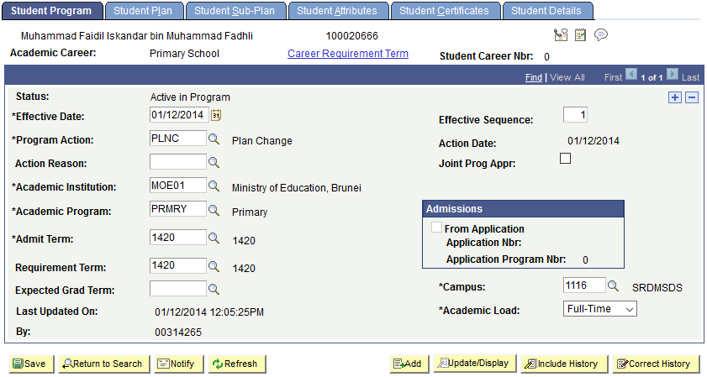
Progress Student Manually
5. Click on the “+” button
4. Click on Include History button

Slide 31
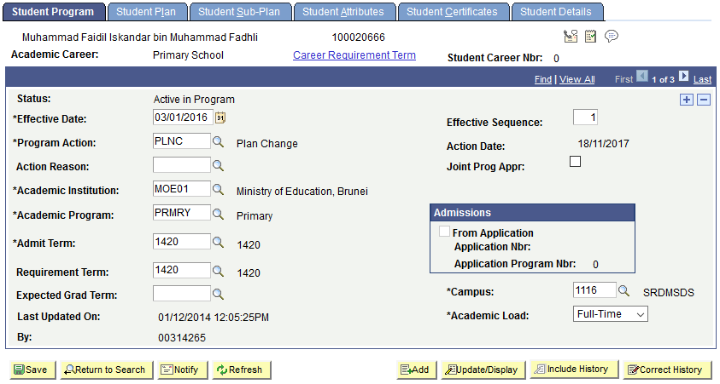
Progress Student Manually
6. Set Effective Date as of one day before the start of the new term
7. Enter the Program Action as PLNC

Slide 32
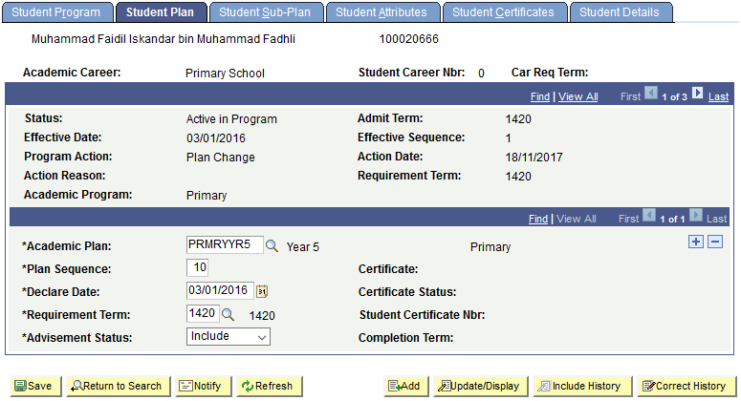
Progress Student Manually
8. Click on Student Plan tab
9. Change the Academic Plan to next year’s plan
10. Change the Declare Date to the same date as the Effective Date
11. Click on the Save button

Slide 33
Manage Student Progression
Retain Student

Slide 34
Flow Chart
Run Attendance Statistics Calculation Process
Run Manage Student Progression Process
Verify Student Program/Plan
Progress Student Manually
Retain Student
Edit Wrong Progression

Slide 35
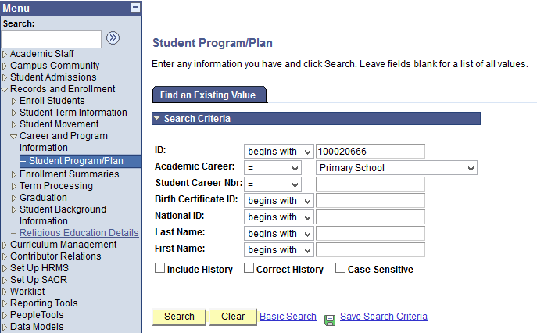
Retain Student
1. Navigate: Records and Enrollment > Career and Program Information > Student Program/Plan
2. Enter the student’s ID and Academic Career
3. Click on the Search button

Slide 36
Retain Student
5. Click on the “+” button
4. Click on Include History button

Slide 37
Retain Student
6. Change the Effective Date as of one day before the start of the new term
7. Enter the Program Action as “DATA”

Slide 38
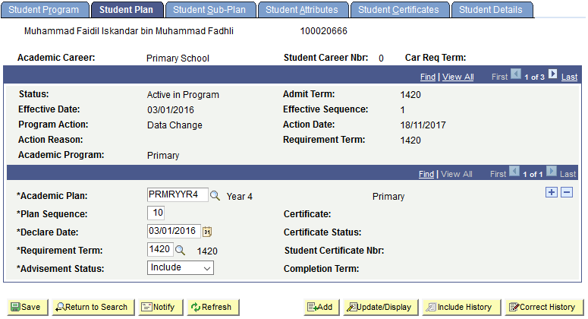
Retain Student
8. Click on Student Plan tab
9. Ensure the Academic Plan is the retaining plan
10. Change the Declare Date to the same date as the Effective Date
11. Click on the Save button

Slide 39
Manage Student Progression
Edit Wrong Progression

Slide 40
Edit Wrong Progression
This function is to allow users to correct the student’s record which has been progressed wrongly.
i.e. Student was progressed to Year 4 in Academic Year 2020, but is supposed to be retained.

Slide 41
Flow Chart
Run Attendance Statistics Calculation Process
Run Manage Student Progression Process
Verify Student Program/Plan
Progress Student Manually
Retain Student
Edit Wrong Progression

Slide 42
Edit Wrong Progression
1. Navigate: Records and Enrollment > Career and Program Information > Student Program/Plan
2. Enter the student’s ID and Academic Career
3. Click on the Search button

Slide 43
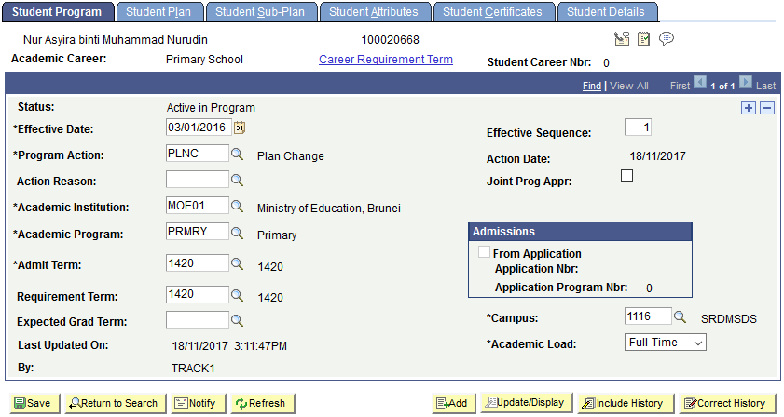
Edit Wrong Progression
4. Click on Correct History button

Slide 44
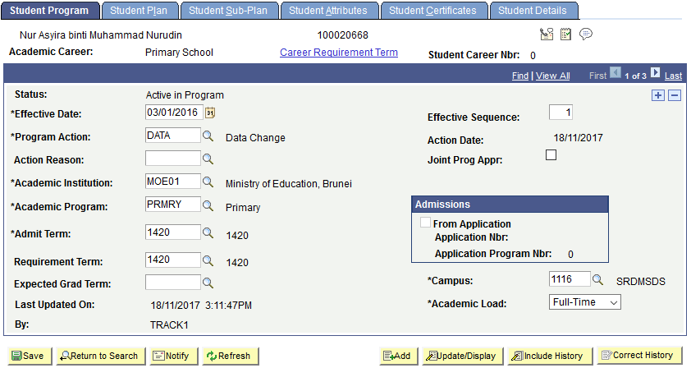
Edit Wrong Progression
5. Ensure the Effective Date is a day before the start of the new term
6. Change the Program Action from “PLNC” to “DATA”

Slide 45
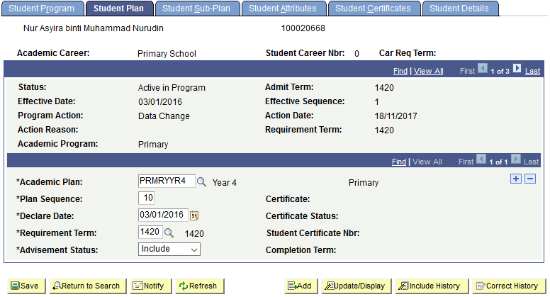
Edit Wrong Progression
7. Click on the Student Plan tab
8. Change the Academic Plan to the retaining plan
9. Ensure the Declare Date is the same date as the Effective Date
10. Click on the Save button

Slide 46
End of Presentation
Thank You

