Slide 1
SAPYR9 Student Progression

Slide 2
Introduction
This process allows user to progress Year 9 Special Applied Program (SAPYR9) students to their specialized plans by uploading the updated SAPYR9 file, which can be obtained from Query Viewer
User Role:
School Student Registrar
NOTE: This process is only applicable for Secondary career students

Slide 3
Download List of SAPYR9 Students
SAPYR9 Student Progression

Slide 4
Flow Chart
Download List of
SAPYR9 Students
Update the file and save as .CSV format
Upload the updated SAPYR9 File
Verify Student Program/Plan

Slide 5
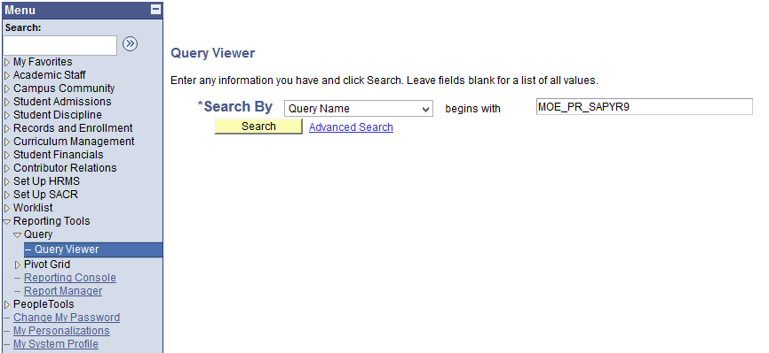
Download List of SAPYR9 Students
2. Enter : MOE_PR_SAPYR9
3. Click on Search
1. Navigate: Reporting Tools > Query > Query Viewer

Slide 6
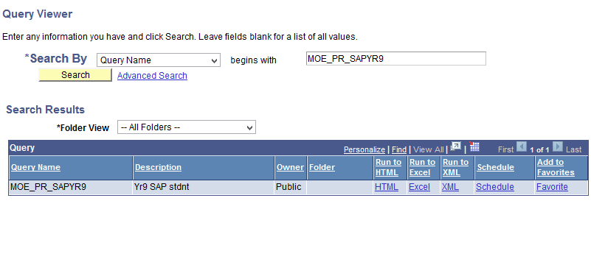
Download List of SAPYR9 Students
4. Click on Excel to download the list

Slide 7
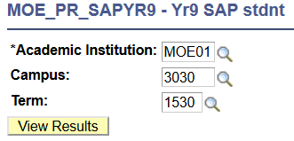
Download List of SAPYR9 Students
5. Enter the Academic Institution, Campus, and Term
Note: Term entered should be the final term of the current academic year.
i.e 1930 for progressing students to year 2020
6. Click View Results

Slide 8
Update the file and save as .CSV format
SAPYR9 Student Progression

Slide 9
Flow Chart
Download List of
SAPYR9 Students
Update the file and save as .CSV format
Upload the updated SAPYR9 File
Verify Student Program/Plan

Slide 10
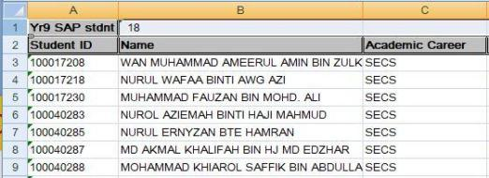
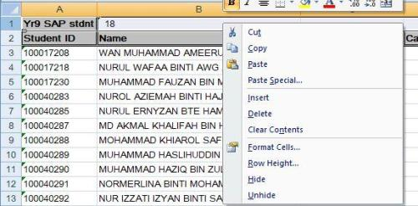
Update the file and save as .CSV format
1. Delete the first row
Select the entire row by clicking on the number to the most left of the first row.
Right click and select Delete from the dropdown list

Slide 11
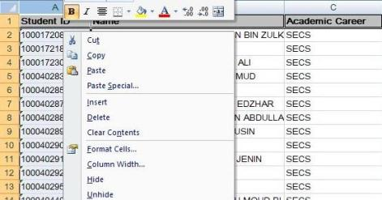
Update the file and save as .CSV format
2. Insert a new column
before the Student ID
Select the entire column by clicking on the “A” alphabet at the top of the sheet.
Right click and select Insert from the drop-down list.

Slide 12
Update the file and save as .CSV format
3. Fill in “Process Instance” in cell A1 as title for the new column.

Slide 13
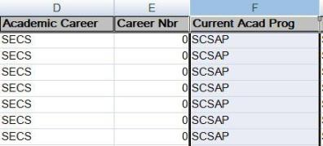
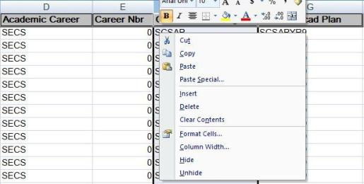
Update the file and save as .CSV format
4. Insert a new column before
the Current Acad Prog:
Select the entire column by clicking on the “F” alphabet at the top of the sheet.
Right click and select Insert from the drop-down list.

Slide 14
Update the file and save as .CSV format
5. Fill in “Program Action” in cell F1 as title for the new column.
6. Fill in the following as the title for the respective columns
“New Acad Prog” in cell I1,
“New Acad Plan” in cell J1, and
“Class Section” in cell K1

Slide 15
Update the file and save as .CSV format
Note: The format for the file should look like this

Slide 16
Update the file and save as .CSV format
Note: The format for the file should look like this

Slide 17
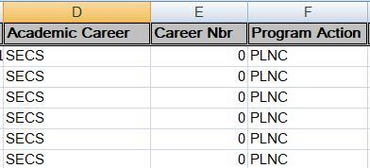
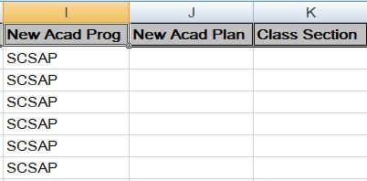
Update the file and save as .CSV format
7. Under Program Action column, enter the following for the respective students
“PLNC” for progressing student, or
“DATA” for retaining student.
8. Enter “SCSAP” under the
New Acad Prog column.

Slide 18
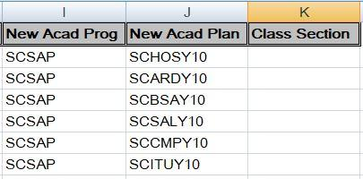
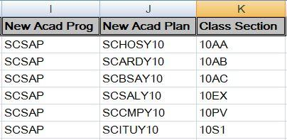
Update the file and save as .CSV format
9. Enter individual student’s New Academic Plan
Example: SCHOSY10, SCARDY10, SCBSAY10, SCSALY10, SCCMPY10 & SCITUY10.
Note: You may refer to Academic Plan’s code for Special Applied Program in the next slide
10. Enter the students’ Class Section.
Note: Maximum is 4 characters

Slide 19
Update the file and save as .CSV format
Academic Plan’s code for Special Applied Program
Career | Program | Academic Plan (From) | Academic Plan (To) | Plan Description
SECS | SCSAP | SCSAPYR9 | SCHOSY10 | BTEC Edexcel Level 1 Introductory - Hospitality
 |  |  | SCARDY10 | BTEC Edexcel Level 1 Introductory - Art & Design
 |  |  | SCBSAY10 | BTEC Edexcel Level 1 Introductory - Business Administration
 |  |  | SCSALY10 | BTEC Edexcel Level 1 Introductory - Sports & Leisure
 |  |  | SCCMPY10 | BTEC Edexcel Level 1 Introductory - Creative Media Production
 |  |  | SCITUY10 | BTEC Edexcel Level 1 Introductory - IT User
This list is also retrievable from the document in Online Help: http://help.ineis.moe.gov.bn/pr/pr_2.3.php

Slide 20
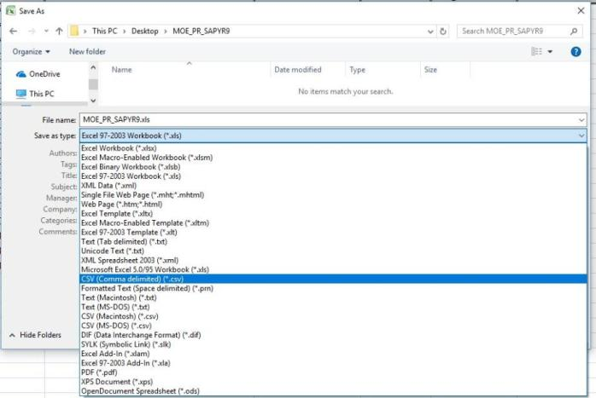
Update the file and save as .CSV format
11. Save the file as .csv (Comma Delimited).

Slide 21
Upload the updated SAPYR9 File
SAPYR9 Student Progression

Slide 22
Flow Chart
Download List of
SAPYR9 Students
Update the file and save as .CSV format
Upload the updated SAPYR9 File
Verify Student Program/Plan

Slide 23
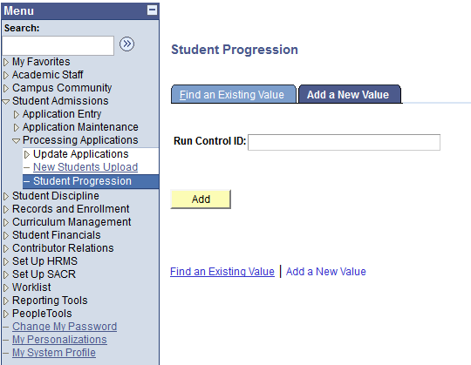
Upload the updated SAPYR9 File
2. Click on Add a New Value tab
Navigate: Student Admissions >
Processing Applications > Student Progression
Enter a new Run Control ID
Format:
School Code_Term_SAPYR9
Eg: 3030_1930_SAPYR9
4. Click Add button

Slide 24
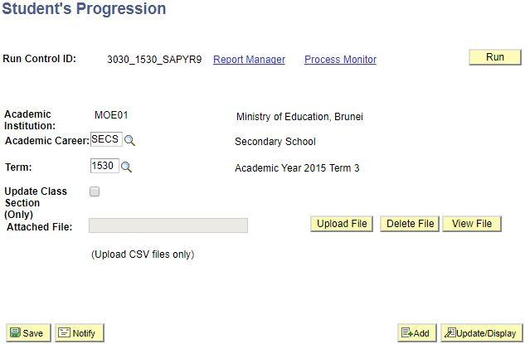
Upload the updated SAPYR9 File
7. Click on the Run button to run the process.
Note: Term should be the final term of the current academic year.
i.e. Term 1930 for progressing students to year 2020
5. Enter the Academic Career and Term.
4. Click on Upload File button.
6. Upload the .csv file

Slide 25
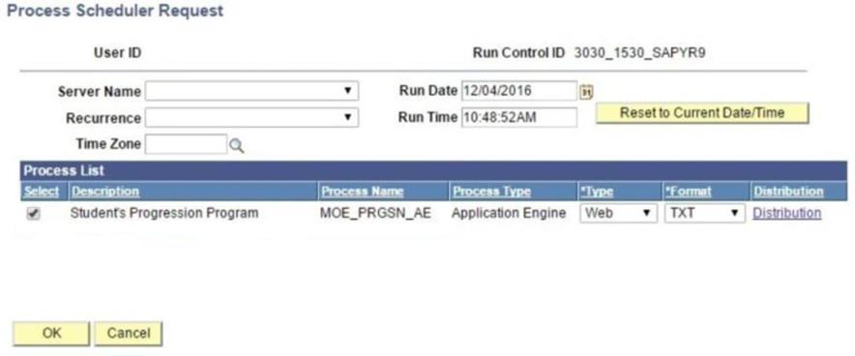
Upload the updated SAPYR9 File
8. Ensure the process name MOE_PRGSN_AE
in Process Scheduler Request page is checked.
9. Click on OK button.

Slide 26
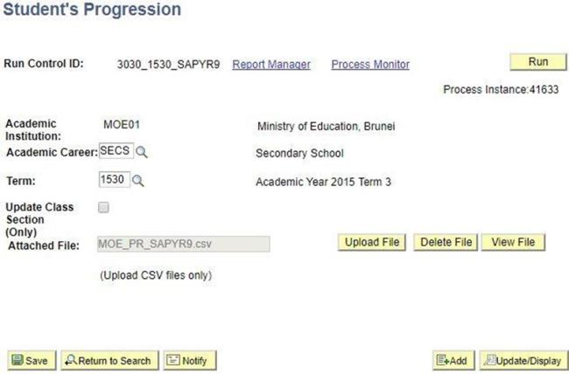
Upload the updated SAPYR9 File
10. Click on “Process Monitor” link to view the status
of the process
*Take note of the
Process Instance number

Slide 27
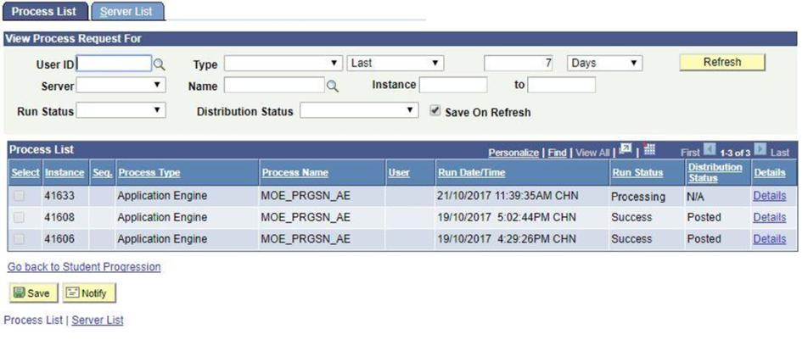
Upload the updated SAPYR9 File
11. Click Refresh button at interval times
Check for Process Name with MOE_PRGSN_AE and the Process Instance number should be the same as earlier
12. You should see that:
Run Status: Processing or Queued and
Distribution Status: N/A

Slide 28
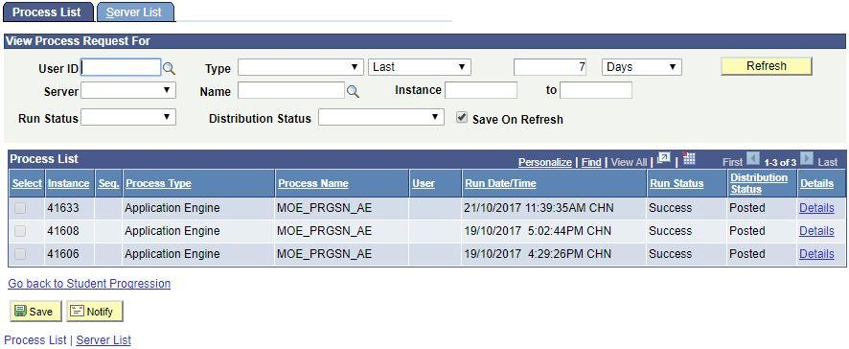
Upload the updated SAPYR9 File
13. Click Refresh at interval times until
Run Status: Success and
Distribution Status: Posted
14. Click on Details.

Slide 29
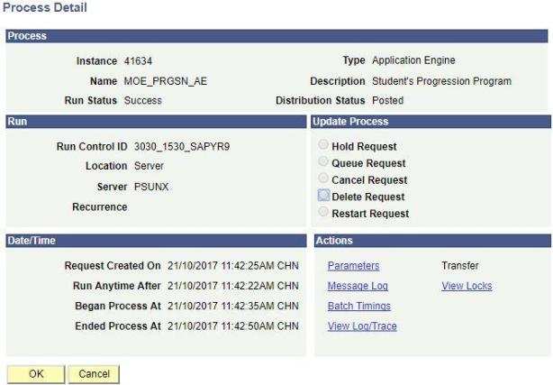
Upload the updated SAPYR9 File
15. Click on the View Log/Trace link.

Slide 30
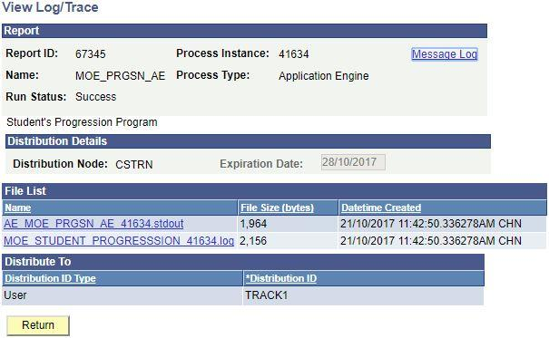
Upload the updated SAPYR9 File
16. Click on .log link to view the results.

Slide 31
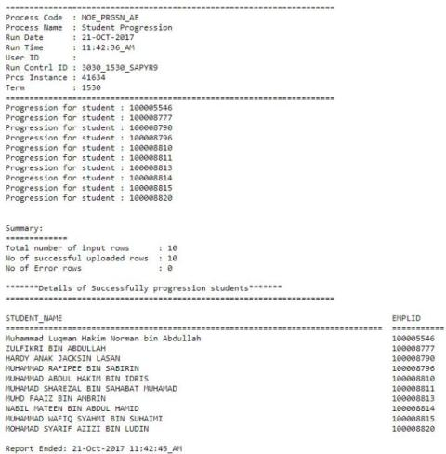
Upload the updated SAPYR9 File
The result shows
Total number of students in the file,
Number of successfully progressed students, and
Number of students unsuccessfully progressed
Details of successfully progressed students.

Slide 32
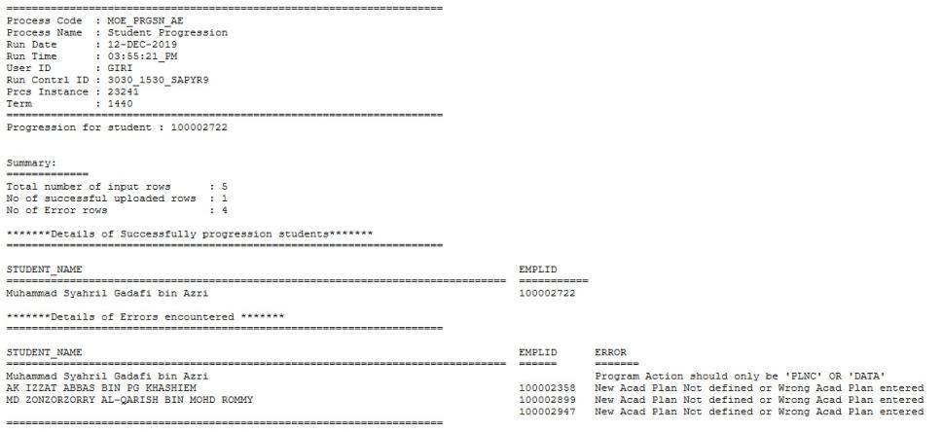
Example of the Uploaded File With Error
The .log file showing the summary of the result and the student with the error. Hence, recheck and correct the details for the specific student(s) in the excel file before reuploading

Slide 33
Verify Student Program/Plan
SAPYR9 Student Progression

Slide 34
Flow Chart
Download List of
SAPYR9 Students
Update the file and save as .CSV format
Upload the updated SAPYR9 File
Verify Student Program/Plan

Slide 35
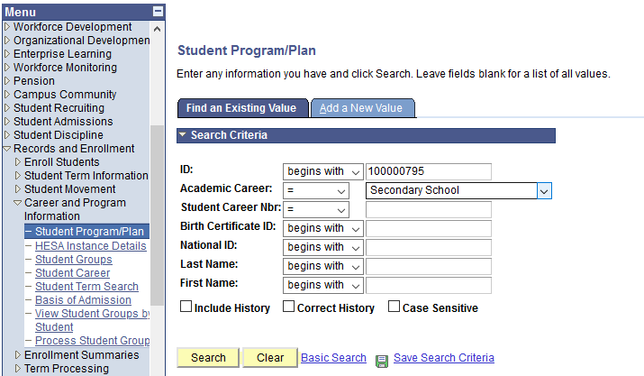
Verify Student Program/Plan
Navigate : Records and Enrollment > Career and Program information >
Student Program/Plan
2. Enter the student’s ID and Academic Career
3. Click Search button

Slide 36
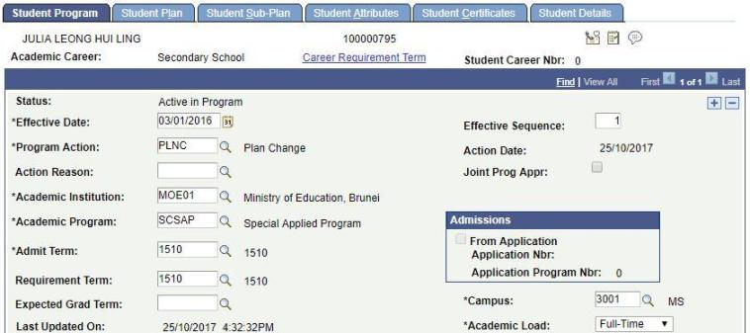
Verify Student Program/Plan
4. In the Student Program tab, ensure that:
Effective Date should be a day before the start of the term
Program Action should be PLNC (Plan Change)
Academic Program remains the same as previous record
Admit Term and Requirement Term remains the same as previous record

Slide 37
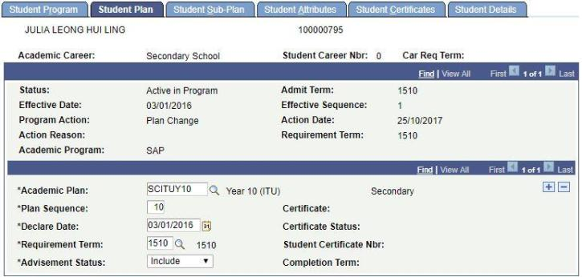
Verify Student Program/Plan
5. Click on Student Plan tab
6. Ensure that:
Academic Plan should be Year 10 plan
Declare Date should follow the Effective Date
Requirement Term should follow Admit Term

Slide 38
End of Presentation
Thank You

