Slide 1
Manage Examination
3rd March 2015, Tuesday
13.30 – 16.30

Slide 2
Overview
1. Track Statement of Entry Forms for Class Teacher
To track distribution of Statement of Entry Forms to students
2. Track Examination Result Slip for Class Teacher
To track distribution of Examination Result Slip to students
3. MC AP info
Allow class teacher to enter details of the students absence from public examinations.
4. View Grade Roster
To view grades obtained by their students in a public examination by specific subjects.

Slide 3
EX01: Track Statement of Entry for Class Teacher
Description:
This Function allows the Roles below to track distribution status of Statement of Entry for students.
Granted Role:
Class Teacher (Secondary and Sixth Forms)
Menu Path:
Academic Staff > Assessment and Exams > Exams > Track Statement of Entry for Class Teacher

Slide 4
How to use
Navigate to the Screen via Menu Path
Click Search for Existing Value
Choose Class Section link
Select Class Section link
Refer also to Online Help

Slide 5
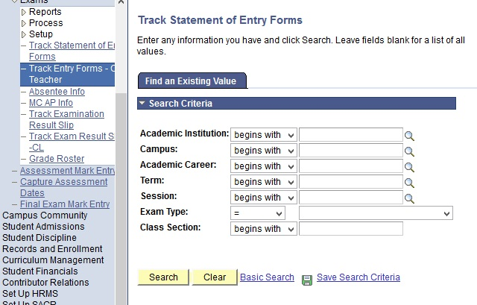
Navigate
Navigation: Academic Staff > Assessment and Exams > Exam > Track Entry Forms – CL Teacher

Slide 6
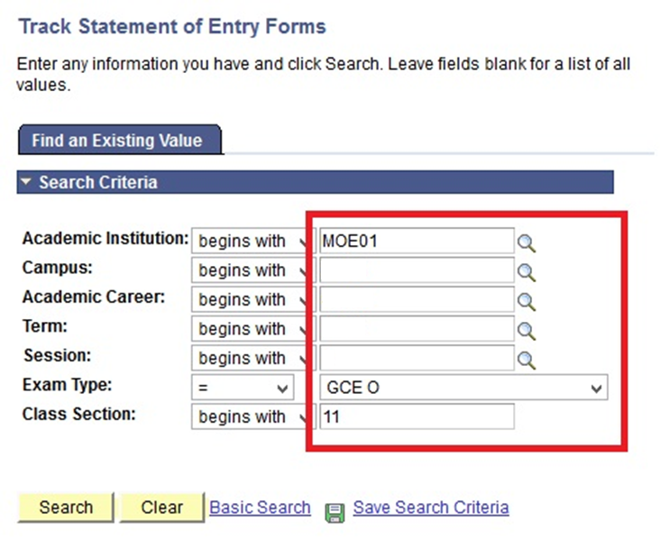
Click Search Button
Click Search Button to view the value

Slide 7
Select the Class Section

Slide 8
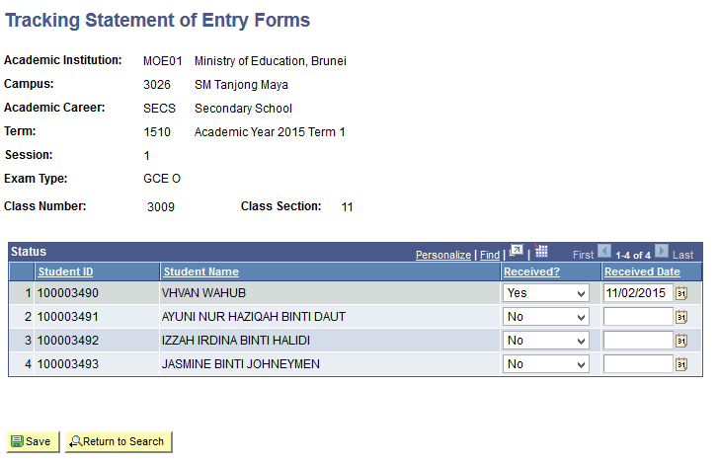
Fill in the Field

Slide 9
Click Save button

Slide 10
Overview
1. Track Statement of Entry Forms for Class Teacher
To track distribution of Statement of Entry Forms to students
2. Track Examination Result Slip for Class Teacher
To track distribution of Examination Result Slip to students
4. View Grade Roster
To view grades obtained by their students in a public examination by specific subjects.
Allow class teacher to enter details of the students absence from public examinations.
3. MC AP info

Slide 11
EX02: Track Examination Result Slip for Class Teacher
Description:
This Function allows the Roles below to track distribution of Examination Result Slips to students.
Granted Role:
Class Teacher (All Careers)
Menu Path:
Academic Staff > Assessment and Exams > Exams > Track Exam Results Slip - CL

Slide 12
How to use
Navigate to the Screen via Menu Path
Click Search for Existing Value
Select Class Section link
Click Class Section link
Refer also to Online Help

Slide 13
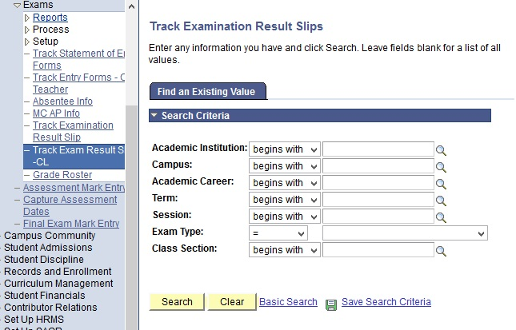
Navigate
Navigation: Academic Staff > Assessment and Exams >Exams > Track Exam Result Slips -CL

Slide 14
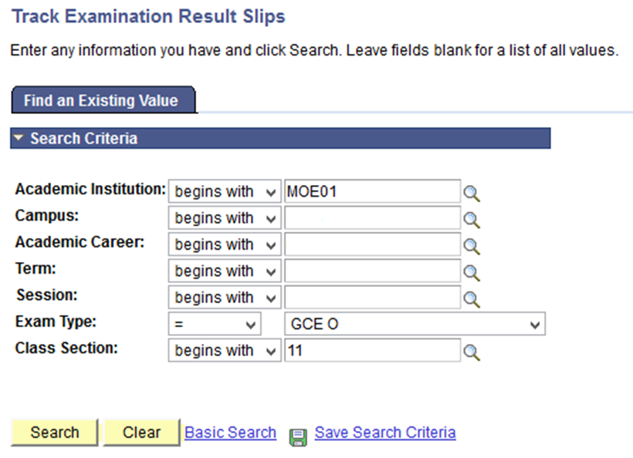
Click Search Button
Click Search Button to view the value

Slide 15
Select the result

Slide 16
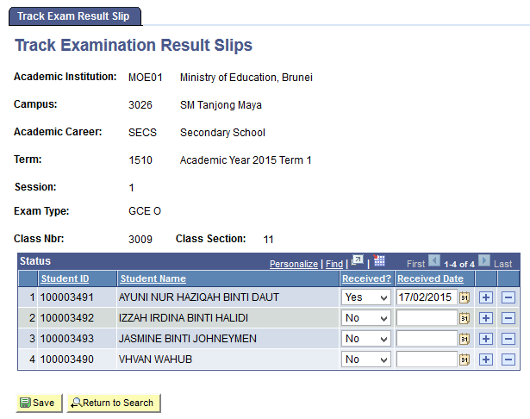
Fill in the Fields

Slide 17
Click Save button

Slide 18
Overview
1. Track Statement of Entry Forms for Class Teacher
To track distribution of Statement of Entry Forms to students
2. Track Examination Result Slip for Class Teacher
To track distribution of Examination Result Slip to students
3. MC AP info
Allow class teacher to enter details of the students absence from public examinations.
4. View Grade Roster
To view grades obtained by their students in a public examination by specific subjects.

Slide 19
EX03: MC AP Info
Description:
This Function allows the Roles below to enter the details of the student’s absence from the public examinations
Granted Role:
Class Teacher (All Careers)
Menu Path:
Academic Staff > Assessment and Exams > Exam > MC AP Info

Slide 20
How to use
Navigate to the Screen via Menu Path
Click Search for Existing Value
Choose Student ID
Click the Student ID
Refer also to Online Help

Slide 21
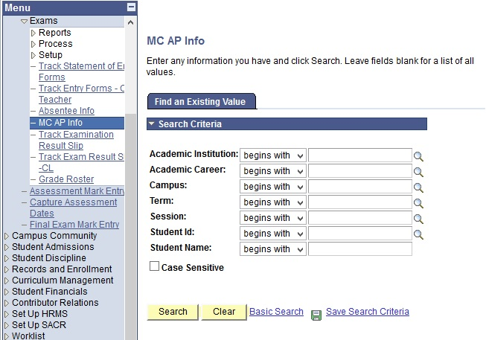
Navigate
Navigation: Academic Staff > Assessment and Exams > Exams >MC AP Info

Slide 22
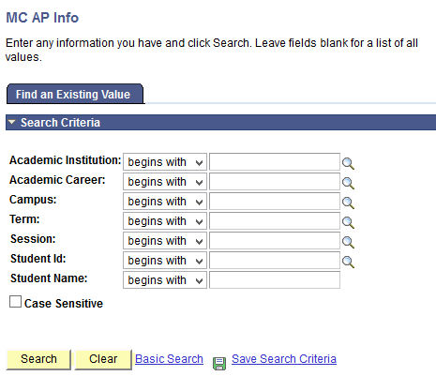
Click Search Button
Click Search Button to view the Existing value

Slide 23
Select one of the results

Slide 24
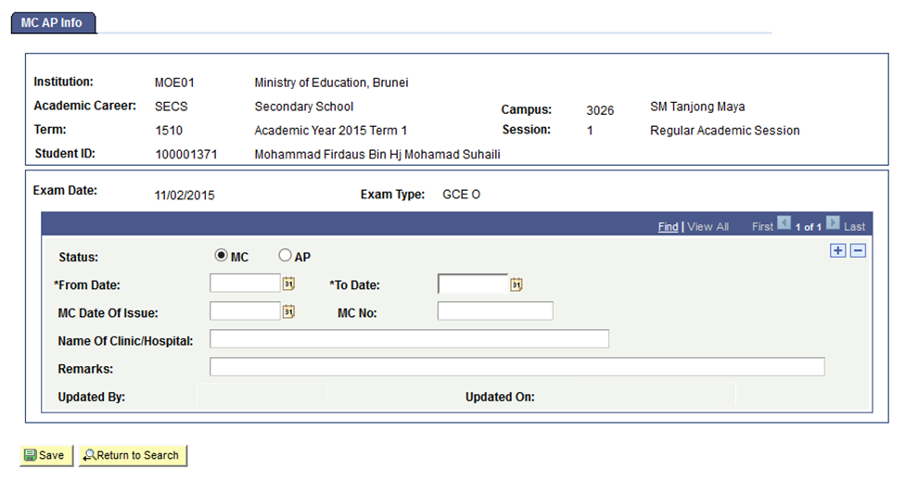
Select the Status

Slide 25
Select the Date
Select the Date by clicking the Calendar icon

Slide 26
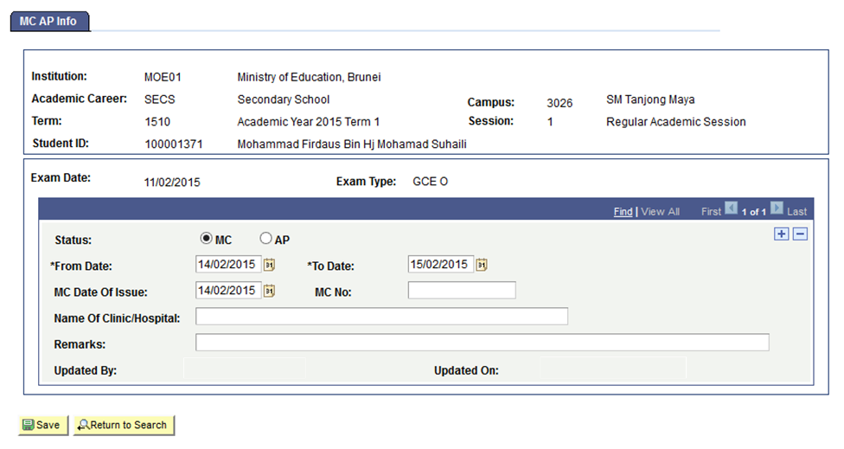
Select the Date
Enter MC No. maximum of 9 Characters

Slide 27
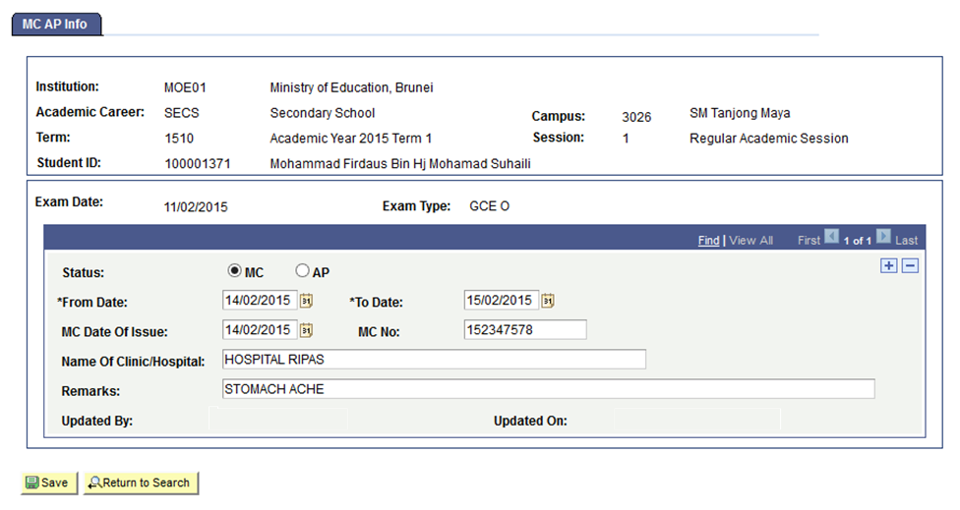
Fill in the details

Slide 28
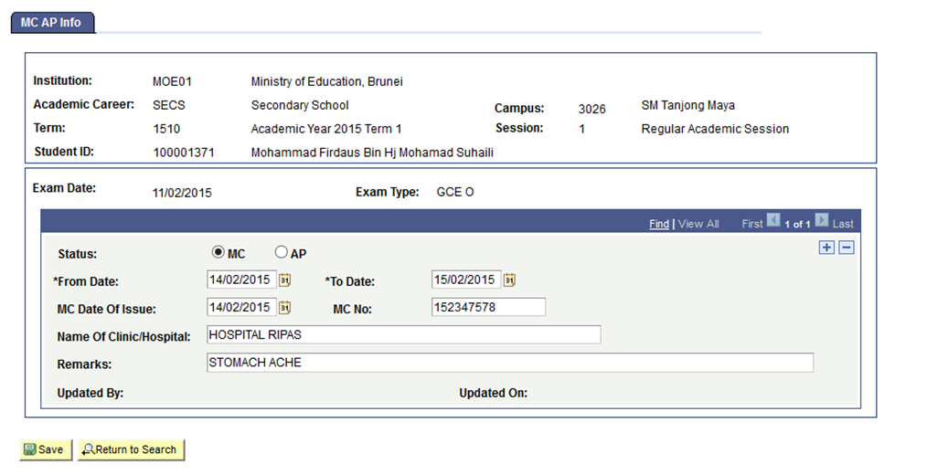
Fill in the details

Slide 29
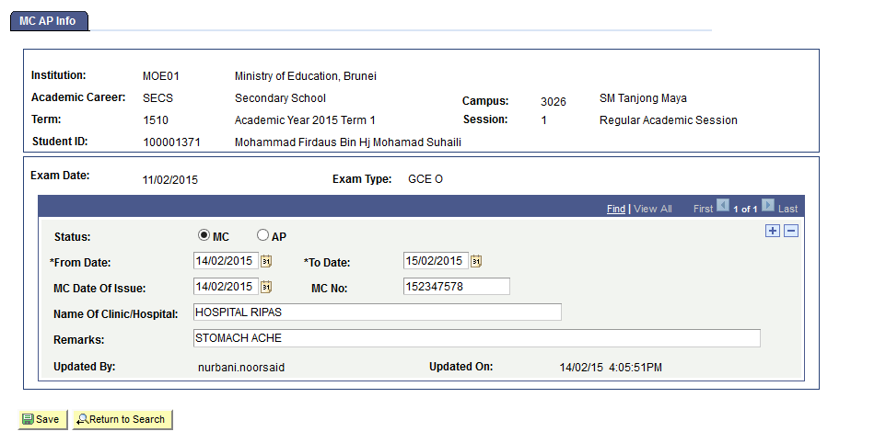
Updated By and Updated On
Updated By and Updated On will be automatically populated

Slide 30
Overview
1. Track Statement of Entry Forms for Class Teacher
To track distribution of Statement of Entry Forms to students
2. Track Examination Result Slip for Class Teacher
To track distribution of Examination Result Slip to students
3. MC AP info
Allow class teacher to enter details of the students absence from public examinations.
4. View Grade Roster
To view grades obtained by their students in a public examination by specific subjects.

Slide 31
EX04 : Grade Roster
Description:
This Function allows the Roles below to View Grade obtained by their students in a public examination by specific subject.
Granted Role:
Class Teacher (All Careers)
Menu Path:
Academic Staff > Assessment and Exams > Exam > Grade Roster

Slide 32
How to use
Navigate to the Screen via Menu Path
Click Search for Existing Value
Choose Class Section link
Click the Class Section link
Refer also to Online Help

Slide 33
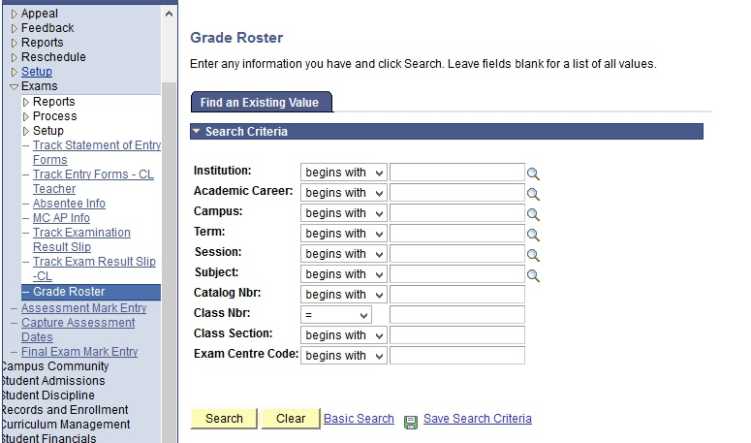
Navigate
Navigation: Academic Staff > Assessment and Exams > Exams > Grade Roster

Slide 34
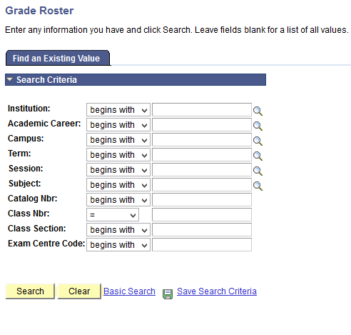
Click Search Button
Click Search Button to view the Existing value

Slide 35
Select one of the results

Slide 36
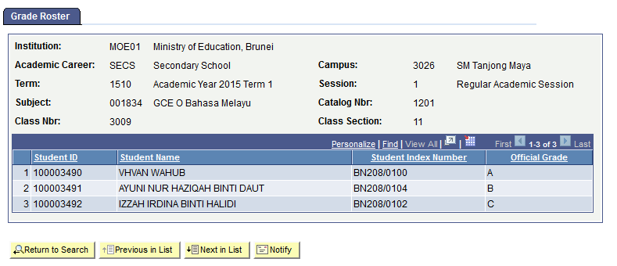
View the results

Slide 37
C4P – Enroll Students
School Examination Secretary

Slide 38
Overview
1. Create Student Block
To list the students to be enrolled
2. Create Class Block
To list the class/ classes for students to be enrolled
3. Register Student to Classes
To allocate the students to the classes

Slide 39
EX05: Enrollment of Student Block
Description:
This Function allows the Roles below to group students in a Student Block
Granted Role:
School Examination Secretary
Menu Path:
Record and Enrollment > Enroll Student > Block Enrollment > Create Student Block

Slide 40
How to use
Navigate to the Screen via Menu Path
Click Add a New Value Tab
Enter the Student Enrollment Block
Click Add Button
Refer also to Online Help

Slide 41
Navigate
Navigation: Records and Enrollment > Enroll Students > Block Enrollment > Create Student Block

Slide 42
Click Add a New Value Tab

Slide 43
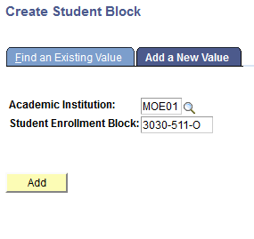
Enter Student Enrollment Block
Class Enrollment Block is limited to 10 characters only

Slide 44
Click Add Button

Slide 45
Fill in the details
Click on the “+” icon to add more students

Slide 46
Click Save Button

Slide 47
Overview
1. Create Student Block
To list the students to be enrolled
2. Create Class Block
To list the class/ classes for students to be enrolled
To allocate the students to the classes
3. Register Student to Classes

Slide 48
EX06: Enrollment of Class Block
Description:
This Function allows the Roles below to list the class/classes for students to be enrolled
Granted Role:
School Examination Secretary
Menu Path:
Record and Enrollment > Enroll Student > Block Enrollment > Create Class Block

Slide 49
How to use
Navigate to the Screen via Menu Path
Click Add a New Value Tab
Enter the Class Enrollment Block
Click Add Button
Refer also to Online Help

Slide 50
Navigate
Navigation: Records and Enrollemnt > Enroll Students > Block Enrollment > Create Class Block

Slide 51
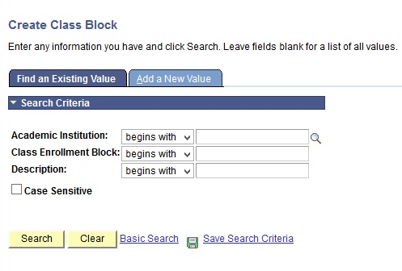
Click Add a New Value Tab

Slide 52
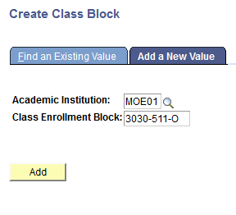
Enter Class Enrollment Block
Class Enrollment Block is limited to 10 characters only

Slide 53
Click Add Button

Slide 54
Fill in the details
Click on the “+” icon to add more classes into the Block

Slide 55
Click Save Button

Slide 56
Class will be automatically populated

Slide 57
Overview
1. Create Student Block
To list the students to be enrolled
2. Create Class Block
To list the class/ classes for students to be enrolled
3. Register Student to Classes
To allocate the students to the classes

Slide 58
EX07: Register Students to Exam Classes
Description:
This Function allows the Roles below to allocate the students to the classes
Granted Role:
School Examination Secretary
Menu Path:
Record and Enrollment > Enroll Student > Block Enrollment > Block Enroll Merge

Slide 59
How to use
Navigate to the Screen via Menu Path
Click Add a New Value Tab
Enter the Block Enroll Merge
Click Add Button
Refer also to Online Help

Slide 60
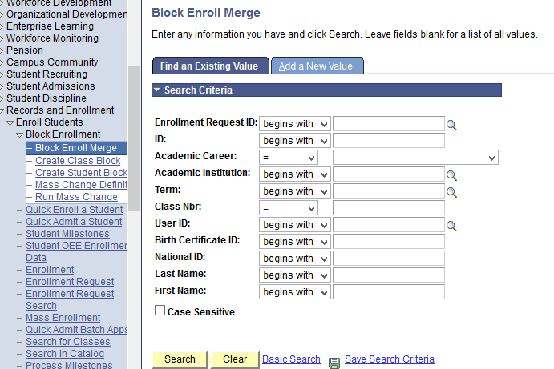
Navigate
Navigation: Records and Enrollment > Enroll Students > Block Enrollment > Block Enroll Merge

Slide 61
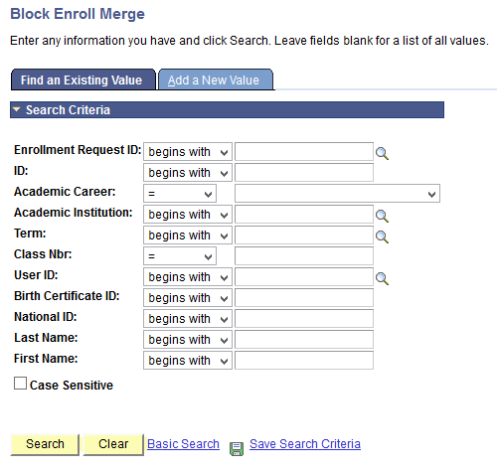
Click Add a New Value Tab

Slide 62
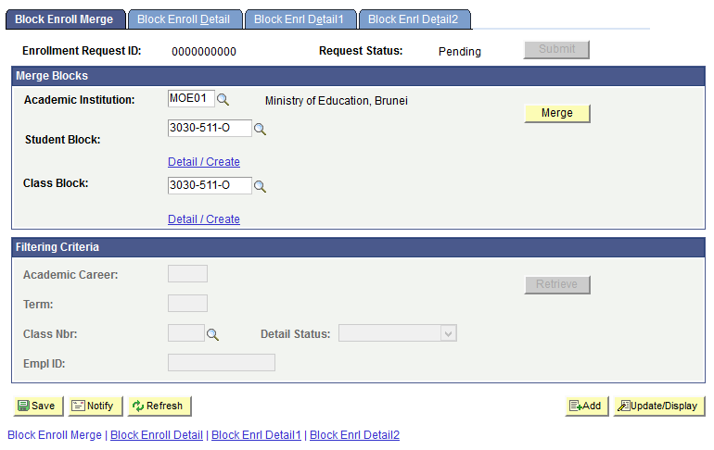
Fill in the details

Slide 63
Click Merge button

Slide 64
Click Submit button

Slide 65
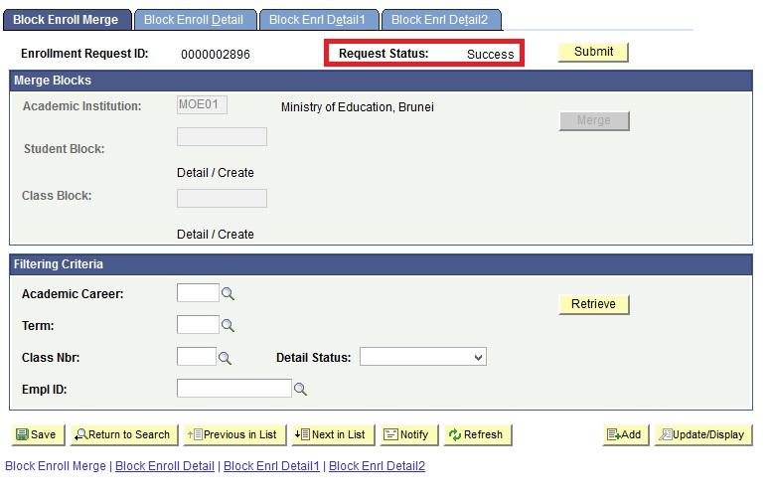
Click Retrieve Button
Ensure the Request Status is ‘SUCCESS’

Slide 66
Click Details link

Slide 67
Register Students to Class
Verify Students Enrollment details

Slide 68
C4P – Manage Examination
School Examination Secretary

Slide 69
Overview
1. Generate Exam Sequence
To allow the School Exam Secretary to generate exam sequence Numbers
2. Track Statement of Entry
To track collection of Statement of Entry Forms from Department of Examination
3. Track Examination Results Slip
To track collection of Examination Result Slip from Department of Examination
4. Absentee Info
To add Absentee Info for students who did not attend public examinations

Slide 70
EX08: Generate Exam Sequence No.
Description:
This Function allows the Roles below to Generate Exam Sequence for SPE
Granted Role:
School Examination Secretary (Secondary)
Menu Path:
Academic Staff > Assessment and Exams > Exams > Process > Generate Exam Sequence

Slide 71
How to use
Navigate to the Screen via Menu Path
Click Add a New Value Tab
Enter Run Control ID
Refer also to Online Help

Slide 72
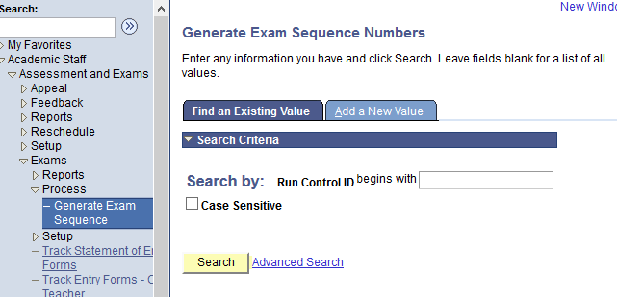
Navigate
Navigation: Academic Staff > Assessment and Exams > Exam > Process > Generate Exam Sequence

Slide 73
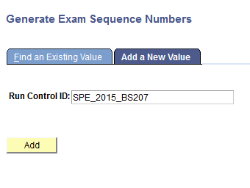
Enter Run Control ID
Enter a meaningful name for easy reference

Slide 74
Click Add Button

Slide 75
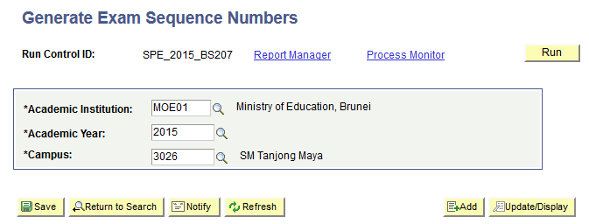
Select values via Lookup Button

Slide 76
Click Run Button

Slide 77
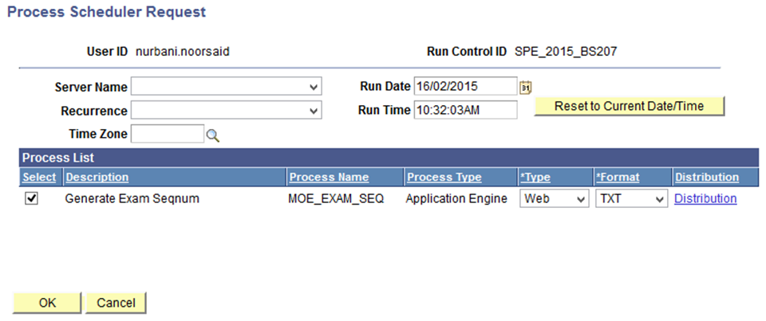
Click Ok Button

Slide 78
Click Process Monitor
Keep track of Process Instance : 7512. It will help you to monitor the process in Process Monitor

Slide 79
Click Refresh Button
Click Refresh Button until the Run Status : Success And Distribution Status : Posted

Slide 80
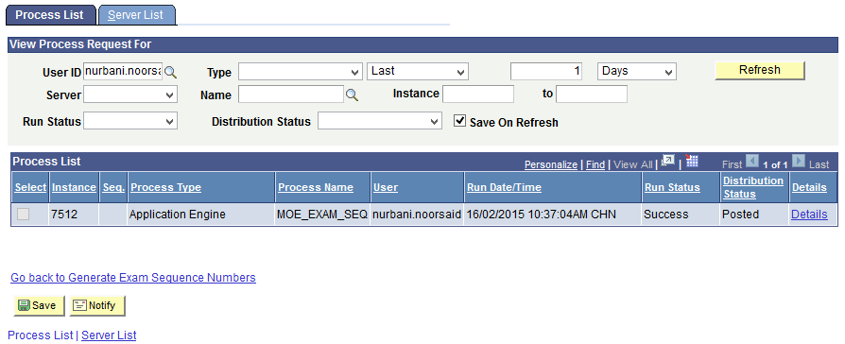
Click Details link

Slide 81
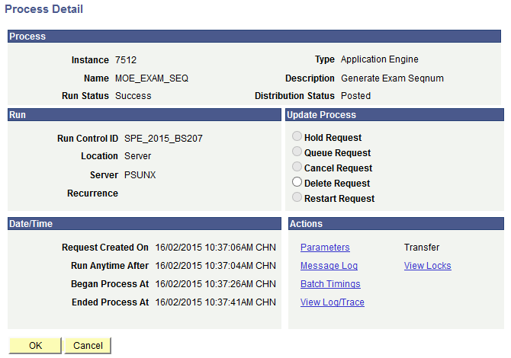
Click View Log/Trace link

Slide 82
Click .csv file

Slide 83
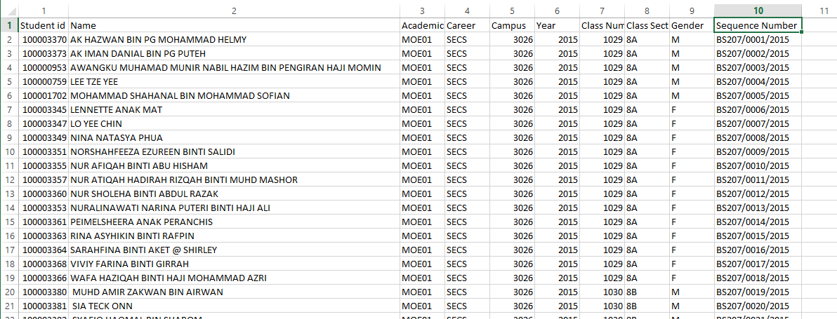
View the Results

Slide 84
Overview
1. Generate Exam Sequence
To allow the School Exam Secretary to generate exam sequence Numbers
2. Track Statement of Entry
To track collection of Statement of Entry Forms from Department of Examination
3. Track Examination Results Slip
To track collection of Examination Result Slip from Department of Examination
4. Absentee Info
To add Absentee Info for students who did not attend public examinations

Slide 85
EX09: Track Statement of Entry Form
Description:
This Function allows the Roles below to Track Collection of Statement of Entry Forms from Department of Examinations.
Granted Role:
School Examination Secretary (Secondary and Sixth Forms)
Menu Path:
Academic Staff > Assessment and Exams > Exams > Track Statement of Entry Forms

Slide 86
How to use
Navigate to the Screen via Menu Path
Click Search for Existing Value
Choose Exam Type link
Select Exam Type link
Refer also to Online Help

Slide 87
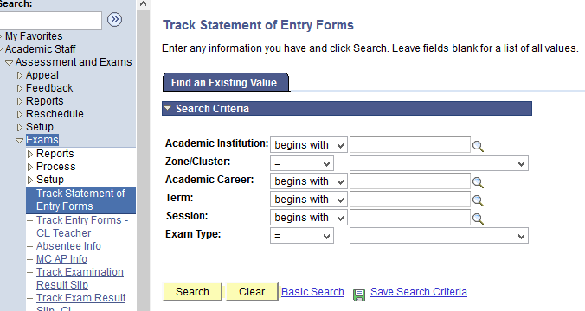
Navigate
Navigation: Academic Staff > Assessment and Exams > Exam > Track Statement of Entry Forms

Slide 88
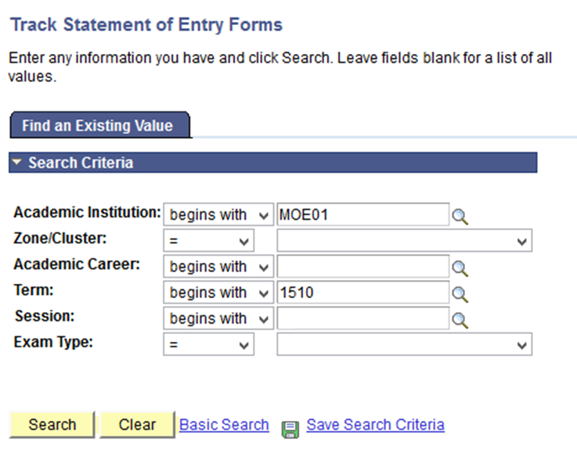
Click Search Button

Slide 89
Select the Class Section

Slide 90
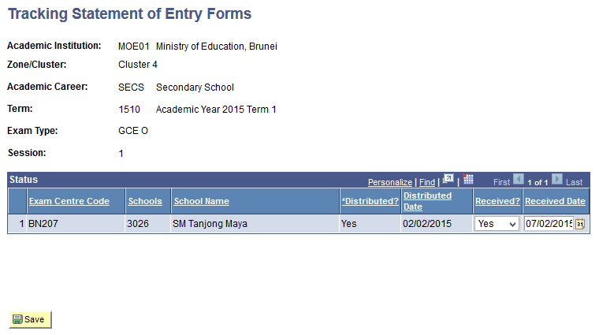
Fill in the Field

Slide 91
Click Save Button

Slide 92
Overview
1. Generate Exam Sequence
To allow the School Exam Secretary to generate exam sequence Numbers
3. Track Examination Results Slip
To track collection of Examination Result Slip from Department of Examination
2. Track Statement of Entry
To track collection of Statement of Entry Forms from Department of Examination
4. Absentee Info
To add Absentee Info for students who did not attend public examinations

Slide 93
EX10: Track Examination Results Slip
Description:
This Function allows the Roles below to Track Collection of Examination Result Slips from Department of Examinations.
Granted Role:
School Examination Secretary (All Careers)
Menu Path:
Academic Staff > Assessment and Exams > Exams > Track Examination Results Slip

Slide 94
How to use
Navigate to the Screen via Menu Path
Click Search for Existing Value
Select Class Section link
Click Class Section link
Refer also to Online Help

Slide 95
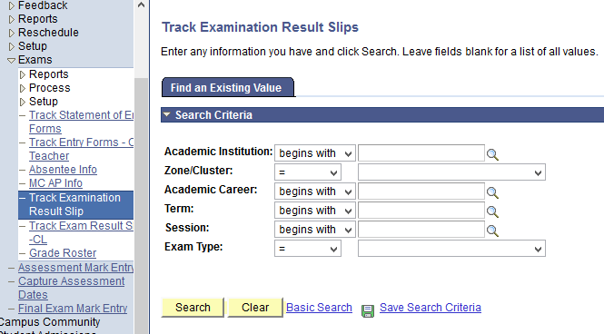
Navigate
Navigation: Academic Staff > Assessment and Exams >Exams > Track Examination Result Slip

Slide 96
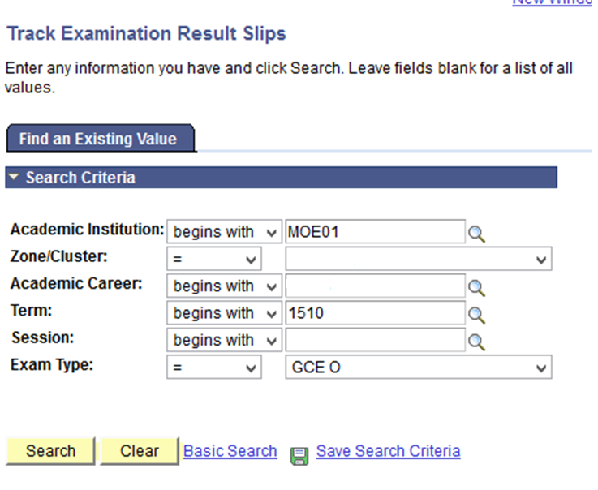
Click Search Button

Slide 97
Select the result

Slide 98
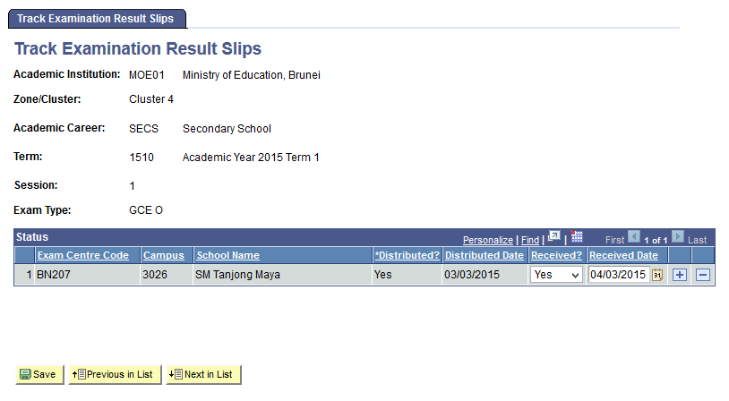
Fill in the Fields

Slide 99
Click Save button

Slide 100
Overview
1. Generate Exam Sequence
To allow the School Exam Secretary to generate exam sequence Numbers
2. Track Statement of Entry
To track collection of Statement of Entry Forms from Department of Examination
3. Track Examination Results Slip
To track collection of Examination Result Slip from Department of Examination
4. Absentee Info
To add Absentee Info for students who did not attend public examinations

Slide 101
EX11 : Absentee Info
Description:
This Function allows the Roles below to track students who did not attend public examinations, e.g. PSR, GCE O, IGCSE, etc.
Granted Role:
School Examination Secretary (All Careers)
Menu Path:
Academic Staff > Assessment and Exams > Exam > Absentee Info

Slide 102
How to use
Navigate to the Screen via Menu Path
Click Add a New Value Tab
Select the Student ID
Click the Student ID
5. Click Save Button
Refer also to Online Help

Slide 103
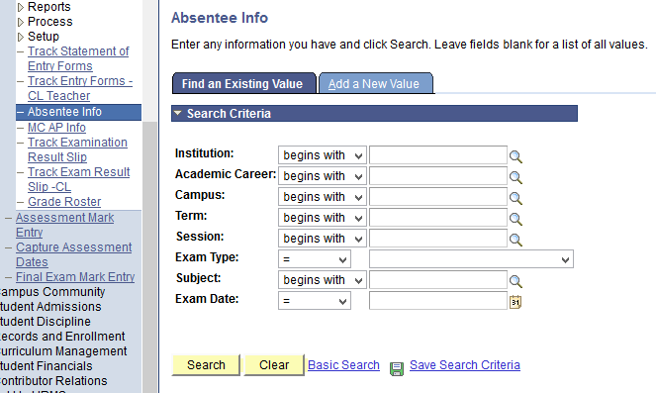
Navigate
Navigation: Academic Staff > Assessment and Exams > Exams > Absentee Info

Slide 104
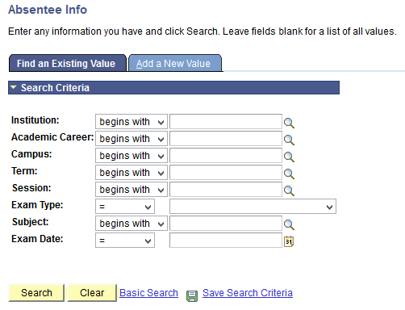
Click Add a New Value tab

Slide 105
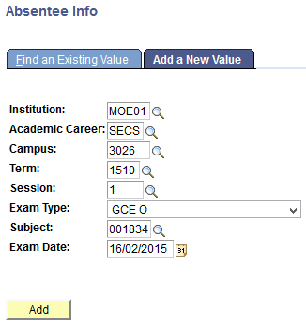
Click Add Button

Slide 106
Fill in the Details

Slide 107
Click Save Button

Slide 108
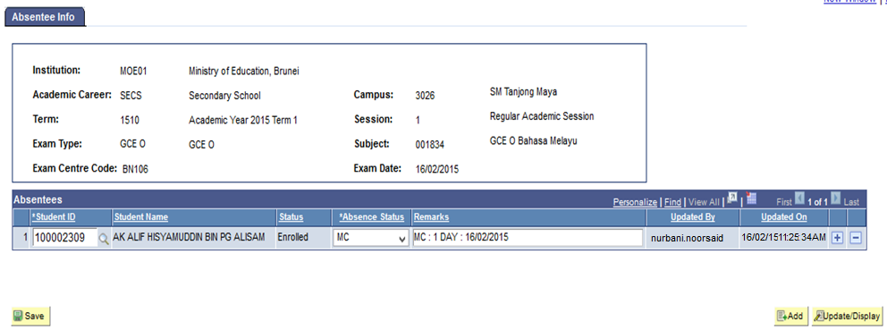
Updated By and Updated On

Slide 109
Examination Report

Slide 110
Overview
1. Verification Slip
To generate verification slip report for Primary
4. List of Absentee from Public Examination
To view the list of absentee from a specific public examination.
2. List of Students Registered for Public Exam
To generate list of students registered for public exam report
3. List of Students Issued with Statement of Entry Forms
To generate list of students registered for a public examination.

Slide 111
EX12:Verification Slip Report
Description:
This Function allows the Roles below to generate Verification Slips report.
Granted Role:
School Examination Secretary (Primary Only)
Menu Path:
Academic Staff > Assessment and Exams > Exams > Report > Verification Slips

Slide 112
How to use
Navigate to the Screen via Menu Path
Click Add a New Value Tab
Enter Run Control ID
4. Click Add Button
Refer also to Online Help

Slide 113
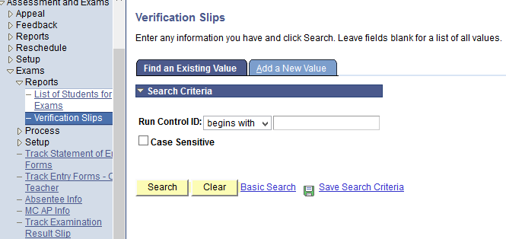
Navigate
Navigation: Academic Staff > Assessment and Exams > Exam > Reports > Verification Slips

Slide 114
Click Add a New Value Tab

Slide 115
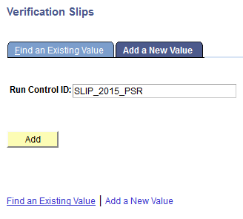
Enter Run Control ID
Enter a meaningful name for easy reference

Slide 116
Click Add Button

Slide 117
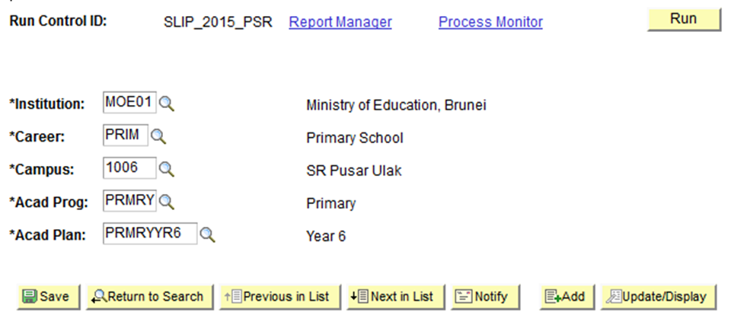
Select values via Lookup Button

Slide 118
Click Run Button

Slide 119
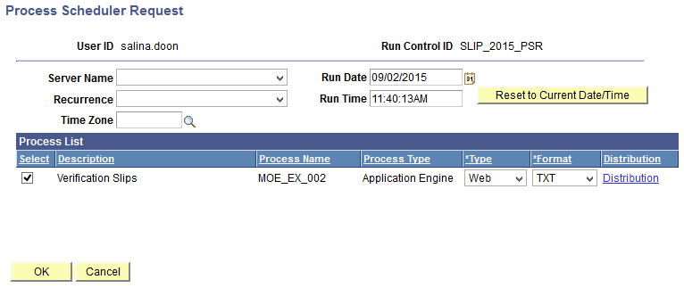
Click Ok Button

Slide 120
Click Process Monitor link
Keep track of Process Instance : 7453. It will help you to monitor the process in Process Monitor

Slide 121
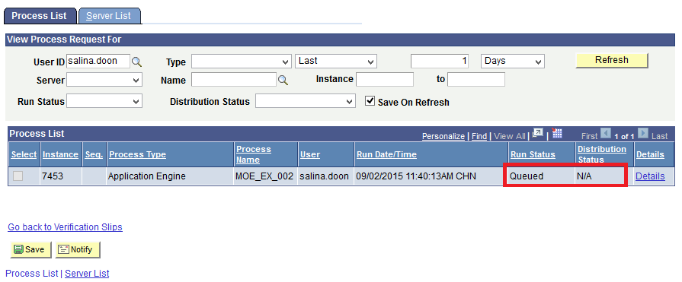
Click Refresh Button
Click Refresh Button until the Run Status : Success And Distribution Status : Posted

Slide 122
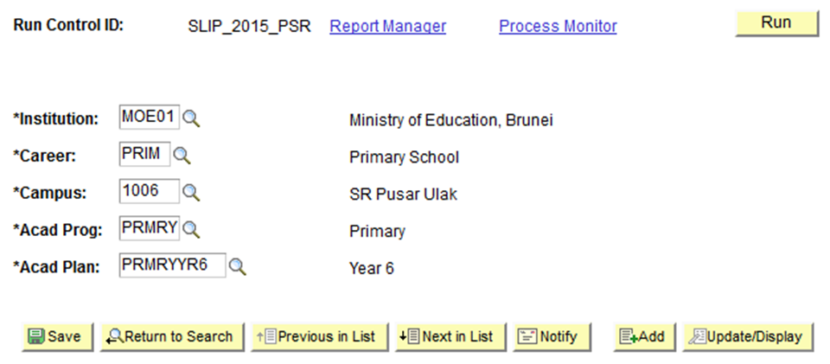
Click Report Manager link

Slide 123
Click Administration Tab

Slide 124
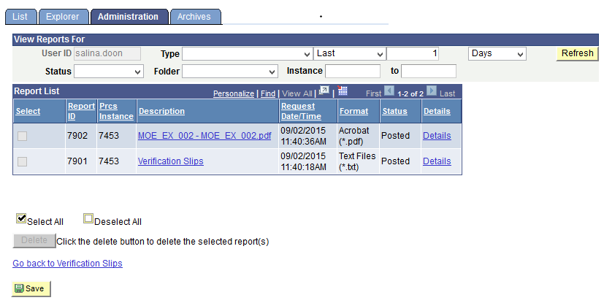
Click pdf. file

Slide 125
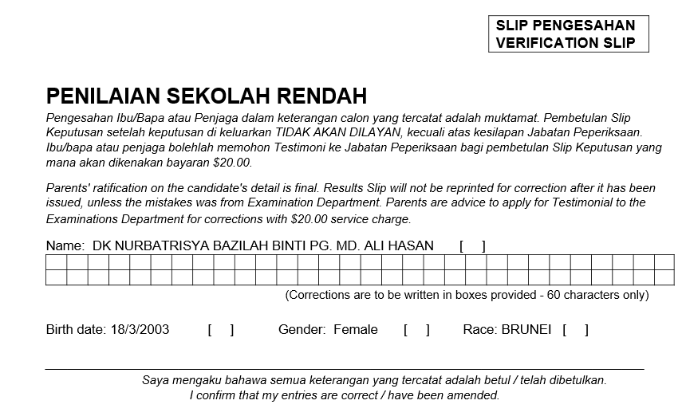
View the Results

Slide 126
Overview
1. Verification Slip
To generate verification slip report for Primary
To generate list of students registered for public exam report
3. List of Students Issued with Statement of Entry Forms
To generate list of students registered for a public examination.
4. List of Absentee from Public Examination
To view the list of absentee from a specific public examination.
2. List of Students Registered for Public Exam

Slide 127
EX13: List of Students Registered for Public Examination Report
Description:
This Function allows the Roles below to List of Students Registered for public examination.
Granted Role:
School Examination Secretary (Secondary and Sixth Forms)
Menu Path:
Academic Staff > Assessment and Exams > Exams > Report > List of Students for Exams

Slide 128
How to use
Navigate to the Screen via Menu Path
Click Add a New Value
Enter Run Control ID
4. Click Add Button
Refer also to Online Help

Slide 129
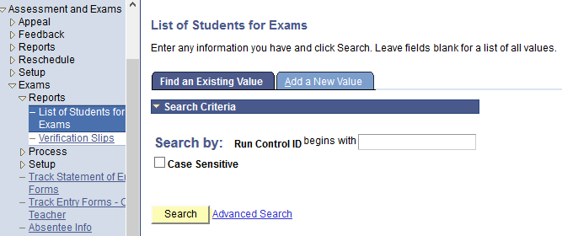
Navigate
Navigation: Academic Staff > Assessment and Exams > Exam > Reports > List of Students for Exams

Slide 130
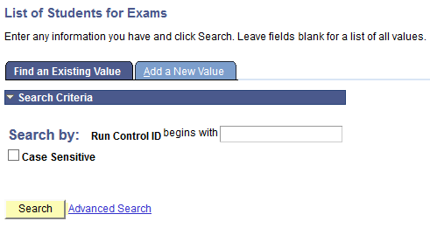
Click Add a New Value Tab

Slide 131
Enter Run Control ID
Enter a meaningful name for easy reference

Slide 132
Click Add Button

Slide 133
Fill in the Details

Slide 134
Click Run Button

Slide 135
Click OK Button

Slide 136
Click Process Monitor
Keep track of Process Instance : 7460. It will help you to monitor the process in Process Monitor

Slide 137
Click Refresh Button
Click Refresh Button until the Run Status : Success And Distribution Status : Posted

Slide 138
Click Go back to List of Students for Exams

Slide 139
Click Report Manager

Slide 140
Click Administration Tab

Slide 141
Click .xlsx File

Slide 142
Click .xlsx file

Slide 143
View the Results

Slide 144
Overview
1. Verification Slip
To generate verification slip report for Primary
2. List of Students Registered for Public Exam
To generate list of students registered for public exam report
3. List of Students Issued with Statement of Entry Forms
To generate list of students registered for a public examination.
4. List of Absentee from Public Examination
To view the list of absentee from a specific public examination.

Slide 145
EX14 : List of Students Issued with SoE Forms Report
Description:
This Function allows the Roles below to view List of Students issued with Statement of Entry (SoE) Forms Report
Granted Role:
School Examination Secretary (All Careers)
Menu Path:
Reporting Tools > Query > Query Viewer

Slide 146
How to use
Navigate to the Screen via Menu Path
Enter Query Name
Click the Search Button
Refer also to Online Help

Slide 147
Navigate
Navigation: Reporting Tools > Query > Query Viewer

Slide 148
Enter Query Name

Slide 149
Click Search Button

Slide 150
Click HTML Link

Slide 151
Fill in the Details

Slide 152
Click View Results button

Slide 153
View the Results

Slide 154
Overview
1. Verification Slip
To generate verification slip report for Primary
2. List of Students Registered for Public Exam
To generate list of students registered for public exam report
3. List of Students Issued with Statement of Entry Forms
To generate list of students registered for a public examination.
4. List of Absentee from Public Examination
To view the list of absentee from a specific public examination.

Slide 155
EX15: List of Absentees from Public Examination Report
Description:
This Function allows the Roles below to view List of Absentees from a specific public examination.
Granted Role:
School Examination Secretary (All Careers)
Menu Path:
Reporting Tools > Query > Query Viewer

Slide 156
How to use
Navigate to the Screen via Menu Path
Enter Query Name
Click the Search Button
Refer also to Online Help

Slide 157
Navigate
Navigation: Reporting Tools > Query > Query Viewer

Slide 158
Enter Query Name

Slide 159
Click Search Button

Slide 160
Fill in the details

Slide 161
Click View Results button

Slide 162
View Results

Slide 163
End of Presentation
Thank You
☺

